Slide 1
Animal kingdom

Slide 2
We shall know
the names of some reptiles;
the names of some mammals;
what they can/can`t do.

Slide 3
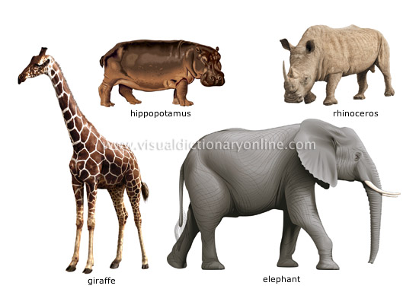
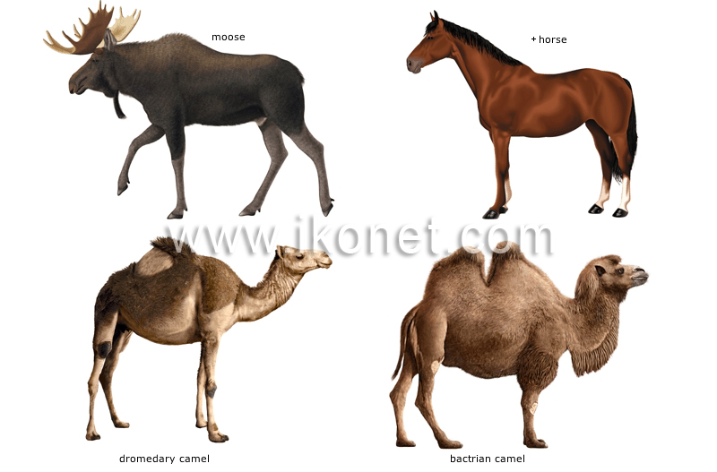
MAMMALS

Slide 4
MAMMALS: giraffe[dʒɪˈrɑ:f] hippopotamus[ˌhɪpəˈpɔtəməs], rhinoceros[raɪˈnɔsərəs], elephant[ˈelɪfənt].

Slide 5
MAMMALS: moose[mu:s], horse[hɔ:s], camel[ˈkæməl].

Slide 6
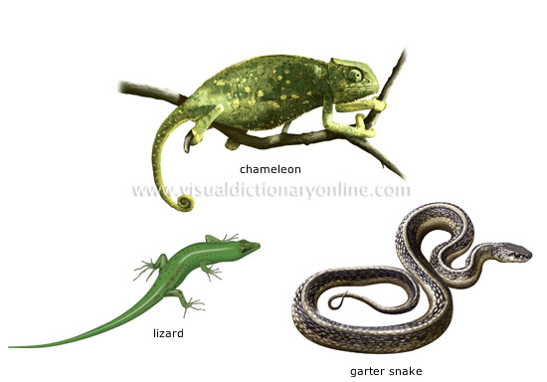
REPTILES

Slide 7
REPTILES: Chameleon[kəˈmi:ljən], lizard [ˈlɪzəd], snake[sneɪk].

Slide 8
REPTILES: Crocodile[ˈkrɔkədaɪl], caiman [ˈkeɪmən] ,alligator[ˈælɪɡeɪtə].

Slide 9
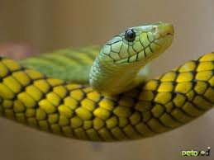
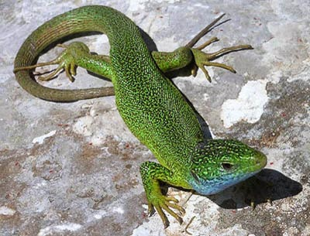
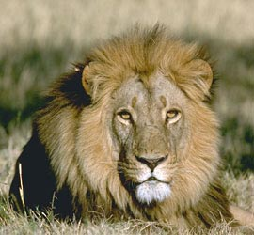
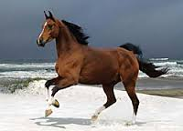
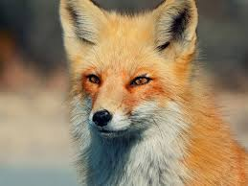
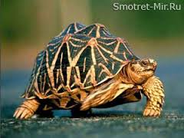
Call the names of reptiles. Call the names of mammals.

Slide 10
Reptiles or mammals?
mammals
reptiles
lion
horse
fox
snake
lizard
tortoise

Slide 11
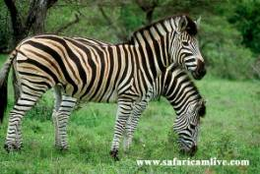
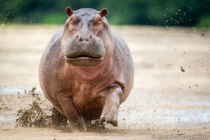
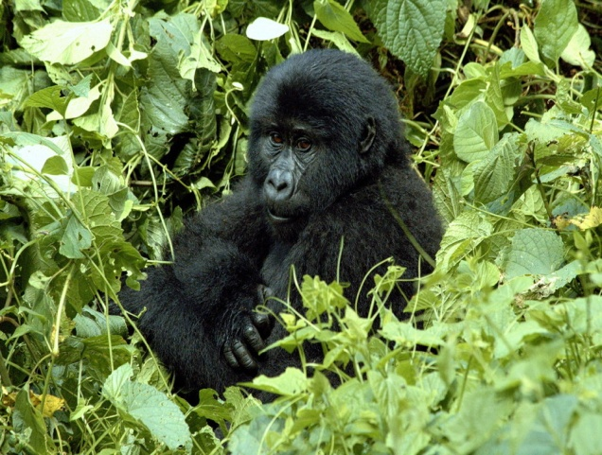
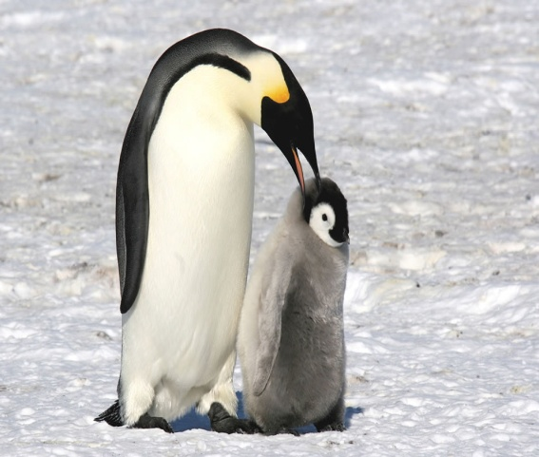
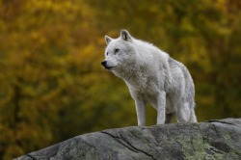
Call the names of reptiles. Call the names of mammals.

Slide 12
Reptiles or mammals?
mammals
reptiles
mouse
zebra
hippo
penguin
monkey
wolf

Slide 13
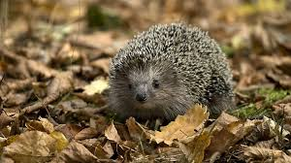
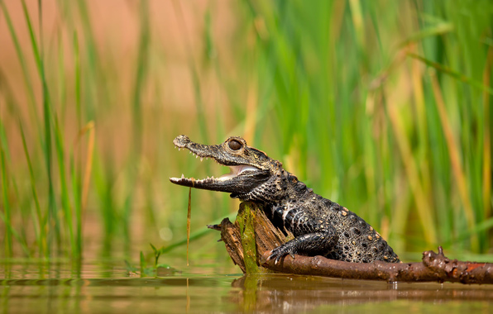
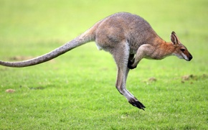
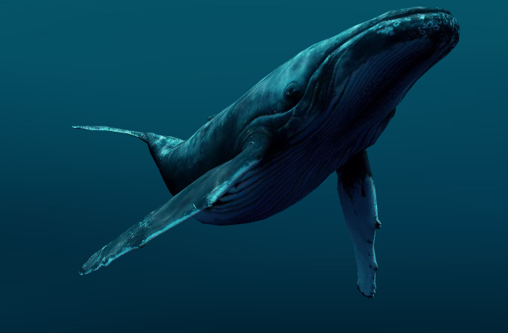
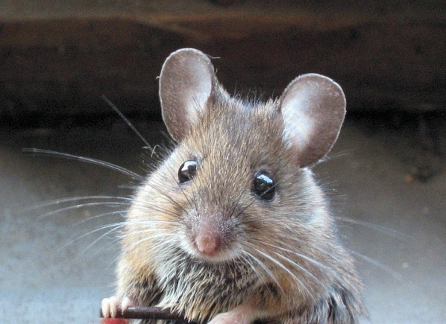
Call the names of reptiles. Call the names of mammals.

Slide 14
Reptiles or mammals?
mammals
reptiles
dear
hedgihog
kengooru
whale
mouse
crocodile

Slide 15
Sing and do. The Can Can song!
Can, can you dance
Like I can?
Can you sing like I can?
Can you run
And can you jump
Like me?
Can, can you work
Like I can?
Can you talk like I can?
Can you swim
And can you climb
Like me?

Slide 16
What can or can`t they do?
СAN / CAN`T
CAN`T/ CAN`T
CRAWL
JUMP
fLY
CLIMB
RUN
RUN
WALK
JUMP
SWIM
FLY

Slide 17
Check your work
It can crawl.
It can climb.
It can`t run.
It can`t jump.
It can`t fly.

Slide 18
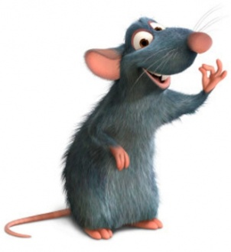
Check your work
It can run.
It can jump.
It can walk.
It can`t swim.
It can`t fly.

Slide 19
Read and fill the missing letter.
cr_c_dile
l_z_rd
t_rt_ise
sn_ke
m_use
h_rse
f_x
l_on
el_phant
d_lphin
g_r_ffe

Slide 20
Check your work
crocodile
lizard
tortoise
snake
mouse
horse
fox
lion
elephant
dolphin
giraffе

Slide 21
Crossword puzzle Find names of animals and cross out
e | c | f | o | x | b | v | c | p | f
l | r | t | g | k | l | i | o | n | a
e | o | r | i | l | i | z | a | r | d
p | c | m | j | i | d | p | d | i | p
h | o | o | f | h | h | c | f | c | a
a | d | u | j | s | n | a | k | e | d
n | i | s | v | a | c | b | h | b | h
t | l | e | v | h | o | r | s | e | p
d | e | h | d | o | l | p | h | i | n
b | j | t | o | r | t | o | i | s | e

Slide 22
Crossword puzzle Check your work
e | c | f | o | x | b | v | c | p | f
l | r | t | g | k | l | i | o | n | a
e | o | r | i | l | i | z | a | r | d
p | c | m | j | i | d | p | d | i | p
h | o | o | f | h | h | c | f | c | a
a | d | u | j | s | n | a | k | e | d
n | i | s | v | a | c | b | h | b | h
t | l | e | v | h | o | r | s | e | p
d | e | h | d | o | l | p | h | i | n
b | j | t | o | r | t | o | i | s | e

Slide 23
Rate yourself
I know | Excellent “5” | Good “4” | Average “3” | Poor “2”
the names of mammals
the names of reptiles
what can / can`t they do

