Slide 1
Изучаем Past Simple
Выполнила:
учитель английского языка
Зайцева Жанна Андреевна

Slide 2
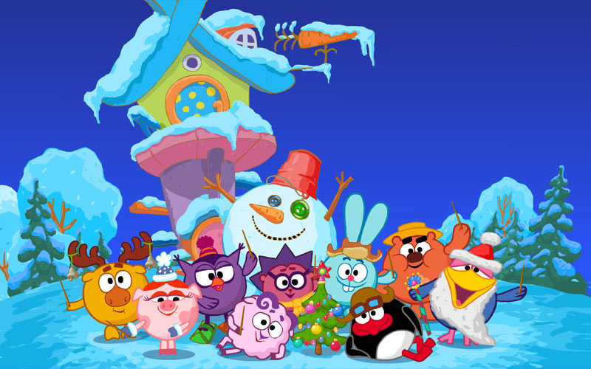

Slide 3
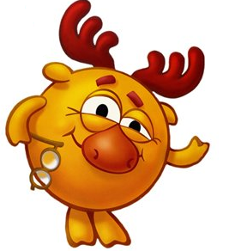
Good morning! My name is Losyash!
Hi! I’m Sovunia!
Hello! I am Ezhic!

Slide 4
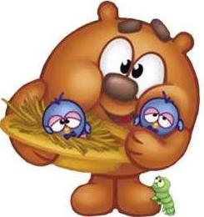
Read the story, please.
Last summer (прошлым летом) Kopatych and Nusha went (go) to the forest. The day was (be) fine. It was (be) very hot and sunny. Kopatych and Nusha walked (walk) in the forest and then they sat (sit) down under а big tree. They talked (talk) and talked. Suddenly they saw (see) a small bird. The bird had fallen (yпaлa) from the tree. Kopatych took (take) (брать, взять) the bird in his hands and they went (go) home. They put (put) the bird into the box. They liked (like) the bird very much. They gave (give) the bird bread, apples, corn and water. The bird lived (live) in their house for two weeks. Then Kopatych and Nusha took (take) the bird back to the forest. The bird was (be) very happy.

Slide 5
ПРАВИЛЬНЫЕ ГЛАГОЛЫ (REGULAR VERBS)
НЕПРАВИЛЬНЫЕ ГЛАГОЛЫ (IRREGULAR VERBS)
«ПОСЛУШНЫЕ»-подчиняются одному общему правилу:
V [ed]
«НЕПОСЛУШНЫЕ»-
у каждого глагола свои правила поведения в прошедшем времени
V2
Неправильные глаголы «живут» в таблице и их нужно УЧИТЬ!

Slide 6
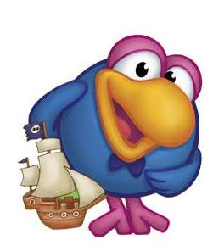
Вопросительное предложение
Did
V
?
?
did
V
?

Slide 7
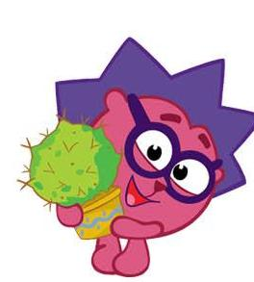
!
V2
Who
?

Slide 8
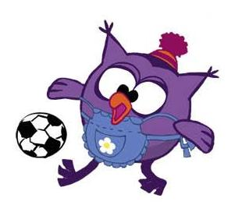
Oh! I’ m tired!
Okay!
Let’s do some exercises!

Slide 9
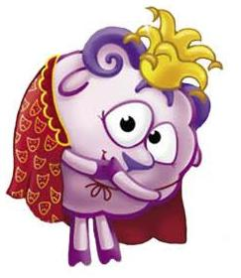
Can you hop like a rabbit?
Can you fly like a butterfly?
Can you swim like a duck?
Can you run like a dog?

Slide 10
I have a task for you!
Find the 2nd form of the verb.

Slide 11
Say
said
Watch
watched
Play
played
Sit
sat
Have
had
Put
put
Come
came
be
was/were

Slide 12
went, I, to the garden, yesterday.
I went to the garden yesterday.
2. his eyes, opened, he.
He opened his eyes.
3. we, tennis, played, last week.
We played tennis last week.
4. saw, I, a wonderful dream.
I saw a wonderful dream.
5. they, in a big house, lived.
They lived in a big house.

Slide 13
I watched TV yesterday. (Yes/No)
Did you watch TV yesterday?
He wrote a letter. (What)
What did he write?
We went to the country. (Where)
Where did you go?
His mother collected the stamps. (Who)
Who collected the stamps?

Slide 14
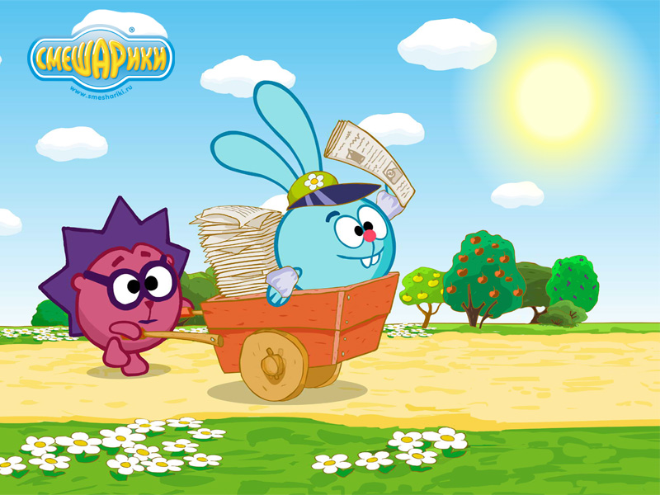
Invitation letter

Slide 15
Good Luck!

