Slide 1
Подготовка к ЕГЭ
Устная часть
задания 3,4
Учитель английского языка
ГОУ СОШ № 180 г.Санкт-Петербург
Белоброва Е.Д.

Slide 2
Task 3. Imagine that while travelling during your holidays you took some
photos. Choose one photo to present to your friend.
You will have to start speaking in 1.5 minutes and will speak for not more than 2 minutes. In your talk remember to speak about:
• •when you took the photo
• •what/who is in the photo
• •what is happening
• •why you took the photo
• •why you decided to show the picture to your friend
You have to talk continuously, starting with:
I’ve chosen photo number … .

Slide 3
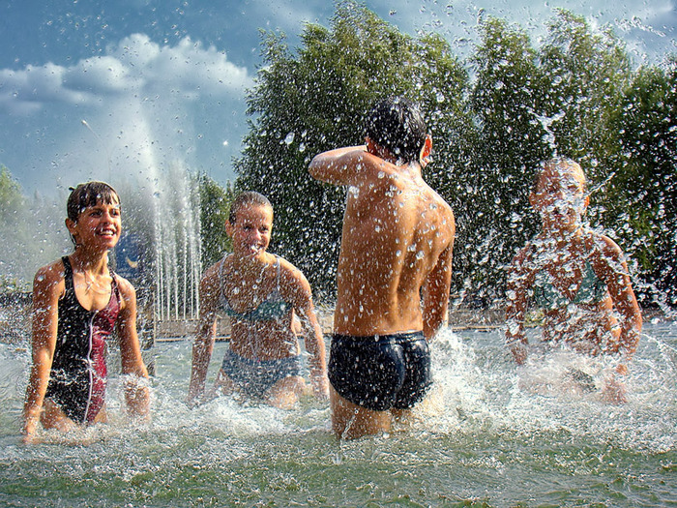
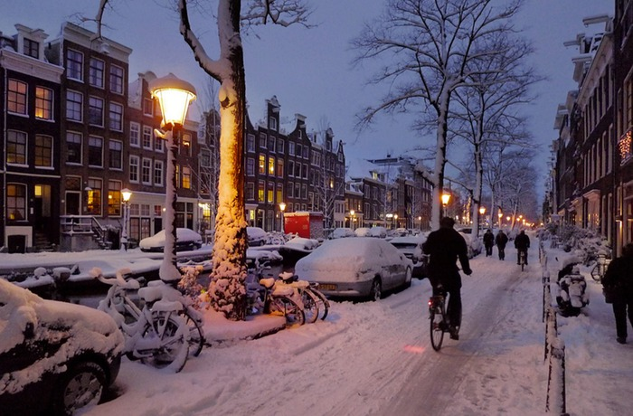
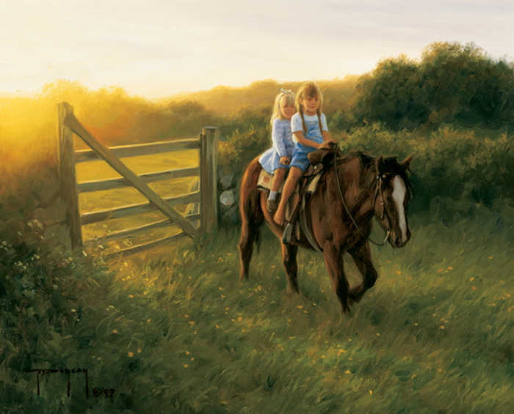

Slide 4
Photo description
I have chosen photo number three.
I took this photo when I was on holiday last summer (at home one evening some
years ago,/while I was walking round a town that I was visiting on holyday,/ while my
family and I were visiting Greece last summer).
It shows …
I took this photo because I had a great time at the event and I wanted something to
remember it by (to remind myself that there are people who… , it was the first time
I had ever seen… , I thought it was a really great experience).
I am showing it to you because I want you to see( what the event (it) was like, where
I spent my holiday, I wanted to show you how interesting …. can be, I thought it was
quite impressive).
It’s one of the best photos I took while I was on holiday.
Maybe we can go there together some time, if you are up for it,/ you like such kind
of activities too / I’d like to go back.

Slide 5
Bridle – уздечка, barefooted -босоногая

Slide 6
Twilight – сумерки, snow-drift – сугроб,

Slide 7
Splash each other - брызгаться

Slide 8
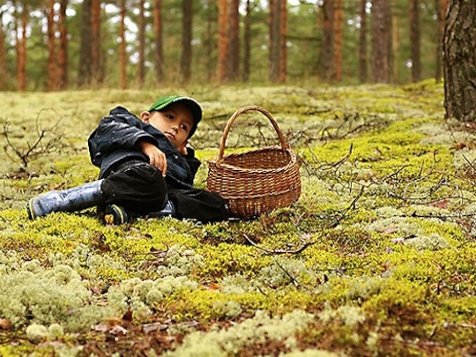
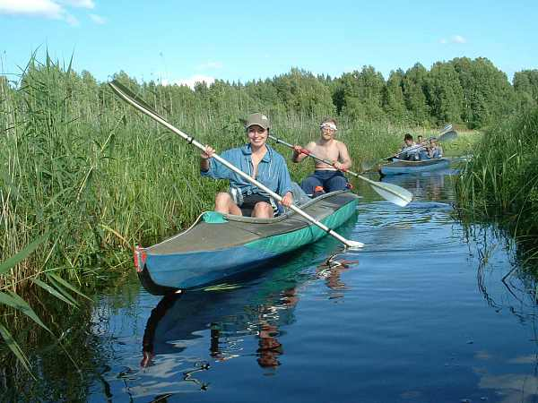
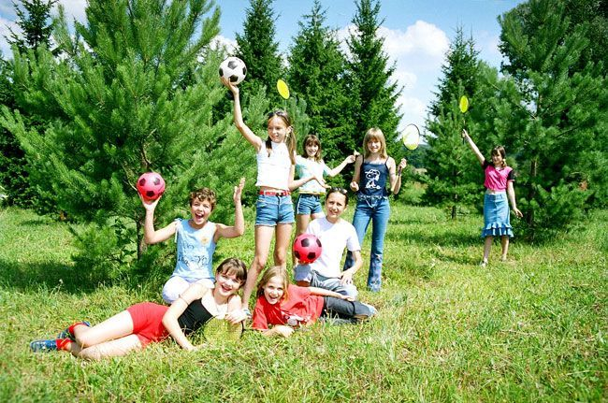

Slide 9
Pine-tree – сосна, moss - мох

Slide 10
Pine-tree – сосна, fir- tree - ель

Slide 11
Oar – весло,

Slide 12
Task 4. Study the two photographs. In 1.5 minutes be ready to compare and contrast the photographs:
• give a brief description of the photos (action, location)
• say what the pictures have in common
• say in what way the pictures are different
• say which of the pictures you’d prefer
• explain why
You will speak for not more than 2 minutes. You have to talk continuously.

Slide 13
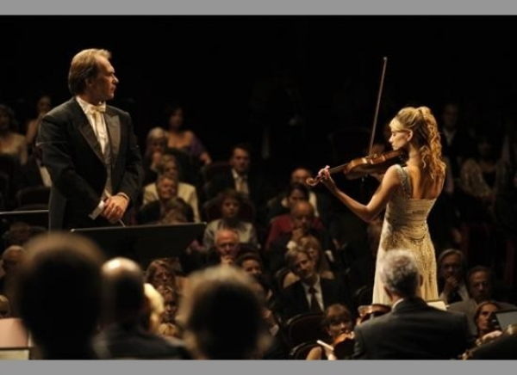
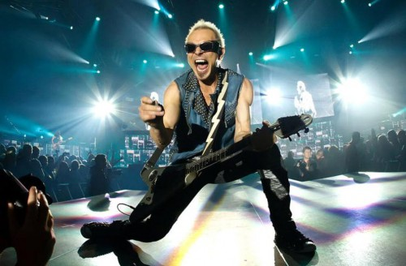
Conductor –дирижер, audience – публика

Slide 14
Compare the photos
These two photos (pictures) show …
In the first photo (in the photo on the left) we can see …(description of the photo).
In the second photo (in the right photo) we can see (there are )… (description of the photo).
The pictures are similar because they both show …
There are a couple of (several) differences between the photos. One is that the
person on the left is …. while the person on the right … . Also, …. Furthermore, …
I prefer the situation with the …because …/ I would prefer to deal with … because …

Slide 15
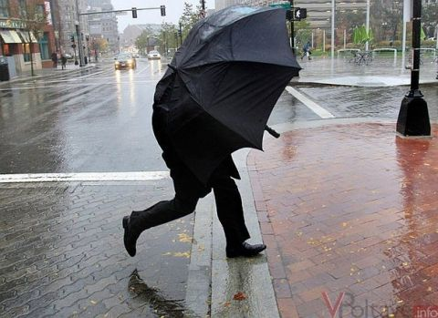
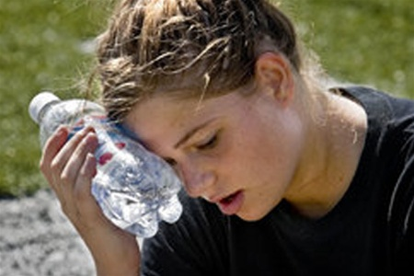
To cope with different types of weather
The man is struggling with the wind

Slide 16
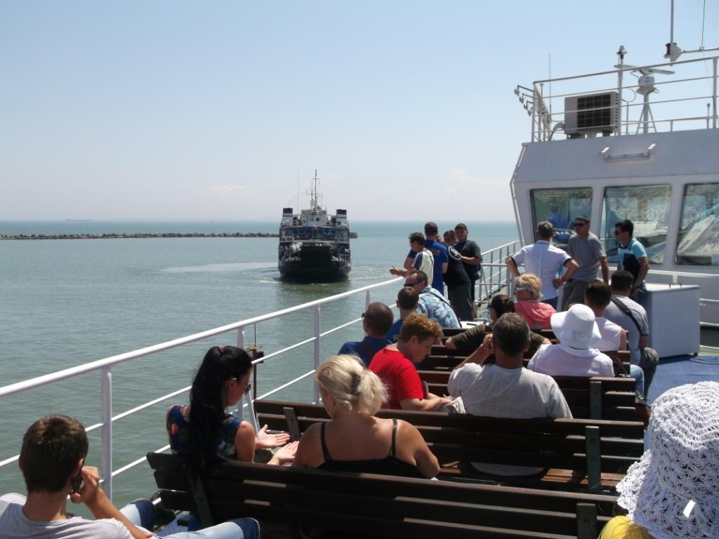

Slide 17
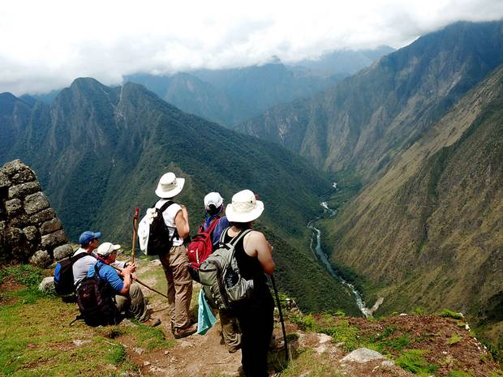
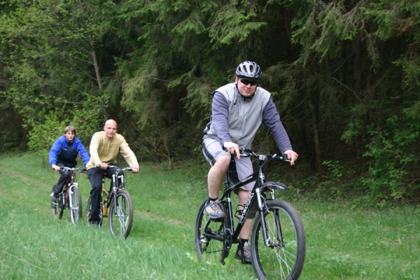

Slide 18
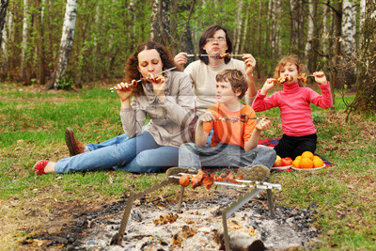
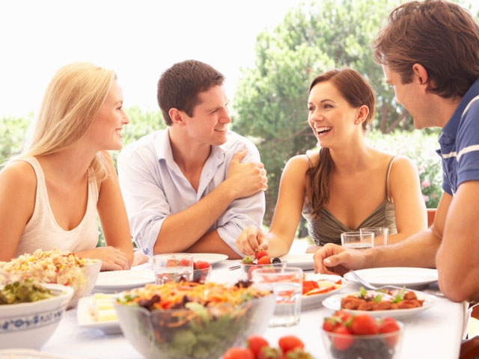
Enjoy the meal

