Slide 1
The Future Simple Tense
Affirmative Statements
I will go to Costa Rica next year.
Will future expresses a spontaneous decision, an assumption with regard to the future or an action in the future that cannot be influenced.
Negative Statements
She will not buy a new house.
Signal Words
in a year, next …, tomorrow
Vermutung: I think, probably, perhaps
Questions:
Where will you go next summer?

Slide 2
The Future Simple Tense
Action can take place:
Tomorrow
Next week
In 3 days
Next week
Next year
In 2017

Slide 3
The Future Simple Tense
shall
I
we
will
he, she, it
you, they
Subject + shall/will + verb.
Shall/will + subject + verb?
Subject + shall/will + not +verb.
Sam will wash his car tomorrow.
- Will you go with us?
- No, I shall not (shan’t). I shall help my mother.
Ann will not (won’t) do this work along.

Slide 4
The Future Simple Tense
Write positive sentences in Future.
. We (help) _____________ you.
. I (get) ______________ you a drink-
. I think our team (win) __________ the match.
. Maybe, she (do) ____________ yoga.
. I (buy) _________ the tickets.
. Perhaps, she (run) __________ next year.
. Maybe we (stay) ___________ at home
. She hopes that he (cook) ________ pizza.
. I’m sure they (understand) ____________ you.
0. They (go/probably) _____________ to San José.

Slide 5
The Future Simple Tense
Write negatgive sentences in Future.
1. (I / answer / the question)
__________________________________
2. (she / read / the book)
__________________________________
3,. (they / drink / beer)
__________________________________
4. (we / send / the postcard)
__________________________________
5. (Vanessa / catch / the ball)
__________________________________

Slide 6
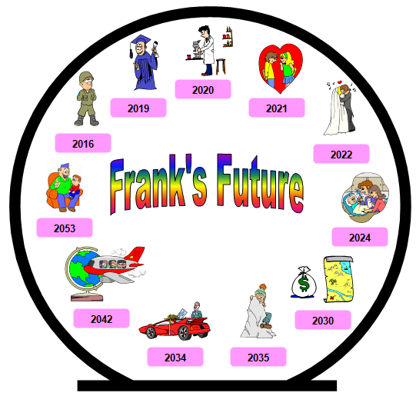
Look at the pictures and use the words on the right to write about Frank’s future
Example:
He will join the army in 2016
buy a new car
fall in love
climb Mount Everest
join the army
become a father
graduate from university
start working as a doctor
get married
become a grandfather
find a treasure map and become rich
travel around the world

Slide 7
The Future Simple Tense
Write about your future life:
1.
2.
3.

