Slide 1
Uzlovaya – my native Town
Made by Malygina Valeria, 8a form, Municipal Gymnasium

Slide 2
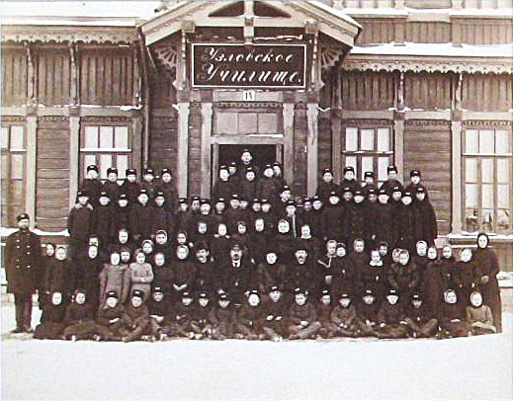
Historical Page
April 26, 1872, Emperor Alexander 2 approved the Charter Ryazhskaya-Vyazma railway. In the summer of 1873 began the construction of the station Khrushchevka. In December 1874 the railroad was built, then - the depot for 12 locomotives, several residential homes, schools and hospitals. Railroad defined way of life and the fate of the inhabitants of the village, which grew due to the inflow from the surrounding villages of hungry people.
So my native town has appeared on the map in 1873. Since that time our town has always been a very important railway station.
The first railway workers

Slide 3
Герб и флаг Муниципального образования «Город узловая и узловского района
«Дорогами доброты по полям надежды колесо приводит к богатству и достатку».

Slide 4
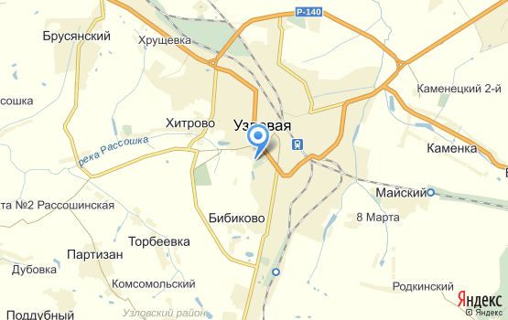
Uzlovaya on the map

Slide 5
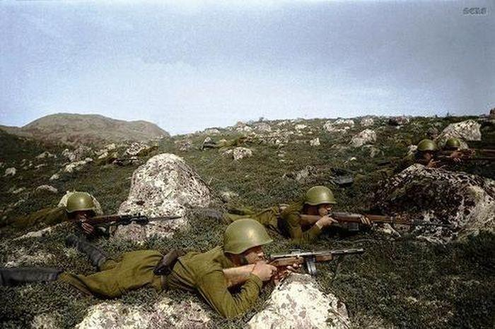
Uzlovaya in war years
Uzlovaya has always been a very important railway point. This strategic point was on the German maps. That’s why during the Great Patriotic War Uzlovaya became the scene of cruel fighting.

Slide 6
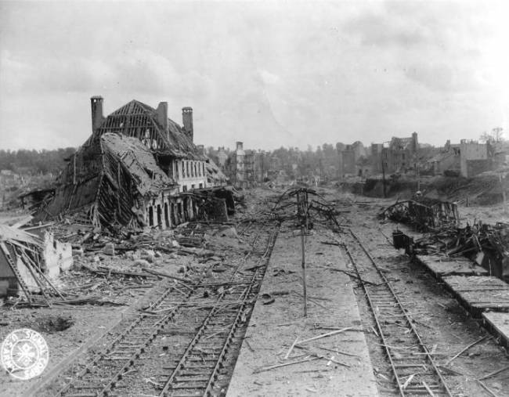
For 21 days fascists occupied my town.

Slide 7
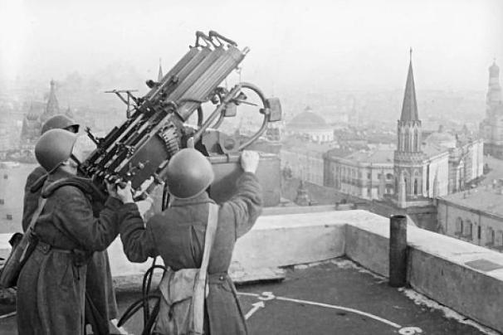
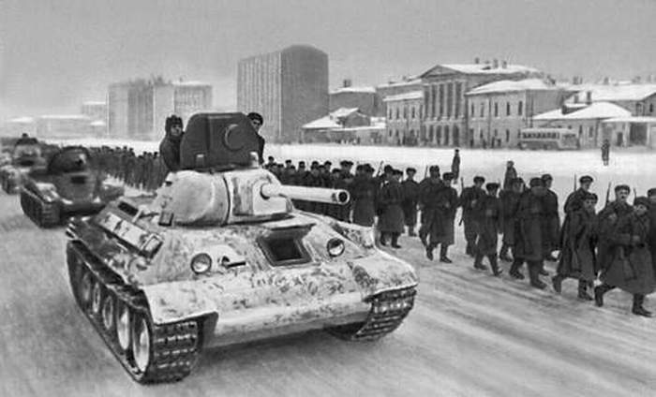
But Uzlovaya and Tula stood on the road of enemy to Moscow. Many inhabitants went to the front and gave their lives for our Motherland. The young and old rose to the clefence of our capital. The fascists’ army could not take Moscow. The fascists were defeated. The victory was won at a high price.

Slide 8
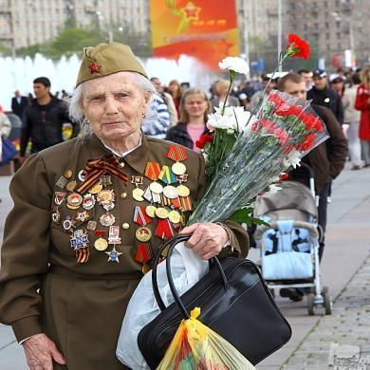
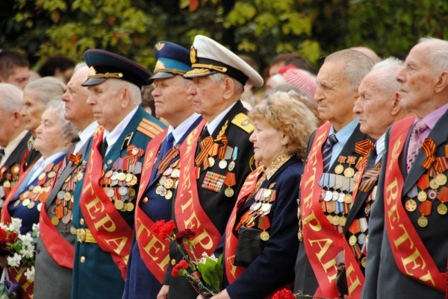
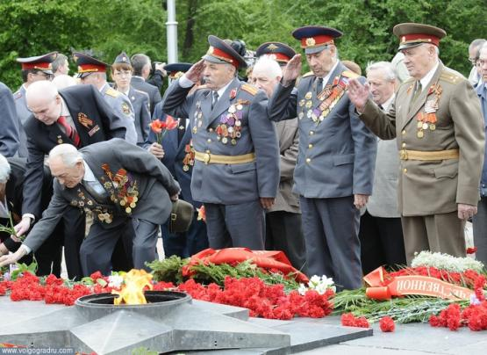
Nowadays on the 9th of May people from all town parts come to Always Fire to honour the memory of heroes who defended their Motherland.

Slide 9
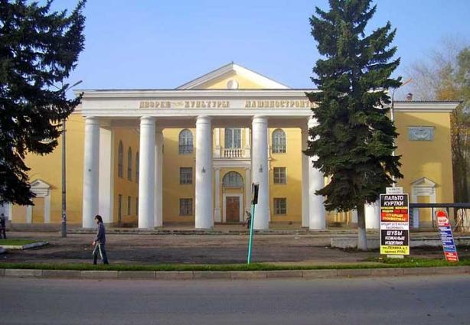
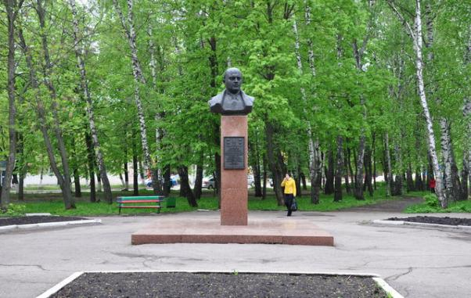
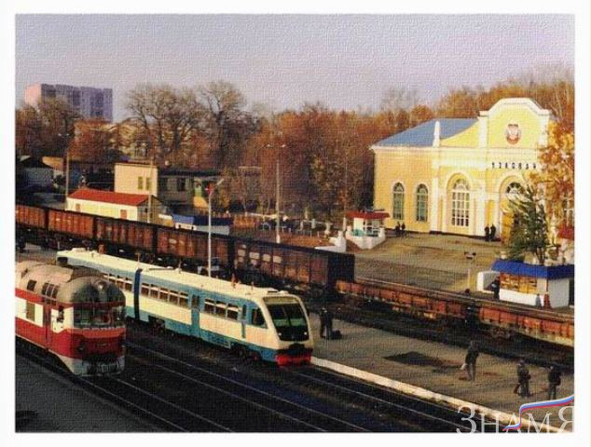
Since the war Uzlovaya has risen from ruins and is finer than ever

Slide 10
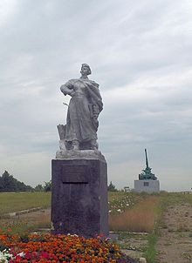
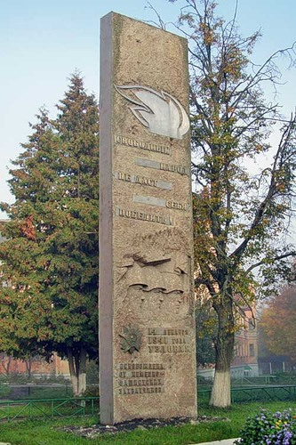
There are a lot of historical places in our town, connected with the Great Patriotic War
Улица имени 14 декабря
Памятник зенитчицам-защитникам Узловой

Slide 11
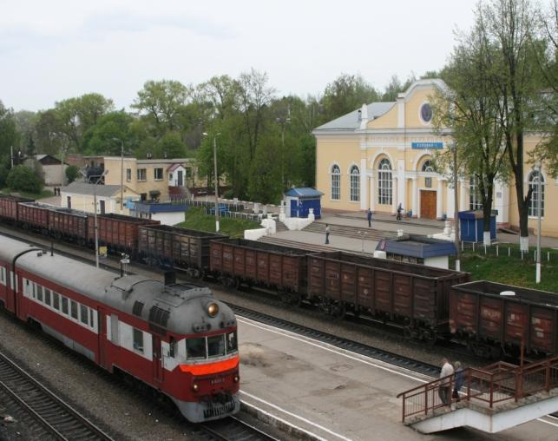
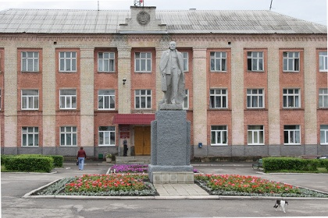
I am proud of my native town
Есть края красивее, я знаю, Но душой нисколько не кривя, Я на них тебя не променяю, Узловая – родина моя. Пусть твое название не звучно - Мне на это незачем пенять, - Сердцу моему оно сузвучно, Как созвучно сыну слово мать. Для меня роднее нету края: Здесь моя любовь, работа, дом. Жизнь моя с тобою, Узловая, Неразрывным связана узлом!
Владимир Сапронов

