Slide 1
The United Kingdom
The United Kingdom of Great Britain and Northern Ireland

Slide 2
The state is located in the British Isles

Slide 3
England

Slide 4
England - the place of origin of the English language and the Church of England

Slide 5
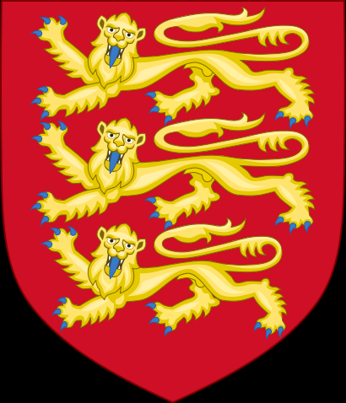
look at arms and flag of England

Slide 6
London-capital of the UK

Slide 7
Wales

Slide 8
Wales-one of the four main parts of the United Kingdom of Great Britain and Northern Ireland

Slide 9
look at arms and flag of Wales

Slide 10
Capital of Wales is Cardiff

Slide 11
Northern Ireland

Slide 12
Northern Ireland-one of the four main parts of the United Kingdom of Great Britain and Northern Ireland

Slide 13
look at arms and flag of Northern Ireland

Slide 14
Belfast-Capital of Northern Ireland

Slide 15
Scotland

Slide 16
Scotland a country that is part of the United Kingdom of Great Britain and Northern Ireland

Slide 17
look at arms and flag of Scotland

Slide 18
thank you for viewing

