Slide 1
QUIZ
The United Kingdom of Great Britain and Northern Ireland,
The United States of America,
New Zealand,
Australia,
Canada.

Slide 2
Round 1 Great Britain.
Geography
Sights
Famous people
General information
100
100
100
100
200
200
200
200
300
300
300
300

Slide 3
Geography.
1. What great monument can we see on Salisbury Plain?
Answer

Slide 4
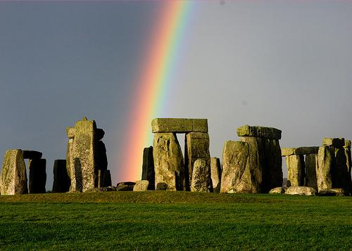
Right answer:
Stonehenge.

Slide 5
Geography.
2. What channel separates the British Isles from the European continent?
Answer

Slide 6
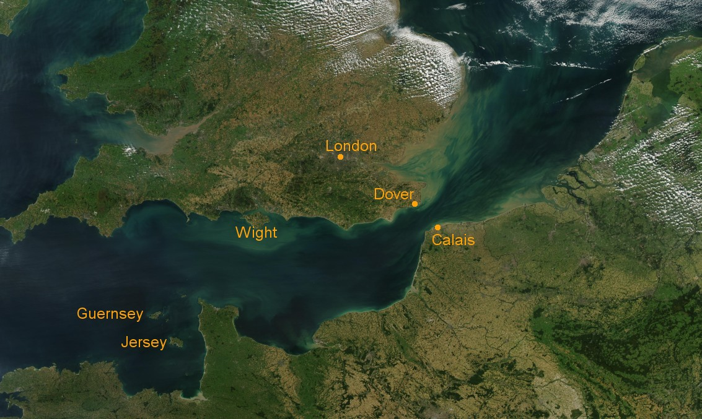
Right answer:
2. The English Channel.

Slide 7
Geography.
3. What is the longest river in Great Britain?
Answer

Slide 8
Right answer:
3.The Severn.

Slide 9
Sights.
What is Big Ben?
Answer

Slide 10
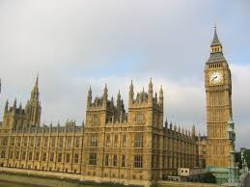
Right answer:
1.The biggest bell in the clock tower at the Houses of Parliament.

Slide 11
Sights.
2. The official residence of the Queen in London is…
Answer

Slide 12
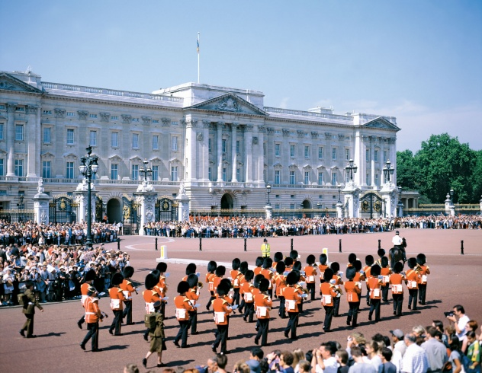
Right answer:
2. Buckingham Palace.

Slide 13
Sights.
3.What is the most famous tennis court in Great Britain?
Answer

Slide 14
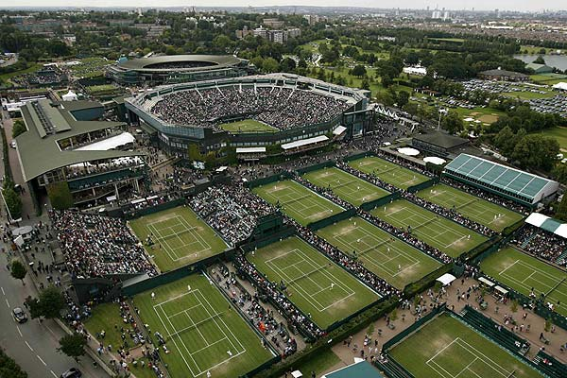
Right answer:
3. Wimbledon.

Slide 15
Famous People.
1.Who presided over the Knight`s Round Table?
Answer

Slide 16
Right answer:
1. King Arthur.

Slide 17
Famous People.
2. The most famous and successful pop-group in 1960s in Britain was …
Answer

Slide 18
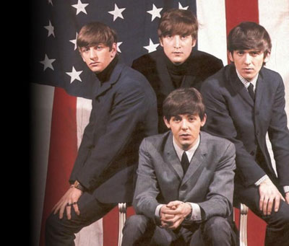
Right answer:
2. The Beatles.

Slide 19
Famous People.
3. The author of the Law of Universal gravitation.
Answer

Slide 20
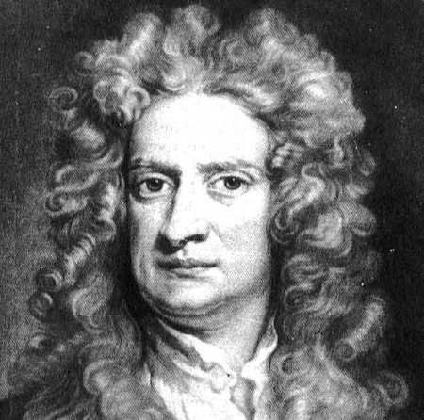
Right answer:
3. Isaak Newton.

Slide 21
General Information.
1. Name the parts of the United Kingdom of Great Britain and Northern Ireland.
Answer

Slide 22
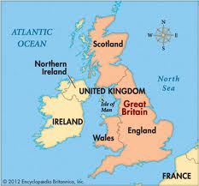
Right answer:
1. England. Scotland. Wales. Northern Ireland.

Slide 23
General Information.
2. What is the nickname of British Flag?
Answer

Slide 24
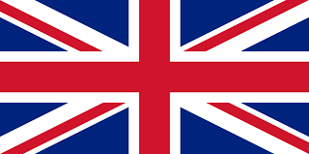
Right answer:
2. Union Jack.

Slide 25
General Information.
3. Where does the Prime Minister of Great Britain live ?
Answer

Slide 26
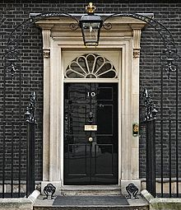
Right answer:
3. 10, Downing street.

Slide 27
Round 2 The United States of America.
Geography
Sights
Famous People
General Information
100
100
100
100
200
200
200
200
300
300
300
300

Slide 28
Geography
1.What river does New York stand on?
Answer

Slide 29
Right answer:
1. The Hudson.

Slide 30
Geography
What is the longest river in the United States ?
Answer

Slide 31
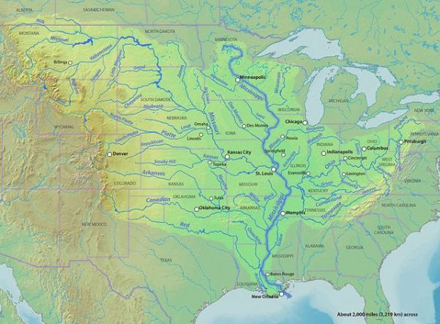
Right answer
2. The Mississippi ( with its tributary Missouri).

Slide 32
Geography.
3. Which two states are not connected to the other states?
Answer

Slide 33
Right answer
3. Alaska and Hawaii.

Slide 34
Sights
1. Whose gift the Statue of Liberty is?
Answer

Slide 35
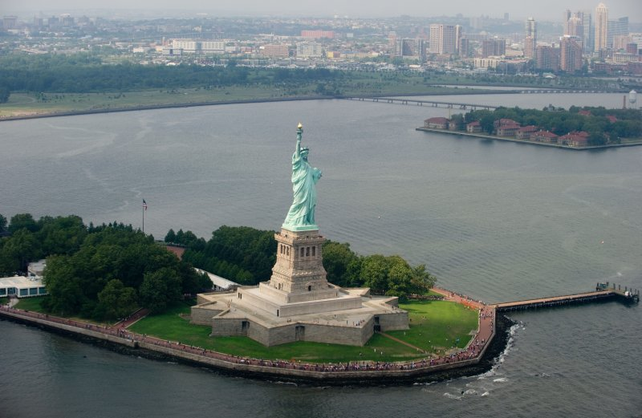
Right answer
1. France.

Slide 36
Sights.
2. The Home-town of Hollywood is…
Answer

Slide 37
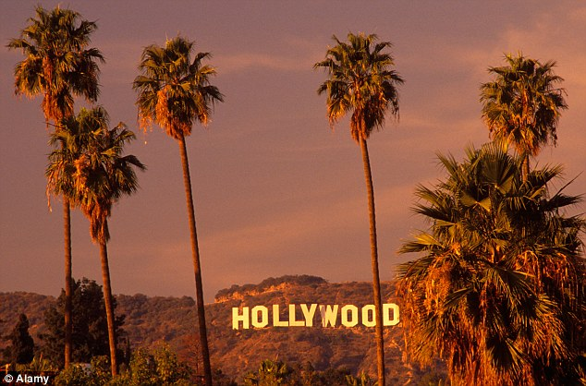
Right answer:
2. Los Angeles.

Slide 38
Sights.
3. The mount Rushmore National memorial is a sculpture of the heads of four presidents. Name them.
Answer

Slide 39
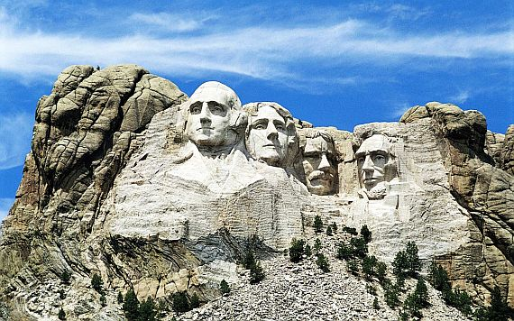
Right answer:
3. George Washington, Theodore Roosevelt, Abraham Lincoln, Thomas Jefferson.

Slide 40
Famous People
1. Who was the first president of the USA?
Answer

Slide 41
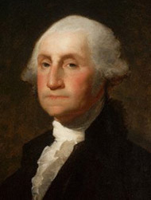
Right answer:
1. George Washington.

Slide 42
Famous People.
2. Who was the head of Apple corporation from 2001 to 2011 ?
Answer

Slide 43
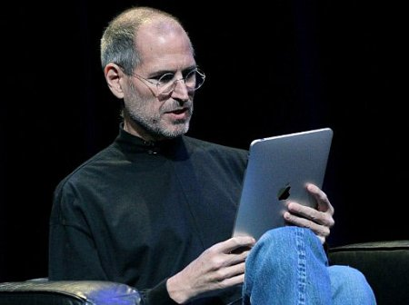
Right answer.
2. Steve Jobs.

Slide 44
Famous People.
3. Who is called “The King of Rock and Roll?”
Answer

Slide 45
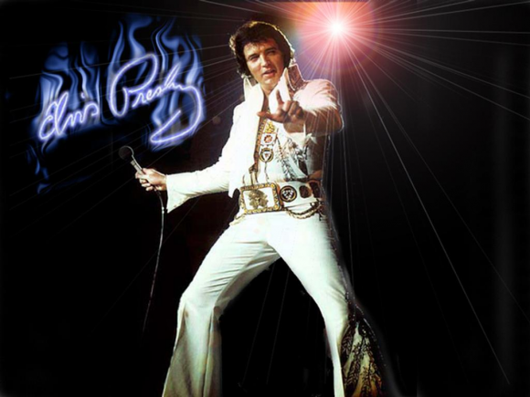
Right answer:
3. Elvis Presley.

Slide 46
General Information.
1. What is the nickname of American flag?
Answer

Slide 47
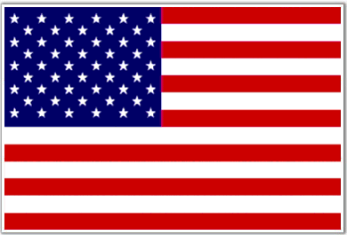
Right answer:
1. Stars and Stripes.

Slide 48
General Information.
2. What is the largest state of the USA?
Answer

Slide 49
Right answer:
2. Alaska.

Slide 50
General Information.
3. Until 1800 New York was called…
Answer

Slide 51
Right answer.
3. New Amsterdam.

Slide 52
Round 3 Canada, Australia, New Zealand.
Canada
Australia
New Zealand
100
100
100
200
200
200
300
300
300

Slide 53
Canada.
1. What is the capital of Canada?
Answer

Slide 54
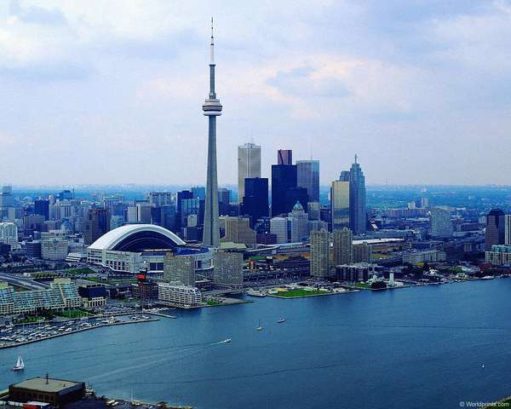
Right answer.
1.Ottawa.

Slide 55
Canada.
2. Which tree is a symbol of Canada ?
Answer

Slide 56
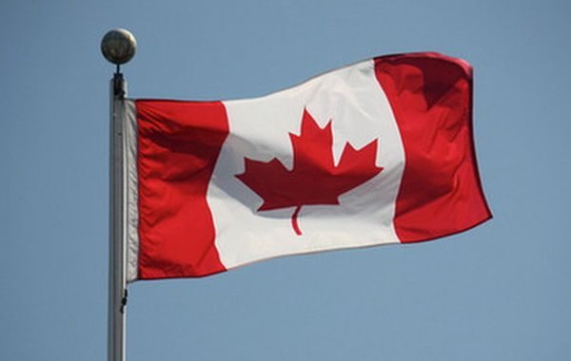
Right answer:
2. Maple.

Slide 57
Canada.
3. Who is the official head of Canada?
Answer

Slide 58
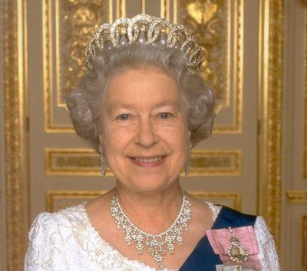
Right answer:
3. Queen Elizabeth II.

Slide 59
Australia.
1.What is the capital of Australia?
Answer

Slide 60
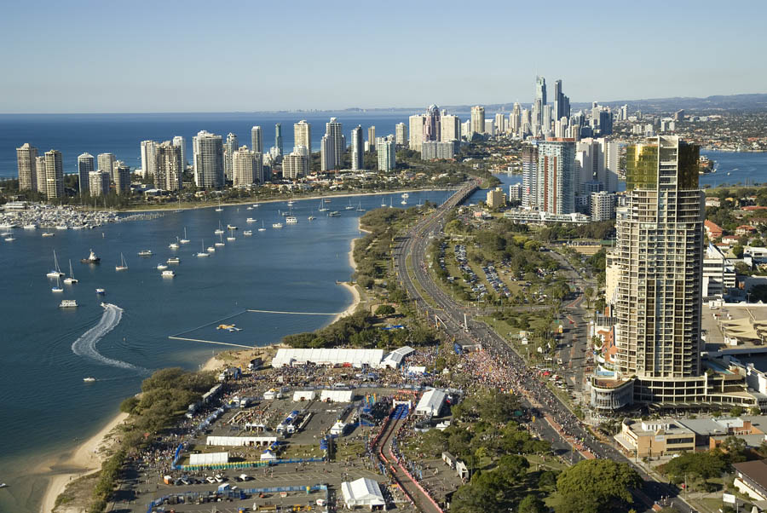
Right answer:
1. Canberra.

Slide 61
Australia.
2. Which is the largest city by population in Australia ?
Answer

Slide 62
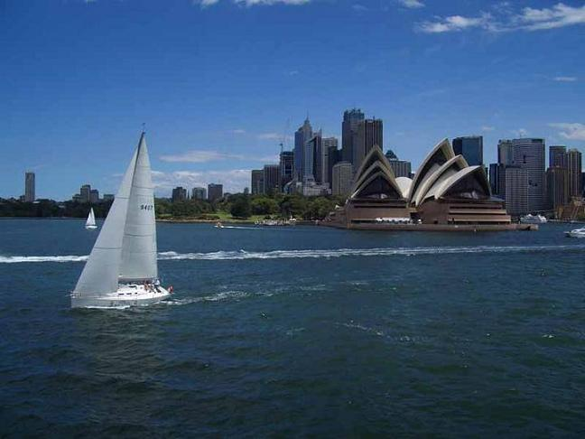
Right answer:
2. Sydney.

Slide 63
Australia.
3. One of the Australia’s 6 states is separated from the others? Which one?
Answer

Slide 64
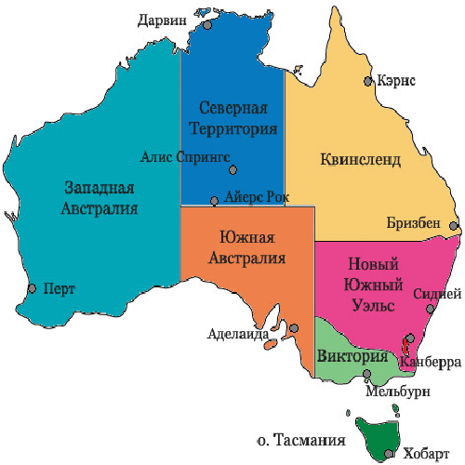
Right answer:
3. Tasmania.

Slide 65
New Zealand.
1. What is the capital of New Zealand?
Answer

Slide 66
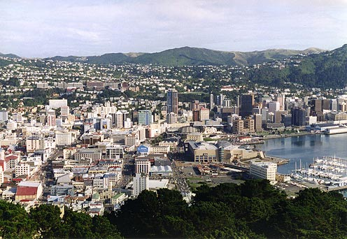
Right answer:
1.Wellington.

Slide 67
New Zealand.
2.Which bird symbolizes New Zealand?
Answer

Slide 68
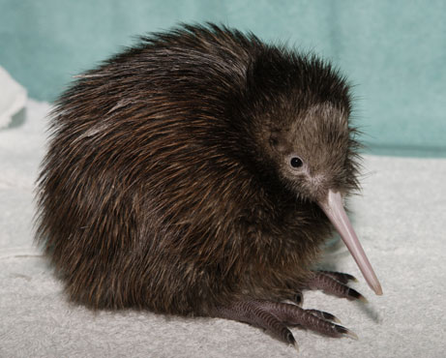
Right answer:
Kiwi bird.

Slide 69
New Zealand.
3. How the native people of New Zealand is called?
Answer

Slide 70
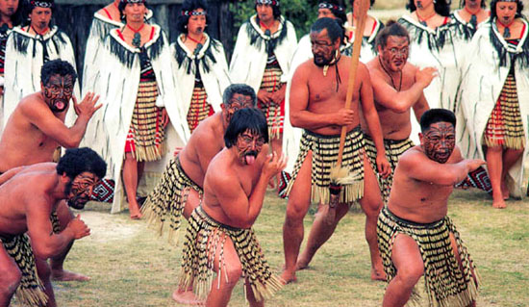
Right answer:
3. The Maoris.

