Slide 1

CHOOSING A CAREER

Slide 2
Groups of jobs: add one more…
outdoor (gardener…)
creative (actress…)
social (teacher…).
clerical (secretary…),
scientific (chemist…),
practical (nurse…).

Slide 3
ANSWER THE FOLLOWING QUESTIONS:
- Do you like meeting and dealing with people?
-Do you like to work inside?
- Do you enjoy thinking about problems?
- Do you enjoy working with your hands?
- Do you enjoy being creative?

Slide 4
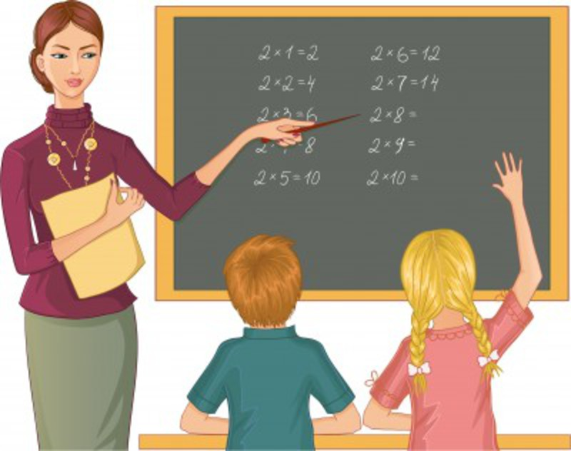
QUALITIES OF A TECHER:
A good teacher should be ….
tolerant
outgoing
self-assured
broad-minded
creative
well-educated
well-informed
organized

Slide 5
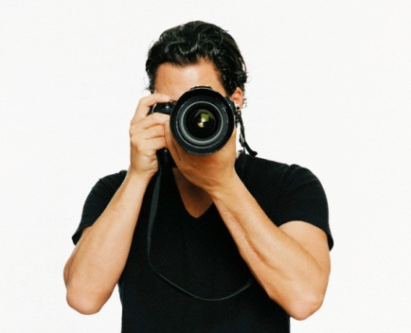
A good photographer should be…
sociable
creative
adventures
intelligent
well-informed

Slide 6

A good doctor should be…

Slide 7
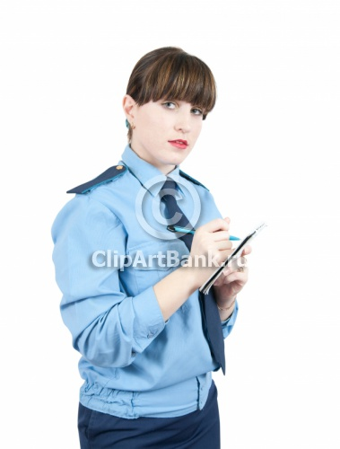
A good policeman should be…

Slide 8
THANK YOU…
Be careful choosing a career…

