Slide 1
3 класс
Изучение новой лексики по теме «Где ты живешь?»

Slide 2
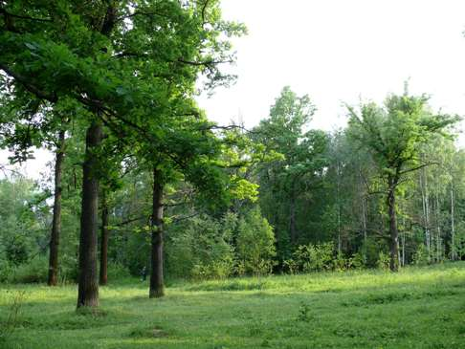
Forest
Do you live in the forest?
Who lives in the forest?

Slide 3
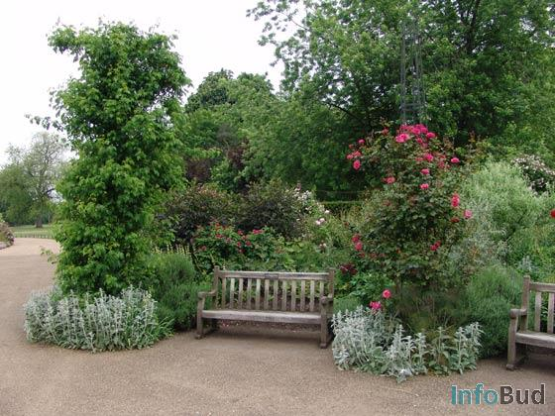
Garden
Do you live in the garden?
Who lives in the garden?

Slide 4
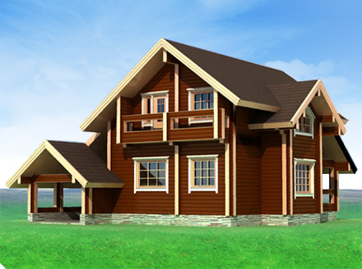
House
Do you live in the house?
Who lives in the house?

Slide 5
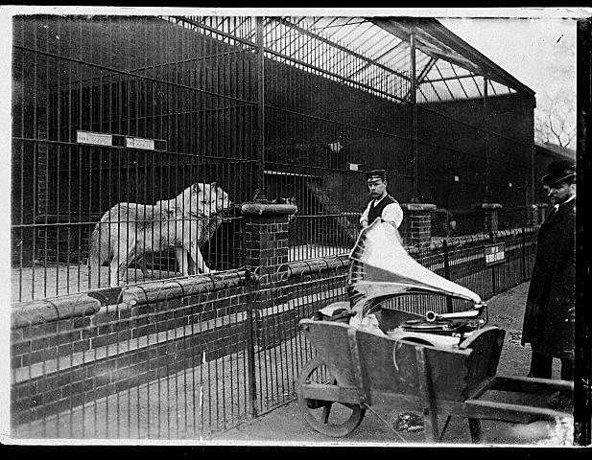
Zoo
Do you live in the zoo?
Who lives in the zoo?

Slide 6
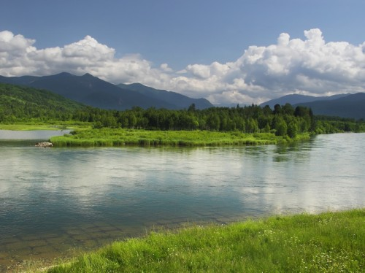
River
Do you live in the river?
Who lives in the river?

Slide 7



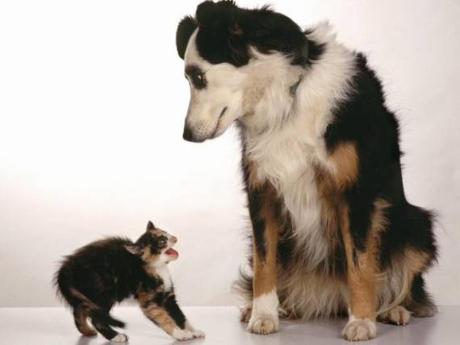
A dog lives in a house
A cat lives in a house
A mouse lives in a house

Slide 8


A crocodile lives in a river
A fish lives in a river

Slide 9


A tiger lives in a forest
A fox lives in a forest

Slide 10


A lion lives in the zoo
An elephant lives in the zoo

Slide 11
Learn these words!
Be clever things!

