Slide 1
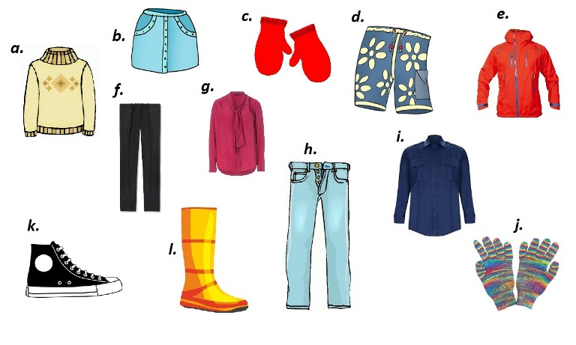
CLOTHES

Slide 2
Fill in the missing words.
1. This skirt ... beautiful.
2. His new shoes ... very nice.
3. My old jacket ... black.
4. I ... wearing my new hat.
5. Her jeans ... blue.

Slide 3
1. This skirt is beautiful.
2. His new shoes are very nice.
3. My old jacket is black.
4. I am wearing my new hat.
5. Her jeans are blue.

Slide 4
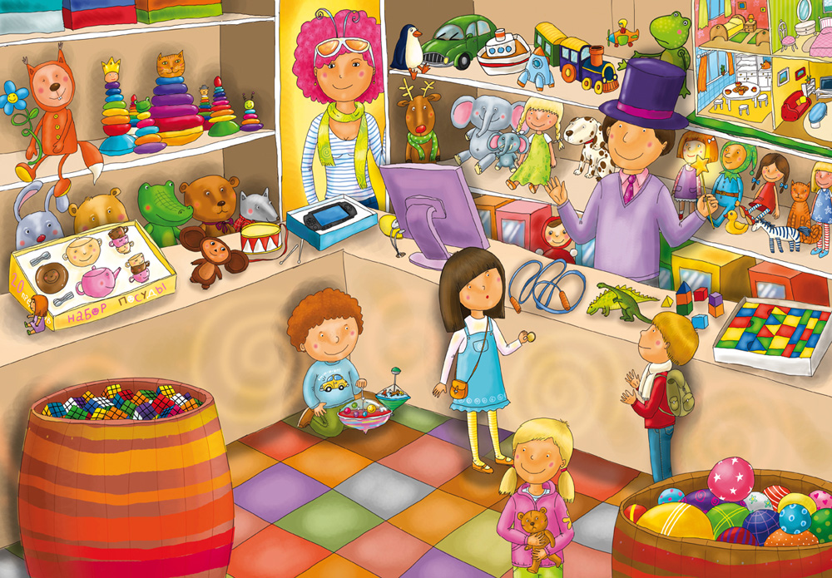
AT THE SHOP

Slide 5
Ask questions for more information. Begin them with the words given in brackets.
1. My mother will wear her pink blouse. (When)
2. The boys went to the Zoo. (Where)
3. My friend lives in Omsk. (Who)
4. Tom will buy a new jacket. (What)

Slide 6
Ask questions for more information. Begin them with the words given in brackets.
1. When will my mother wear her pink blouse?
2. Where did the boys go?
3. Who lives in Omsk?
4. What will Tom buy?

Slide 7
What are you going to do?

Slide 9
Make up sentences.
1. Mike, does, football, play?
2. Not, swim, friend, my, can.
3. Funny, is, his, cat, why?
4. Play, do, you, hockey?
5. Billy, to, wear, doesn’t, like, jeans.

Slide 10
Make up sentences.
1. Does Mike play football?
2. My friend can not swim.
3. Why is his cat funny?
4. Do you play hockey?
5. Billy doesn’t like to wear jeans.

Slide 11
T a s t e s d i f f e r

Slide 12
