Slide 1
That Wonderful Mark Twain
Form 9b Mikhail Shirokov
v. Tomskoe

Slide 2
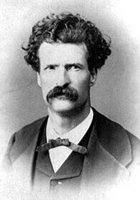
Mark Twain

Slide 3
«…Вся американская
литература вышла
из одной книги
Марка Твена,
которая называется
«Гекльберри Финн»…
Ничего равного ей
не создано с тех пор».
Эрнест Хемингуэй

Slide 4
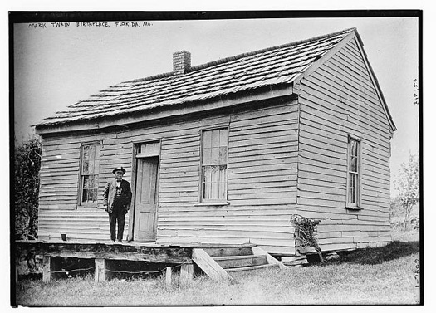
The House where He was Born

Slide 5
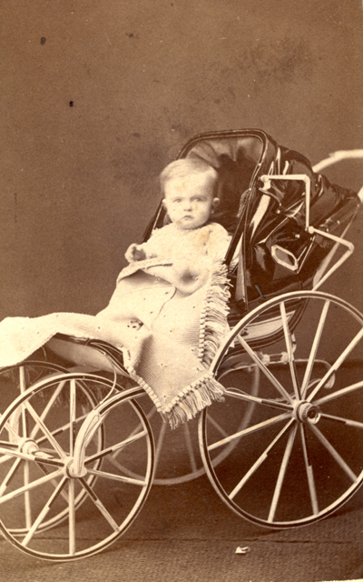
His Childhood

Slide 6
His uncle s farm

Slide 7
His work as printer’s apprentice in St. Louis, New York

Slide 8
….. Piloting a Riverboat on the Mississippi River.

Slide 9
Golden Rush in Nevada

Slide 10
His Work as a Reporter in San Francisco

Slide 11
His Favorite Family

Slide 12
His First Book

Slide 13
Books for Children

Slide 14
Books for Children

Slide 15
His Literature Characters

Slide 16
His Literature Characters

Slide 17
As a Lecturer

Slide 18
Receiving Honorary Degrees from Yale University

Slide 19
His Last Years….

Slide 20
His Grave in Hannibal

Slide 21
His Memorial House in Hannibal

Slide 22
Thank You!

