Slide 1
There is a board on the wall.
There are 3 posters on the wall.

Slide 2
The things
you can use
in the lesson

Slide 3
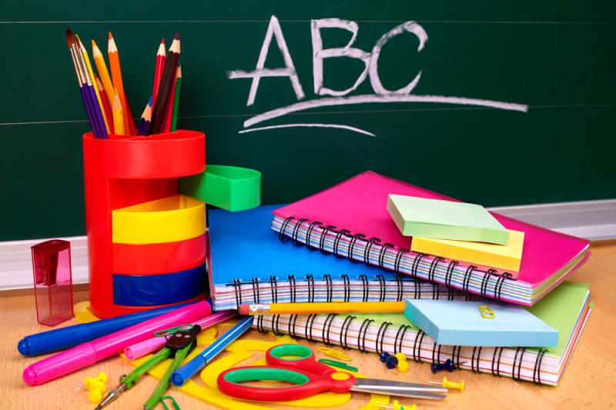

Slide 4
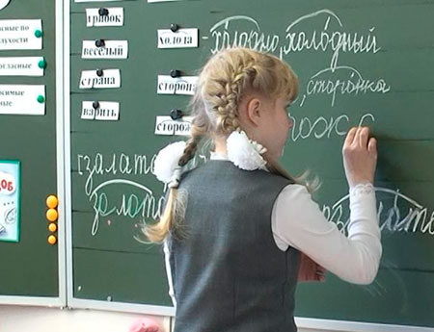
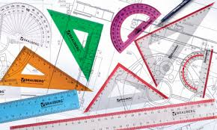
A bo_rd
A rul_r

Slide 5
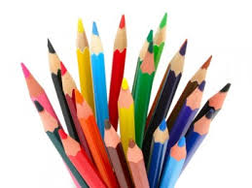
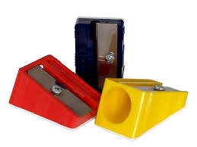
A penc_l
A
sh_ _pener

Slide 6
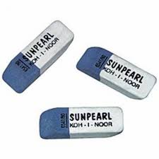
A dicti_nary
A
r_ _ber

Slide 7
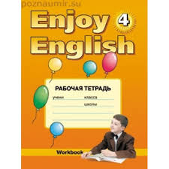
A wo_kbook
A te_tbook

Slide 8
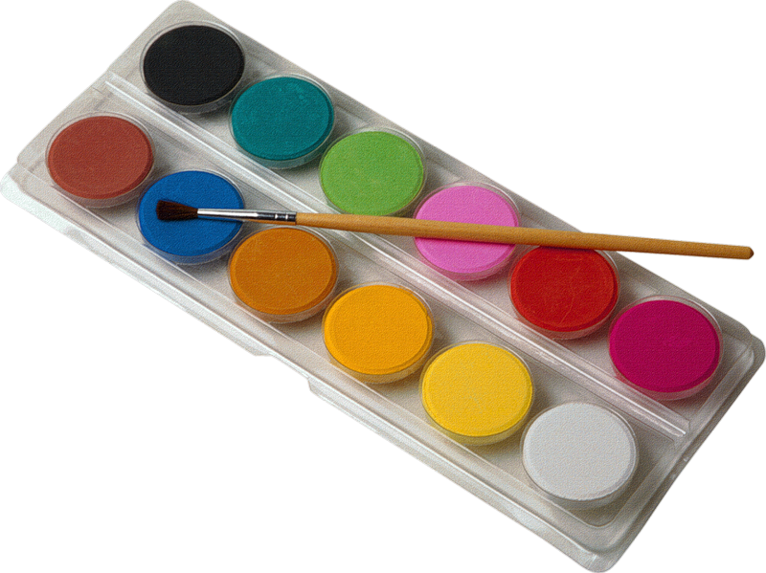
Pa_nts

Slide 9
THANK YOU FOR YOUR WORK!

