Slide 1
"ST. VALENTINE'S DAY"

Slide 2
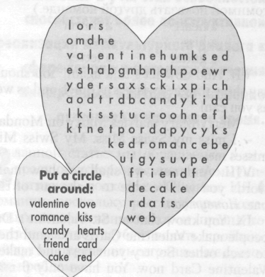
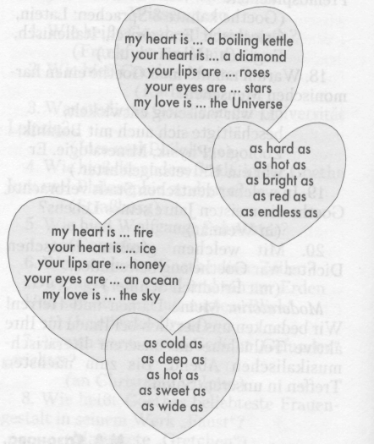
Put a circle around these words when you find them
Try to pantomime
these words to another
team so that they can name them

Slide 3
