Slide 1
We are going to travel

Slide 2
LISTEN A TONGUE TWISTER AND REPEAT
If two witches would watch two watches,
which witch would watch which watch?

Slide 3
LET’S PLAY A LITTLE! Угадайте слово.
MAKE SENTENCES UP TO A MODEL:
1) IS IT THE WORD “SOCIAL”?
No, it isn’t. – Yes, it is.

Slide 4
Make up sentences using tags.
It is an interesting programme, ….?
- He will stay with his family, …?
- There is not a local school in this street, …?
- She is responsible for the tickets, …?
- They always arrange a school party, …?
- He can't bring an invitation letter, …?

Slide 5
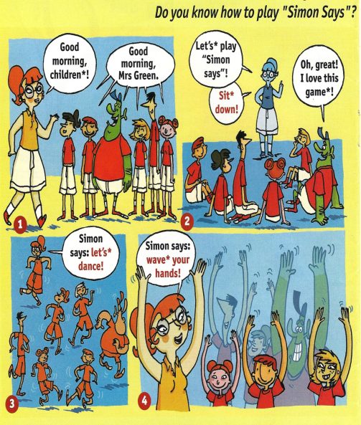
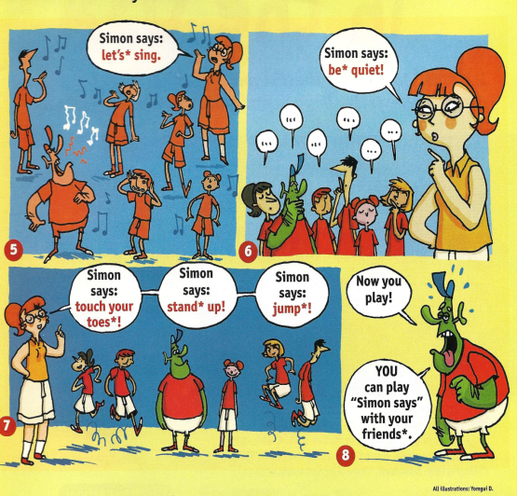

Slide 6
Конструкция to be going to..
I | am going | we | are going
You | are going | You | are going
He | is going | They | are going
She | is going | you | are going
it | is going

Slide 7
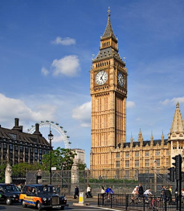
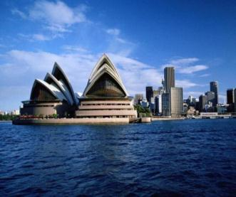
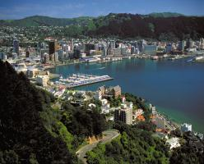
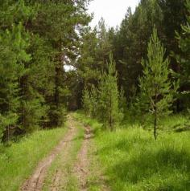
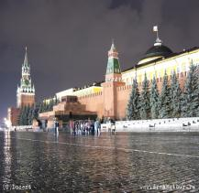
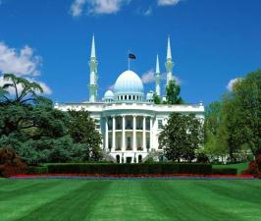
Where are you going to travel next holidays?
I am going to London next holidays

Slide 8
Do exercises 11 on page 29, 12 on page 30

Slide 9
HOMETASK
УПРАЖНЕНИЕ 7 НА СТР. 37 В УЧЕБНИКЕ
(УПРАЖНЕНИЕ 11 НА СТР.29 ПИСЬМЕННО В ТЕТРАДИ)

