Slide 1
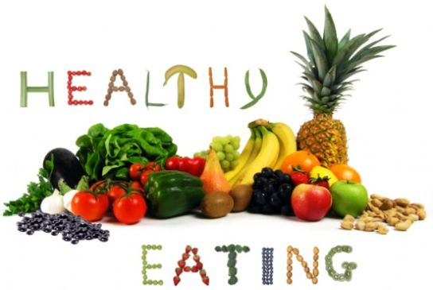
The healthy food.
Peredreeva Anastasia,
Peredreeva Anna
8 «A» class.

Slide 2
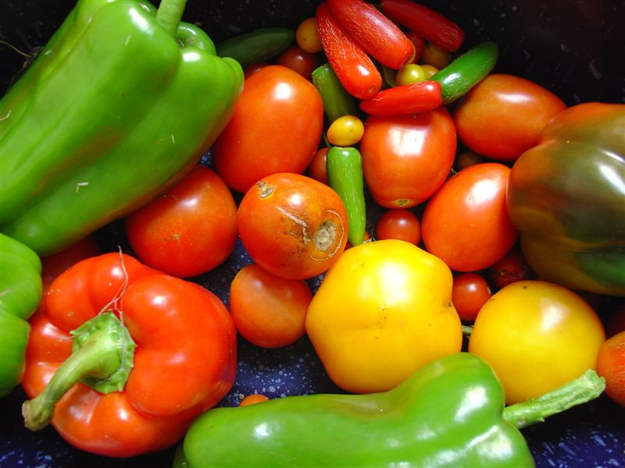
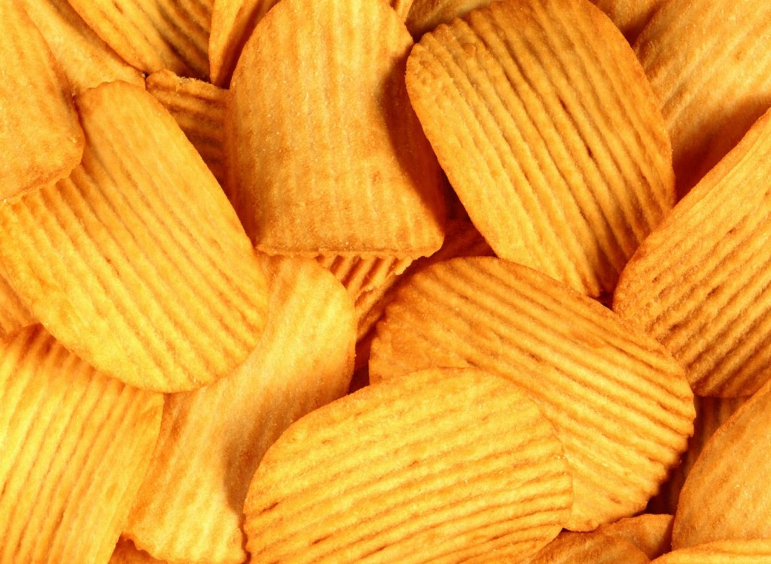
The healthy food is important.

Slide 3
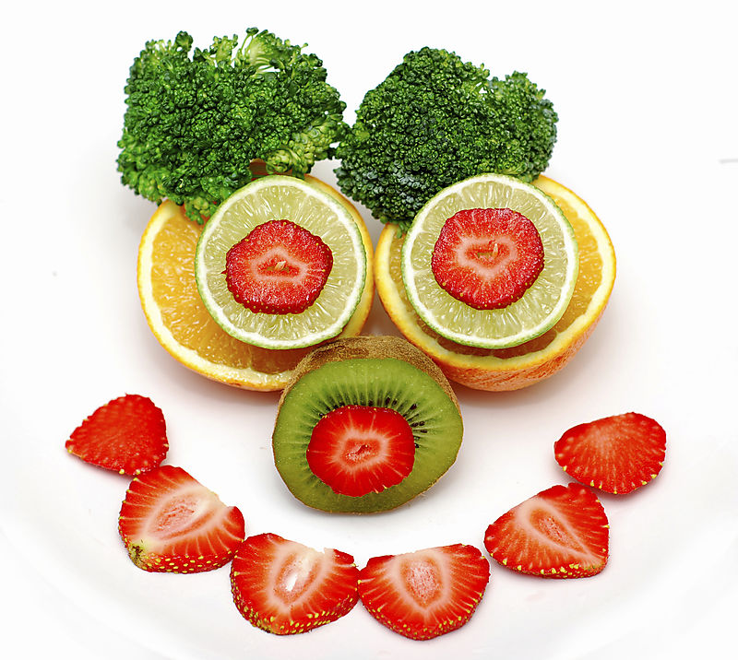
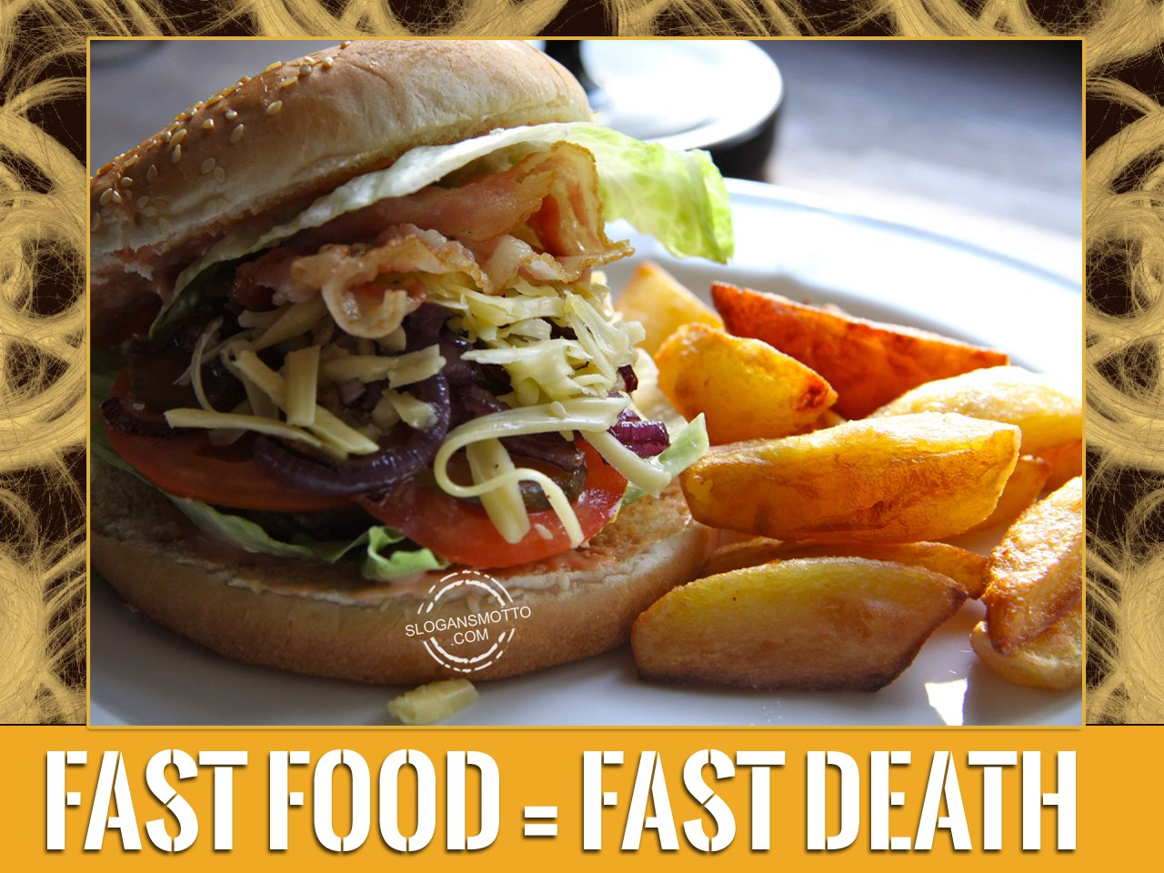
The first rules of a healthy food.

Slide 5
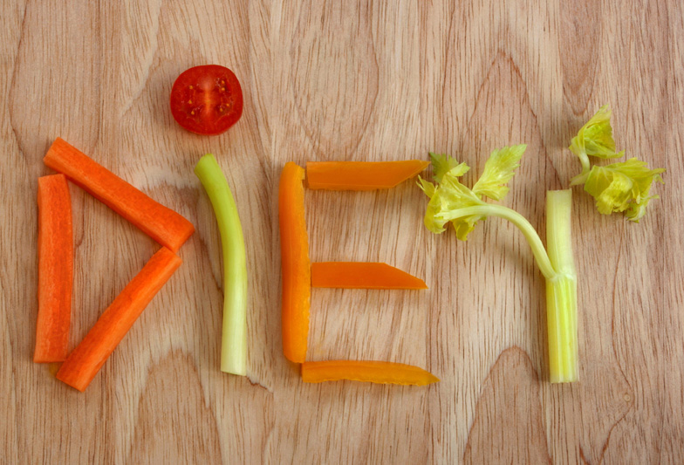
A diet is not good!

Slide 6
The health is very important.

Slide 7
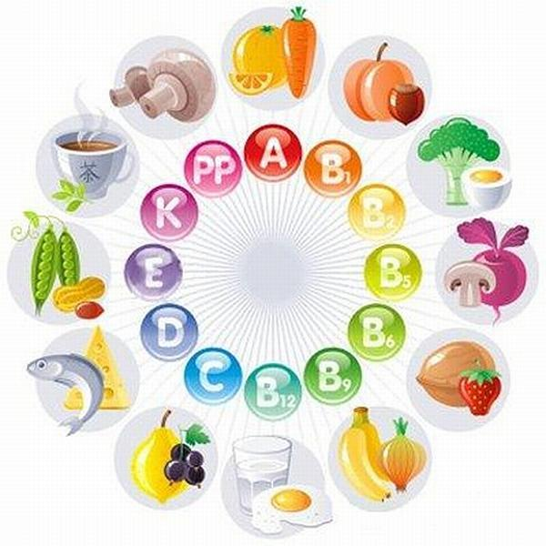
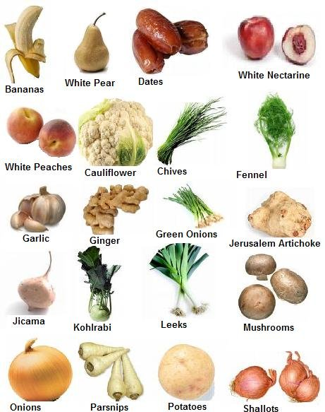
Vitamins

Slide 8
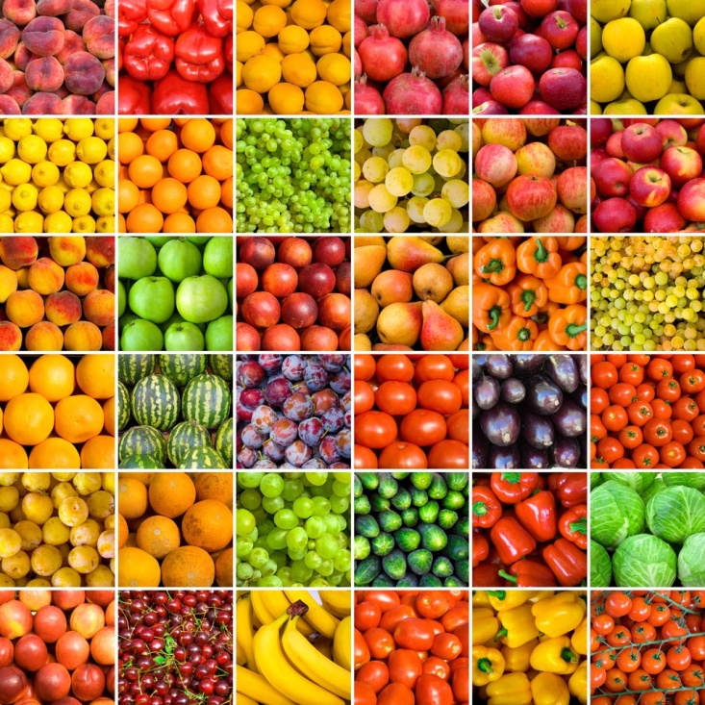
Vitamin A
Vitamin A improves sight and promotes growth of bones and development of teeth. Vitamin A sources in fruit: apricot, avocado, blackberry, melon, kiwi, peas, and etc.

Slide 9
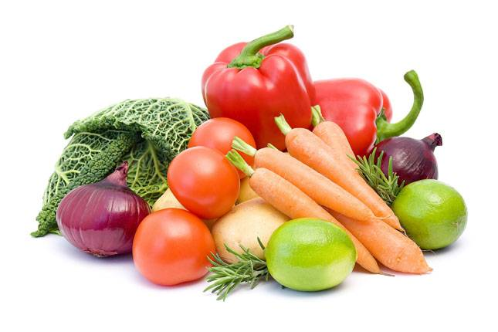
Vitamin B
Vitamin B regulates an exchange of amino acids and carbohydrates. Also it is necessary for healthy functioning of heart, nervous system and muscles.

Slide 10
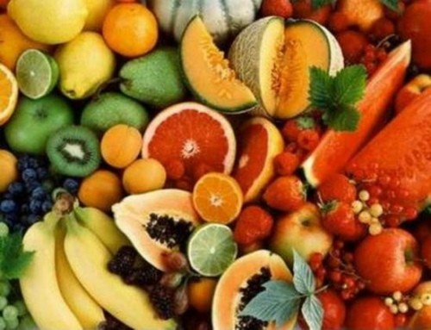
Vitamin C
Vitamin C works as antioxidant and helps to protect cells of a body. Vitamin C sources in fruit: apples, bananas, blackberry, kiwi and etc.

