Slide 1
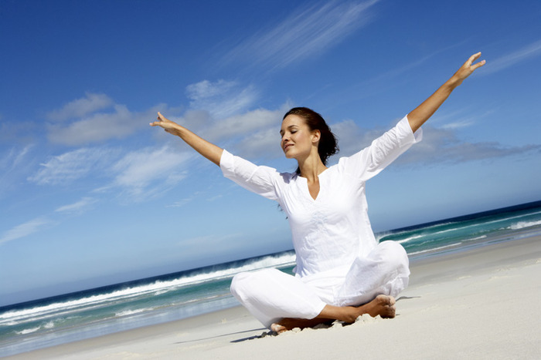
Healthy
Lifestyle

Slide 2
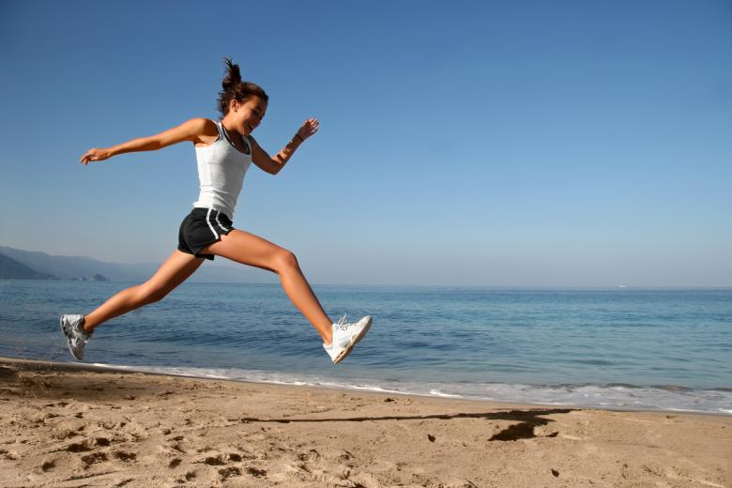
Could you run a marathon?
1. Your bus passes you as you are walking to the bus stop.
What do you do?
a) I run for the bus stop and arrive there at the same time
as the bus. All the passengers are looking at me in
amazement and cheering.
2. You and your friends are deciding how to b) I run for the bus stop and arrive there panting and
spend the afternoon. Which activity would sweating just as the bus is leaving.
you prefer to do? c) I continue walking. There’ll be another bus in half an
a) Play basketball. hour and I don’t want to get all sweaty and out of breath.
b) Go bowling.
c) Watch a video.
3. Your friend lives in a flat on the eighth floor. You go to visit him/her, but when you arrive, you discover that the lift is out of order. What’s your reaction?
a) It doesn’t matter. I always walk up the stairs anyway.
b) It’ll do me good to walk up the stairs for once.
c) Ah, well. I’ll visit again when the lift’s working.

Slide 3
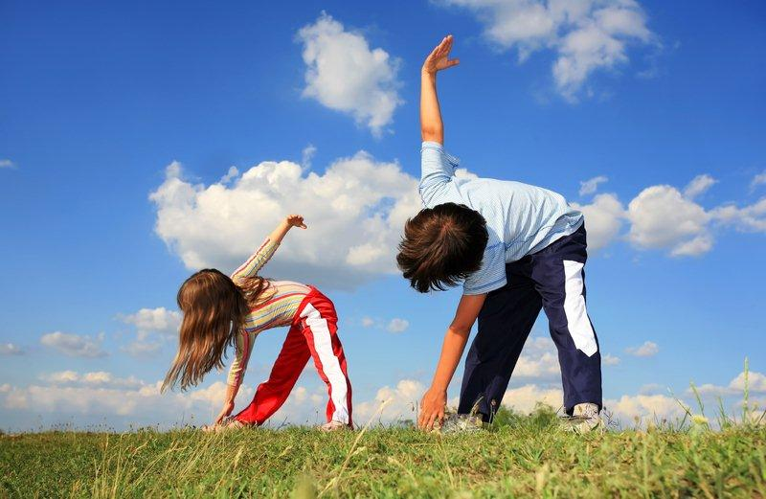
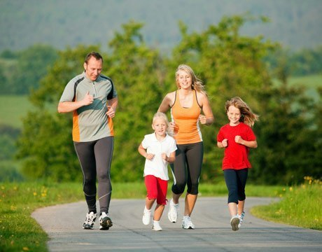
4. What’s your attitude towards sport?
a) I’m good at sport and I’m in several teams.
b) I enjoy playing sport at school.
c) I hate all sport and I don’t do sport if possible.
5. You are on a school trip and there is an organized
climb to the top of a mountain. What do you do?
a) Take the whole thing extremely seriously – I want
to be the first at the top!
b) Stop regularly and complain frequently. The analysis
c) Sneak away and spend the afternoon in a café
eating cakes. Mostly a: You are extremely fit and with a little training you
probably could run a marathon.
Mostly b: You are an active person so you are quite fit. To
become really fit, you need more dedication.
Mostly c: You are very lazy and you aren’t fit at all. Get out
of your chair and start exercising.

Slide 4
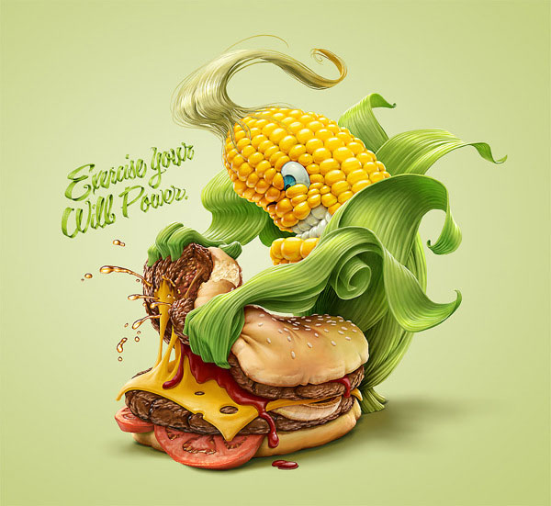
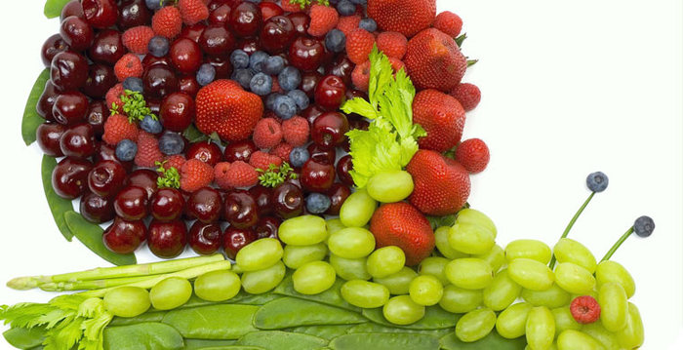
How fit are you?
Answer the questions and see where you are on the fit-o-meter.
1. When do you get up?
a) I get up before seven o’clock.
b) Late. I get up ten minutes before
school starts.
2. What do you have for breakfast?
a) I don’t have time for breakfast. I
have a coffee and a cake at 11 o’clock.
b) Eggs, muesli and a glass of orange
juice.
3. How do you travel to school? 4. What do you eat at break time? 5. When you play sports at school, do you:
a) I go by bus or car. a) A packet of crisps and a chocolate bar. a) hide in the changing rooms?
b) I go by bike or on foot. b) An apple and some mineral water. b) stay for extra practice?
6. What do you do in your free time? 7. What’s your favourite sport? 8. How much fruit do you eat?
a) I sit in front of the TV and eat chocolate. a) I like most sports. a) I eat five pieces of fruit a day.
b) Free time? Never! I am always busy. b) I like most sports (on TV). b) Sometimes I eat fruit sweets.

Slide 5
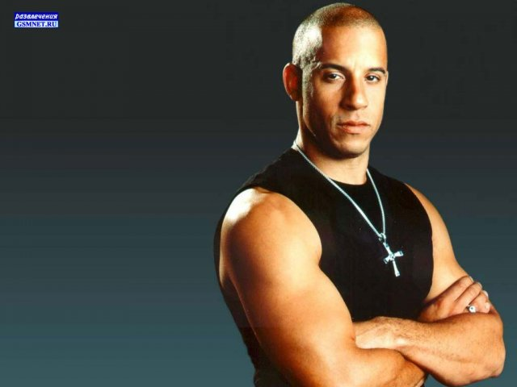
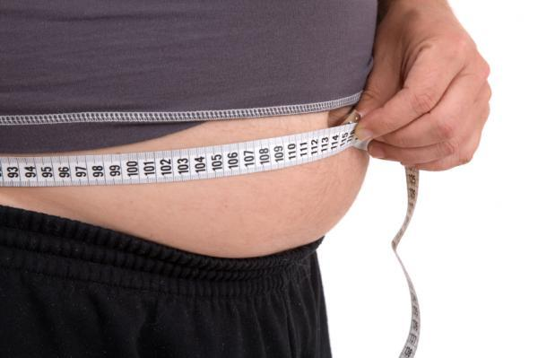
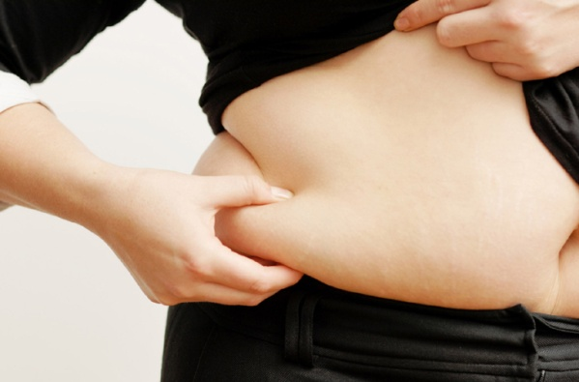
a=6 b=1
a=1 b=6
a=2 b=7
a=2 b=6
a=2 b=6
a=1 b=5
a=6 b=2
a=6 b=2
Now add up your points. Where are you on the fit-o-meter? Draw an arrow.
0
45 15
30

Slide 6
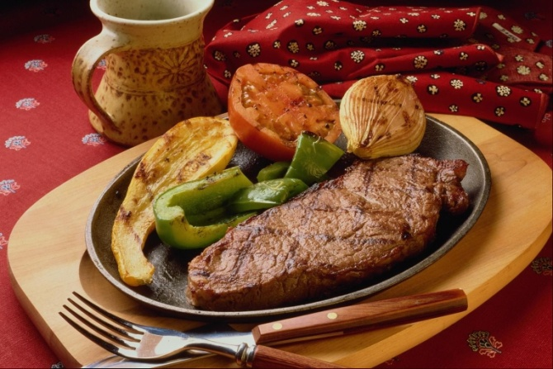
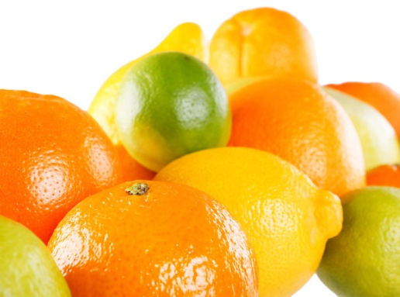
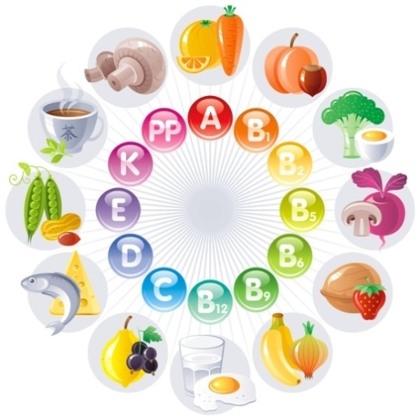
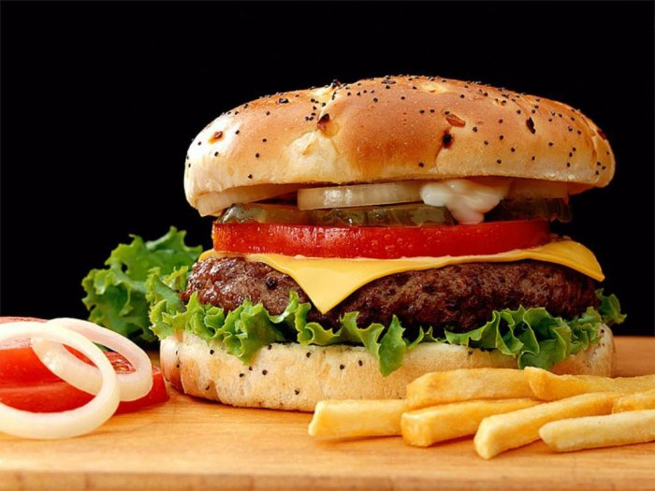
How do you feel about food?
1. Which of these makes you feel hungry?
a) Chicken salad
b) English Sunday lunch: roast beef, roast potatoes, vegetables
c) Fish and a baked potato
d) Hamburger and chips
2. Who’s your heroine?
a) Janet Jackson
b) Roseanne Barr
c) Cindy Crawford
d) Claudia Schiffer

Slide 7
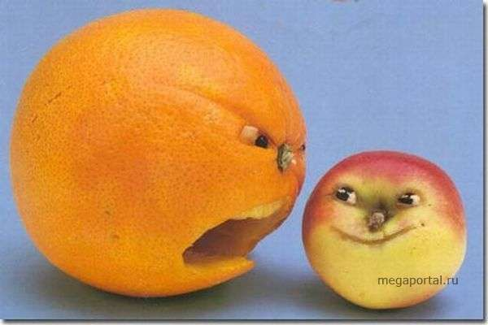
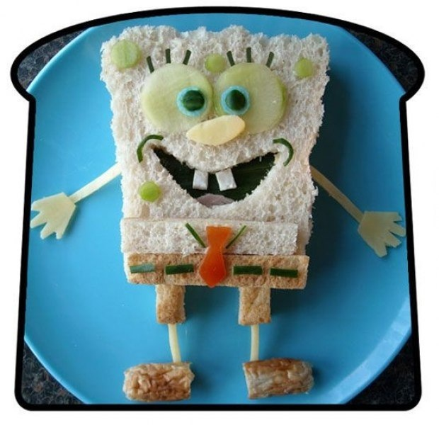
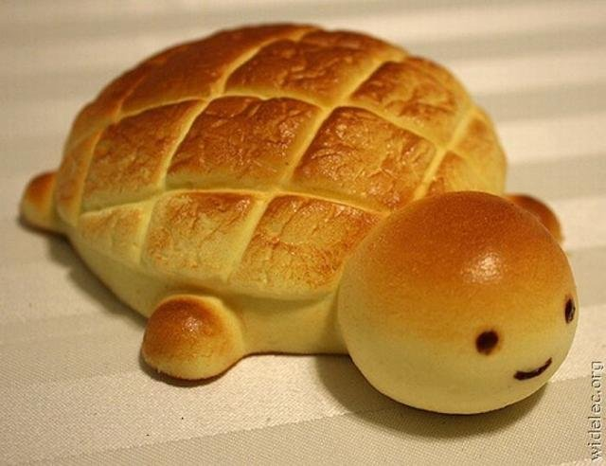
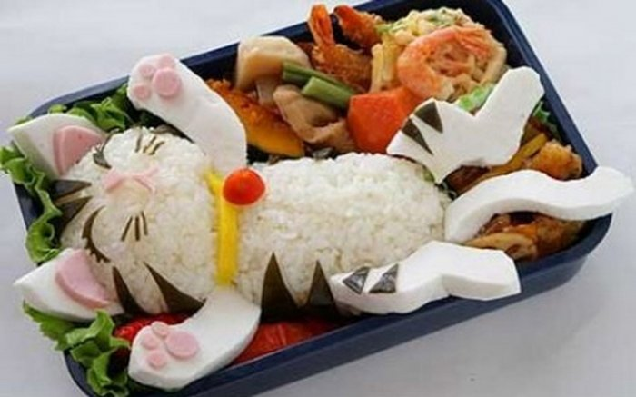
3. After the main course, the waiter asks, “Would you like anything else?”
a) You say, “No, thank you.”
b) You ask for that big chocolate cake
c) You ask for fruit salad
d) You have what your friends have.
4. When do you exercise?
a) anywhere and everywhere
b) when I feel guilty
c) three or four times a week
d) regularly

Slide 8
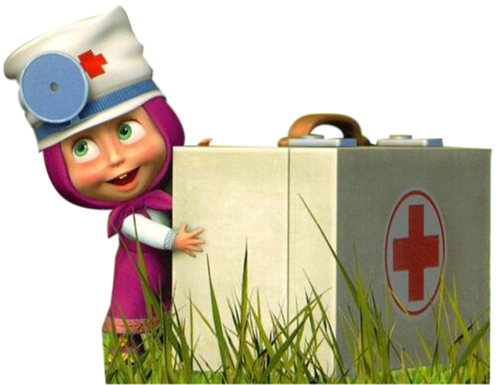
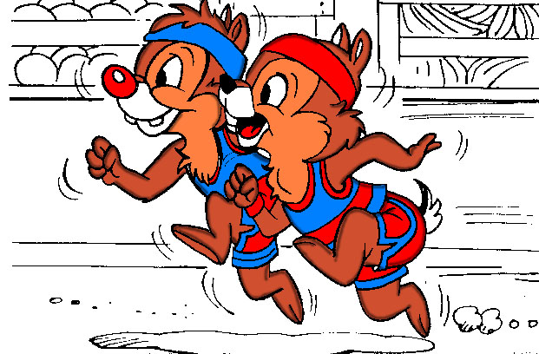
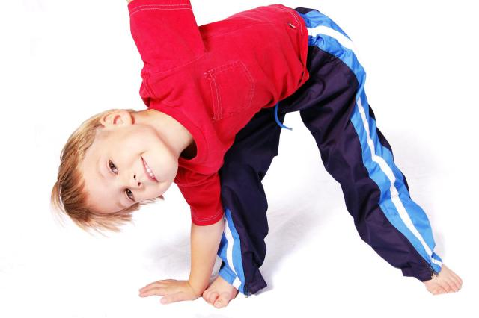
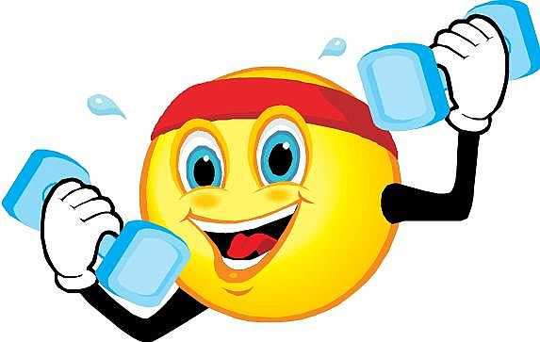
5. Which of these do you say to
yourself after a meal?
a) “I feel full. I ate too much.”
b) “What are we having for dinner tonight?”
c) I don’t think or say anything.
d) “What a good meal! I feel really content.”
6. How often do you weigh yourself?
a) every day
b) once a month, maybe never
c) once a week
d) when I feel fat

Slide 9
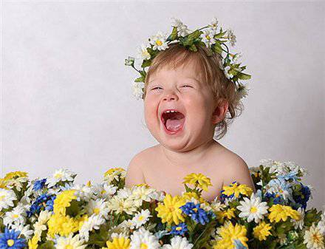
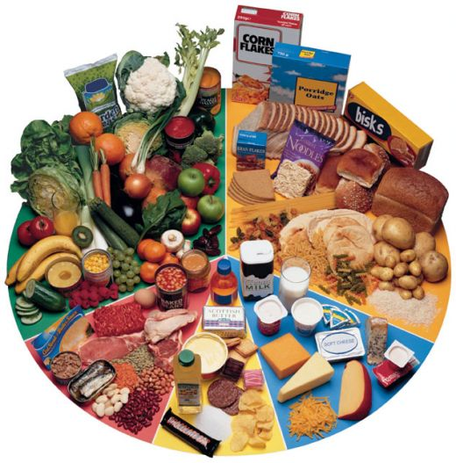
You chose a most of the time: you feel too guilty food. Relax, enjoy it and enjoy being
yourself. Don’t be a slave to food.
You chose b most of the time: you never think about food. You like eating and your
weight is not a problem for you. But be careful: too much sugar and fat are bad for you.
Try to eat more healthy things and take exercise.
You chose c most of the time: you are too good to be true. You know all the facts
about food and health. Learn to enjoy eating and exercise…life is fun. Everyone is not
the perfect size, but you are not going to become a giant after one piece of chocolate
cake.
You chose d more of the time: you’re very lucky. You are happy with your body. You
know the facts about food and exercise, but you enjoy your food too.

