Slide 1
Project
Healthy Food

Slide 2
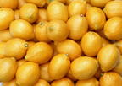
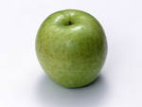
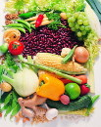
Healthy Food.
Eat carrots, apples and cabbage. Have porridge, cheese and milk for breakfast. Drink juice ever y day.
Eat fruit and vegetables every day.

Slide 3
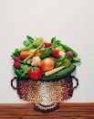
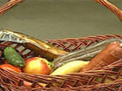
Traditional Russian Food.
Shchi. There are many vegetables in it: carrots, cabbage, onion, tomato, potato, pepper, meat.
2. Pancakes and pies. The Russian like to eat them with different vegetables.
3. Porridge. They like porridge with jam, pumpkin and honey.
4. Potatoes. The Russian like potatoes with vegetables.
5.Fish and meat.

Slide 4
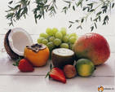
Do not eat many sandwiches, sweets and cakes, hamburgers and chocolate.
If you want to be healthу you must not eat «Fast Food»!
Good health is better than wеalth.
So I do morning exercises, take a shower, eat always in time. I try to eat the right food. For breakfast I usually have porridge and drink juice. At school I have lunch.
At two o’ clock I come home and have dinner. For dinner I usually have soup, spaghetti and fruit salad.
I drink juice.
For supper I have fruit and drink milk.

Slide 5
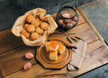
All children like to eat sweets, biscuits, jam and cookies.
I want to give you a recipe of carrots biscuits:
1 cup of flour
1 teaspoon of boiled carrots
4 tablespoons of raisins
1. Mix the flour. Baking powder, egg, sugar, some salt, boiled carrots and raisins.
2. Roll out the past to out 1 cm thick.
3. Cut into rounds.
4. Bake 15-20 minutes in a hot oven.

Slide 6
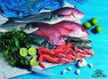
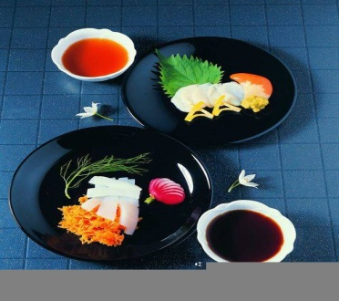
Traditional English Food .
For breakfast they usually eat porridge, ham, eggs and drink juice.
For lunch they drink juice and eat salad.
For dinner they usually eat fish, potatoes, meat, salad.
English people like tea. They drink a lot of tea. They have tea two or three cups of tea at tea-time. They like to have tea with milk.

Slide 7
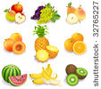
Eat Healthy Food

