Slide 1
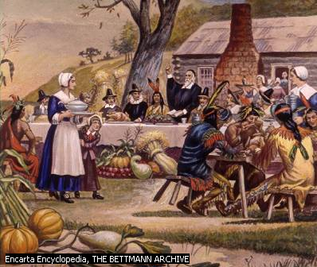
"Thanksgiving Day"

Slide 2
«Корзинка идей» по теме «Праздники».
A present | Merry | Celebrate
A firework | Happy | Give / get presents
Coloured lights | Happy | Invite friends
A greeting card | Nice | Enjoy the party

Slide 3
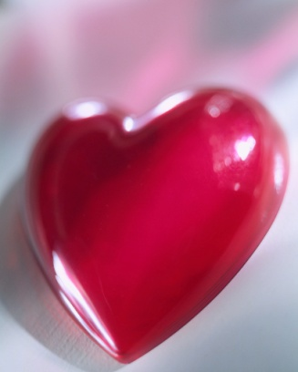

Easter
Christmas
Halloween
St.Valentine’s Day

Slide 4
"Thanksgiving Day" .

Slide 5
Таблица для заполнения при чтении текста.
questions | Before reading | After reading
Where do people celebrate Thanksgiving Day?
What are the symbols of the day?
When do people celebrate this holiday?
What kind of holiday is this?
What do people do on this day?
What’s the traditional food on this holiday?
Why did the Americans begin to celebrate it?
Were the Indians invited to the thanksgiving dinner?
Who taught the pilgrims to survive in America?

Slide 6
Ten little Indian boys.
One little, two little, three little Indians
Four little, five little, six little Indians
Seven little, eight little, nine little Indians
Ten little Indian boys.
Ten little, nine little, eight little Indians
Seven little, six little, five little Indians
Four little, three little, two little Indians
One little Indian boy.

Slide 7
Circle the best answer in each sentence.
1. The pilgrims landed in 1620 in …
A. New York
B. Georgia
C. Massachusetts
2. The pilgrims celebrated the first … in the fall of 1621.
A. Christmas
B. Thanksgiving Day
C. Easter
3. The name of their ship was the …
A. Harvest
B. Plymouth
C. Mayflower
4. … has become the symbol of Thanksgiving Day.
A. popcorn
B. a goose
C. a turkey
5. The pilgrims gave thanks for …
A. a good harvest
B. a new ship
C. clever advice

Slide 8
Your home task .
Exercise №21 at page 115.Сompare the two holidays Christmas and Thanksgiving Day on the following points:
date, presents, food, symbols, and people’s activities.

