Slide 1
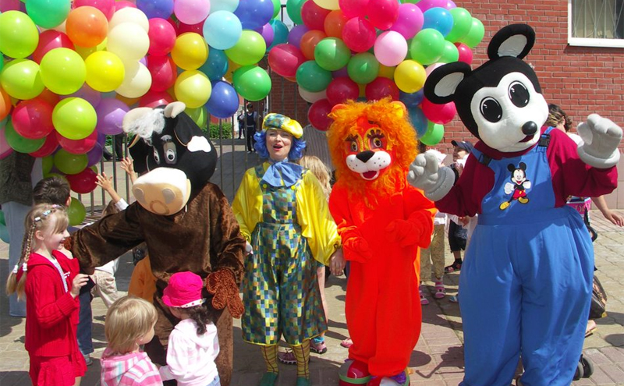
Holidays in New Zealand

Slide 2
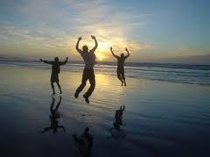
In New Zealand there are two types of national public holidays, those that are 'Mondayised' and those that are not.

Slide 3
Date | Holiday
1 January¹ | New Year's Day
2 January² | Day after New Year's Day
6 February | Waitangi Day
The Friday before Easter Sunday | Good Friday
The day after Easter Sunday | Easter Monday
25 April | Anzac Day
The first Monday in June | Queen's Birthday
The fourth Monday in October | Labour Day
25 December¹ | Christmas Day
26 December² | Boxing Day

Slide 4
Anzac Day
Anzac Day
Anzac Day Dawn Service at Kings Park, Western Australia, 25 April 2009, 94th anniversary
Observed by | Memorial services, public holiday
Type | Patriotic, Historical, Nationalist
Significance | First landing of the Anzacs at Gallipoli
Date | 25 April
Observances | Military parades, remembrance services
Related to | Remembrance Day(Commonwealth of Nations), Armistice Day

Slide 5
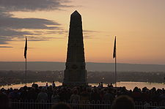
Anzac Day is a national day of remembrance in Australia and New Zealand, and is commemorated by both countries on 25 April every year to honour members of the Australian and New Zealand Army Corps (ANZAC) who fought at Gallipoli in Turkey during World War I.

Slide 6
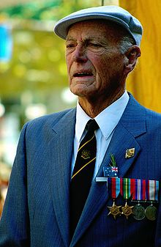
It now more broadly commemorates all those who died and served in military operations for their countries. Anzac Day is also observed in the Cook Islands, Niue, Samoa and Tonga.
A veteran on Anzac Day.

Slide 7
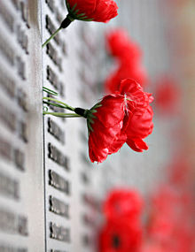
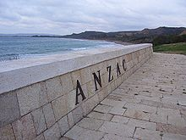
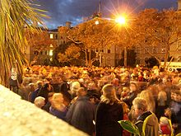
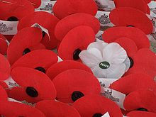

Slide 8
Waitangi Day
Traditional Maori Waitangi Day celebrations at Waitangi, Bay of Islands.
Also called | New Zealand Day
Observed by | New Zealanders
Type | National, Nationalist
Significance | The day which the Treaty of Waitangi was signed in 1840
Date | 6 February
Observances | Family meetings, hui, parades, citizenship ceremonies, Order of New Zealand honours.

Slide 9
Waitangi Day commemorates a
significant day
in the history of New Zealand.
It is a public holiday
held each year on 6 February to
celebrate the signing of the
Treaty of Waitangi,
New Zealand's founding document,
on that date in 1840.

Slide 10
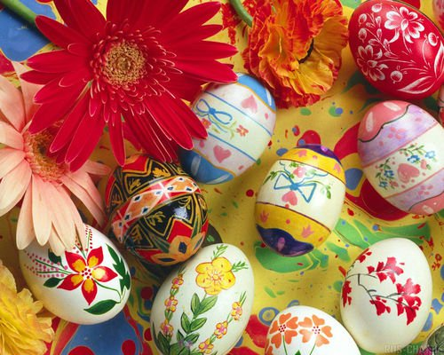
Easter Sunday

Slide 11
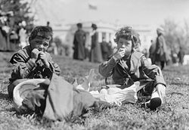
Easter Monday is the day after Easter Sunday and is celebrated as a holiday in some largely Christian cultures, especially Roman Catholic and Eastern Orthodox cultures. Easter Monday in the Roman Catholic liturgical calendar is the second day of the octave of Easter Week.
Two boys enjoy treats during the annual Easter egg roll a
t the White House lawn on Easter Monday, 1911.

Slide 12
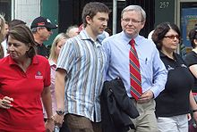
LABOUR DAY
In New Zealand, Labour Day is a public holiday held on the fourth Monday in October. Its origins are traced back to the eight-hour working day movement that arose in the newly founded Wellington colony in 1840, primarily because of carpenter Samuel Parnell's refusal to work more than eight hours a day.

Slide 13
In 1899 government legislated that the day be a public holiday from 1900. The day was celebrated on different days in different provinces. This led to ship owners complaining that seamen were taking excessive holidays by having one Labour Day in one port then another in their next port. In 1910 the government stipulated that the holiday would be observed on the same day throughout the nation.

Slide 14
Boxing Day
Observed by some members and former
members of the Commonwealth
of Nations
Type Bank holiday / Public holiday
Date 26 December - Bank or public holiday (or 28 December - public holiday only)
Related to St. Stephen's Day

Slide 15
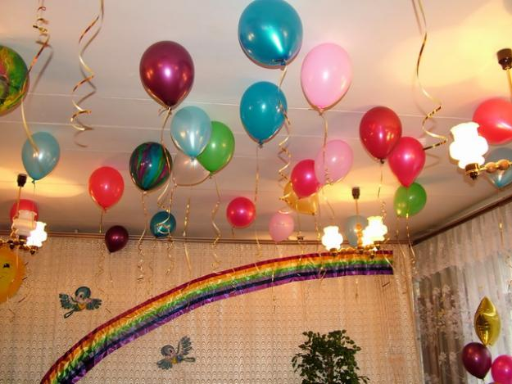
Boxing Day is a bank or public holiday that occurs on 26 December, or the first or second weekday after Christmas Day, depending on national or regional laws. It is observed in Australia, Canada, New Zealand, the United Kingdom and some other Commonwealth nations.

Slide 16
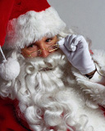
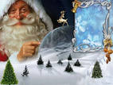
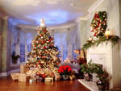
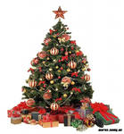
Christmas
and New Year

Slide 17
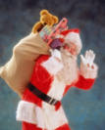
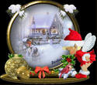
Christmas and New Year are ‘Mondayised’ holidays, so if these fall on a weekend that employee does not normally work then the holiday is transferred to the following Monday or Tuesday. If the employee would normally work on the particular weekend then it remains a traditional holiday and the employee is entitled to that day off on pay. If they normally work on both days, they are only entitled to the traditional holiday and the Mondayised holiday is treated as a normal work day.

Slide 18
Видео «Салют в новогоднюю ночь в Окланде»

Slide 19
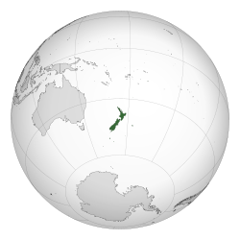
Traditions in NEW ZEALAND

Slide 20
Kiwi hospitality Traditions here are very similar to the traditions of Australia and the UK. Here, for example, is never to invite guests between 16.45 and 17.13, never cavalier will not be asked to pay for a lady in a restaurant. Invited to a party, you will most likely be invited to the picnic, which will take place in the mountains, beach, near the waterfall or in a garden near the house. In this case we expect from you will only drink, assuming that the starter is the case of your host. For dessert you certainly will offer air-cake "Pavlova", which was named in 1926 after the famous Russian ballerina Anna Pavlova and presents here at every holiday table.

Slide 21
Local traditions
Buzzy Bee '- bright red and yellow toy, which publishes a characteristic noise when driving. How many children kiwi rose to her to say impossible, but today it is among the favorite toys, and popular and will remain an integral part of Kiwi.

Slide 22
Ragby
Ask a Kiwi, a sport he loves, and the answer can be no doubt. Of course, the rugby! Of boys age five to the power of fathers family - all played and loved the hard sport. All kiwis in every corner of the country gather in front of the TV during the broadcast of a major match.

Slide 23
L & P
L & P - has been and will long remain the national drink of kiwifruit. The recipe of the drink was invented in 1904 in the town of Paeroa and was a characteristic blend of lemon and a local mineral water. Despite almost a century, a drink is always popular among the Kiwis and even exported abroad.

Slide 24
Book “Edmonds”
Each family has a kiwi Edmonds Cookbook - an assertion that does not require proof! Was first published in 1907, this povarennayakniga became the most published book in New Zealand with a total circulation of about 3.5 million!

Slide 25
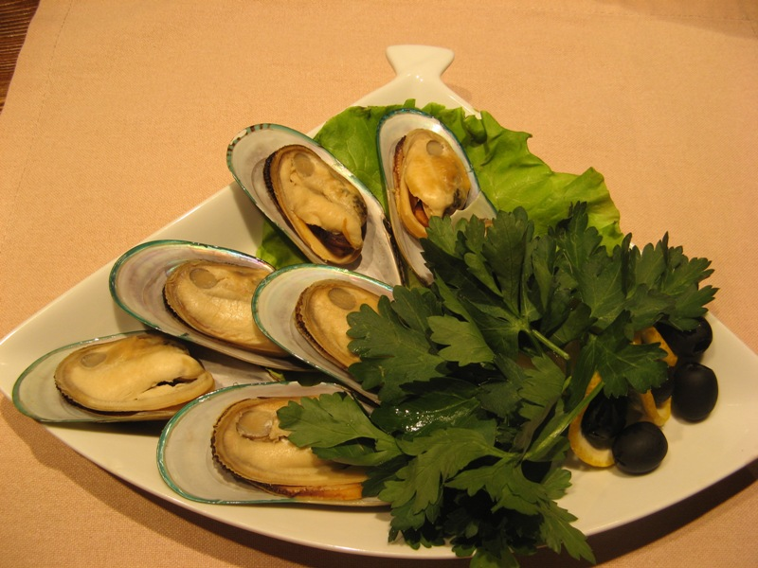
Traditional kitchen
Traditional kitchen of the country, which existed on the islands long before the Europeans arrived, almost unknown to tourists. Numerous settlers from all over the world have brought here the culinary traditions of their homeland, so now the country can taste dishes of almost all the nations of the world. But prevails, of course, the Anglo-Saxon kitchen.

Slide 26
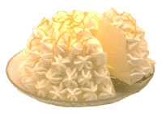
Traditional desserts of New Zealand - a cake with whipped cream and fruit, a big round cake with fruit and whipped cream, a variety of jams and dry biscuits English type.

Slide 27
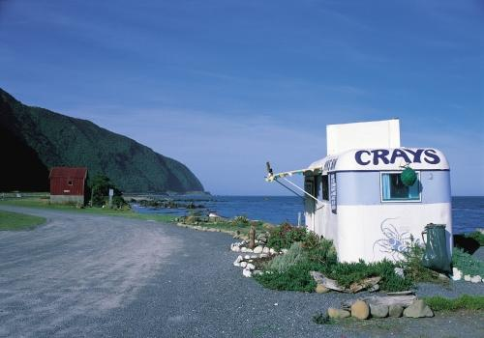
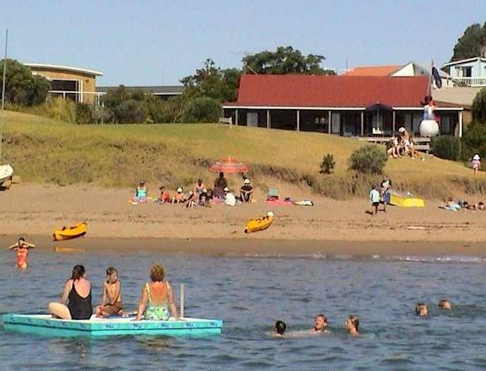

Slide 28
Thank you!!!

