Slide 1
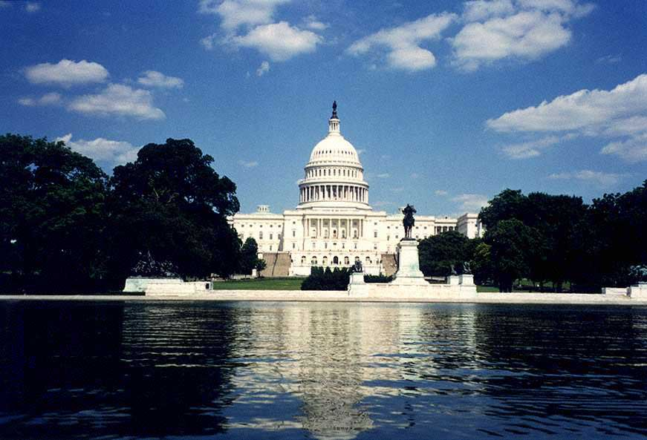
Washington D.C.
Prepared by Anastasia Filyaeva, form 9 “A”

Slide 2
Washington D.C.
Washington is the capital of the United States of America. The city is on the left bank of the Potomac River. It was named after the first President George Washington.
The population of the city is nearly three million people.

Slide 3
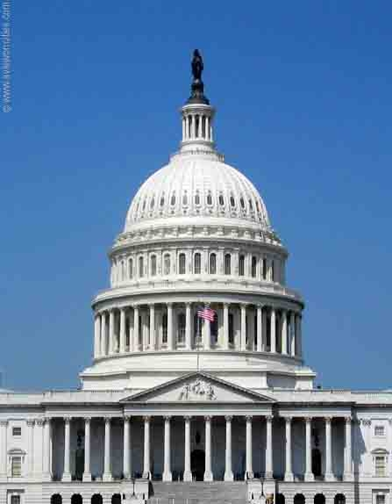
The Capitol
The Capitol is the centre of the city It is situated on Capitol Hill.
The U.S. Capitol is one of the most recognizable buildings in the world, serves as a symbol of democracy, the home of the House and Senate and a tourist attraction visited by millions every year.

Slide 4
The White House
The White House is the home and office of the U.S. president.

Slide 5
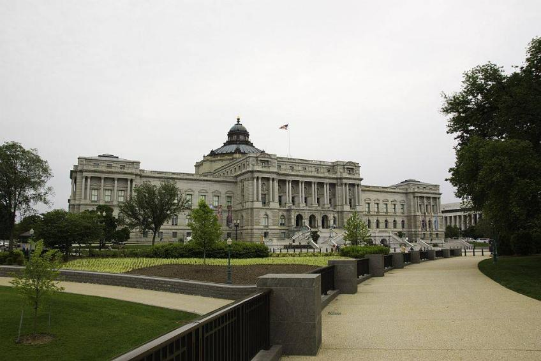
The Library of Congress
The Library of Congress in Washington, DC, is the world’s largest library containing more than 128 million items including books, manuscripts, films, photographs, music and maps.

Slide 6
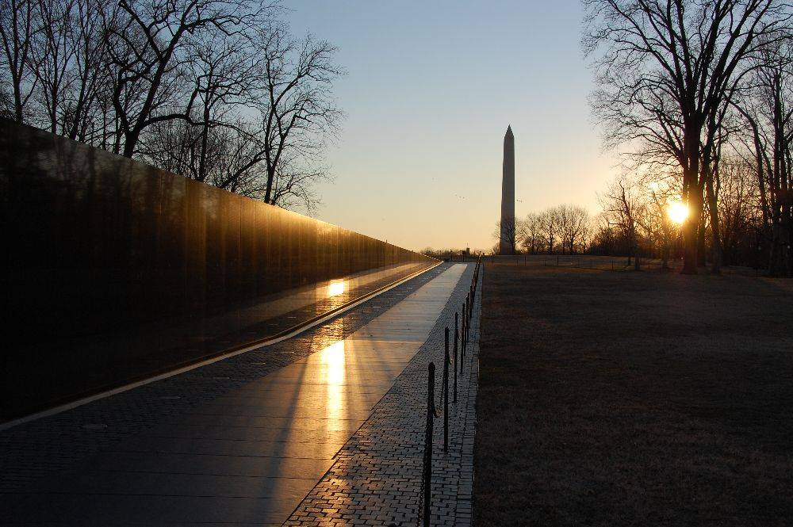
The Vietnam Memorial
The Vietnam Veterans Memorial pays tribute to those who served in the Vietnam War.

Slide 7
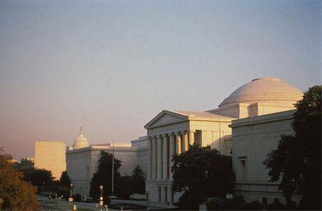
The National Gallery of Arts
The National Gallery of Art in Washington, DC is a world-class art museum that displays one of the largest collections of masterpieces in the world including paintings, drawings, prints, photographs, sculpture from the 13th century to the present.

Slide 8
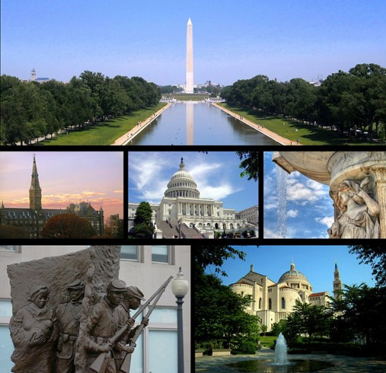
Washington is a large scientific and cultural centre. There are five universities in the city and the National Academy of sciences.

