Slide 1
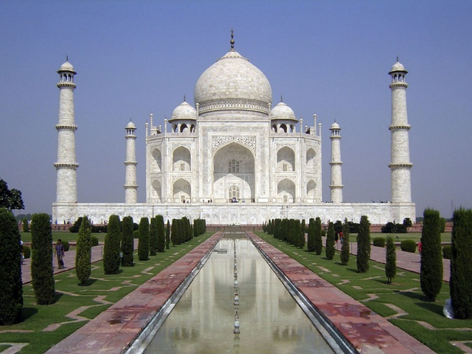
The Bengal tiger, India

Slide 2
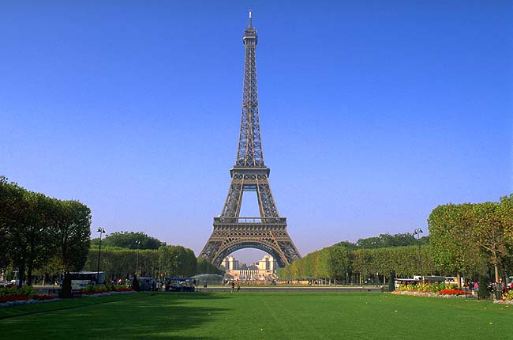
The Cock, France

Slide 3
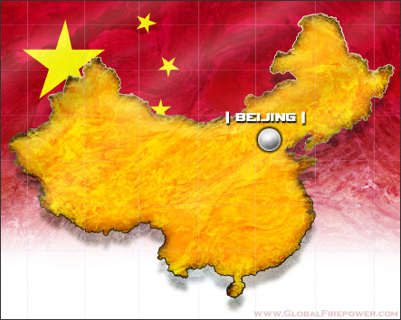
The Panda, China

Slide 4
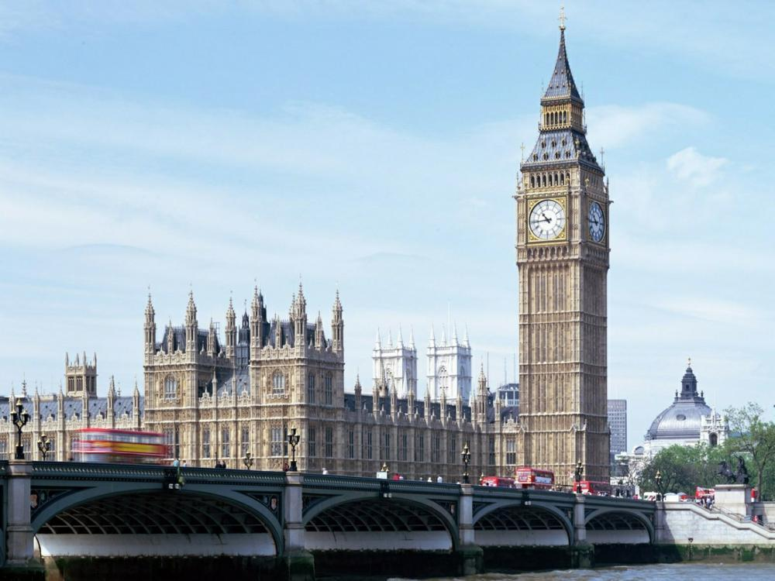
The Lion, England

Slide 5
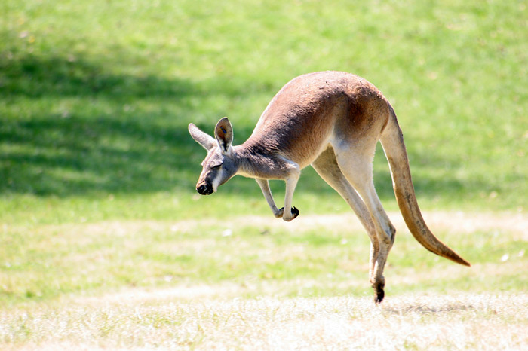
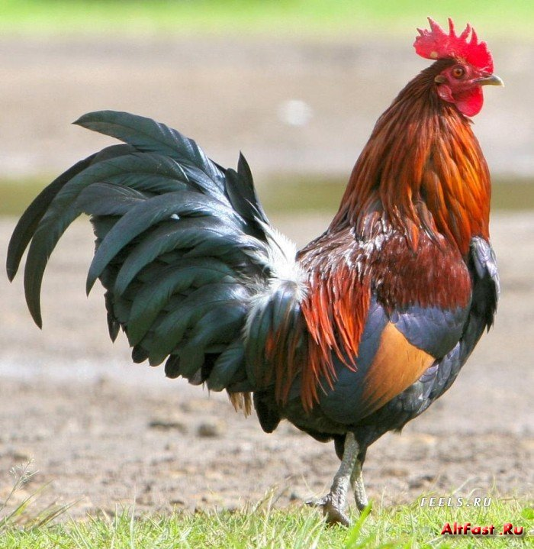
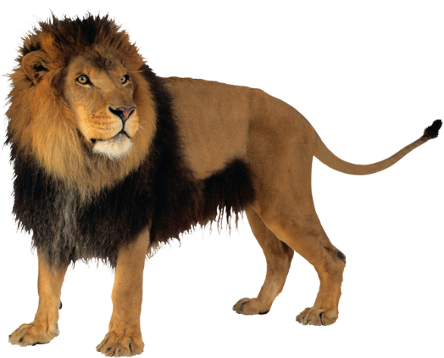
National Animals

Slide 6
Spotlight on Russia p.7 The Kamchatka’s Brown Bear
I know | I want to know | I learnt

Slide 7
Spotlight on Russia p.7 The Kamchatka’s Brown Bear
I know | I want to know | I learnt
 | Colour: Habitat: Look like: Food: Activities: Opinion:

Slide 8
I learnt
Colour: brown
Habitat: thick forests, next to the rivers in summer, in winter in a den
Look like: 400 kg, 2.50 m tall, big teeth, long, sharp claws
Food: berries, nuts, roots, fish
Activities: travels, catches fish, swims well, makes a den
Opinion: strong, gentle, peaceful

Slide 9
Cinquain
Title
2 adjectives
3 verbs
1 sentence (What’s it?)
Noun-synonym for the topic

Slide 10
Cinquain
The Brown Bear
Gentle and peaceful
Travels, catches fish, makes a den
It’s a national animal of Russia
Giant

Slide 11
Assessment You may begin with:
At the lesson I…
…. got new information about…
… read the text about…
… liked …

Slide 12
H/W:
Write a letter to your foreign pen-friend about animals on Russian city emblems. (A4)
Remember the rules of letter – writing!

