Slide 1
“MUTTER” in German
“MITERA” in Greek
“Мати” in Ukrainian

Slide 2
…in English?

Slide 3
MOTHER

Slide 4
Answer the questions
What’s your mother’s name?
How old is she?
What is she?
What are her main characteristics?

Slide 5
5. What is your mother for you?
The DENTIST who uses a string.
The SUNSHINE on a cloudy day.
The STORY TELLER when you can't get to sleep.
The TEACHER who teaches about life.
The BAKER who makes chocolate cookies.
The KEY that unlocks the door to the future.
The SINGER who sings childhood songs.
The FRIEND who puts real meaning into "I Love You"!
Choose 3 you like best of all
USE:
To my mind…
In my opinion…
I think…

Slide 6
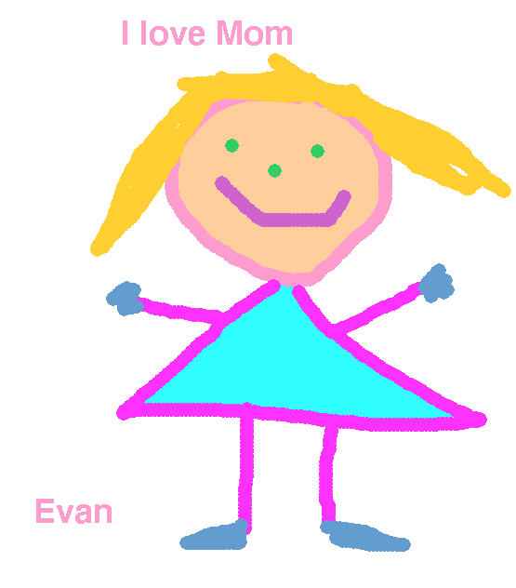
6. Why do you love your mother?
…because she is special.
…because she makes good food.
…because she hugs me.
…because she takes me to swimming lessons.
…because she smells nice.
… because she is the best.

Slide 7
Why Mothers are so Special_1
Mum and Dad were watching TV when Mum said, “I’m tired, and it’s getting late. I think I’ll go to bed.”
She went to the kitchen to make sandwiches for the next day, put spoons and bowls on the table.
She picked up the game pieces left on the table, put the phone back on the charger and put the telephone book into the drawer.

Slide 8
Why Mothers are so Special_2
She watered the flowers. She stopped by the desk and wrote a note to the teacher, counted out some cash for the excursion.
Dad said, “I thought you were going to bed.”
“I’m on my way,” she said. She put some water into the dog’s dish , then made sure the doors were locked .
About that time, Dad turned off the TV and said: “I’m going to bed, dear!”

Slide 9
Why is your mother special?

Slide 10
Let’s check your home task!
You are welcome!

Slide 11
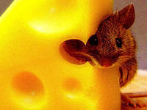
Three blind mice

Slide 12
Pretend somebody’s mother and ask for help your daughter or son
To help your mother
To lay the table
To clear the table
To do the washing up
To go shopping
To buy bread and milk
To sweep the floor
To cook
To clean your flat

Slide 13
Sinquain poems
1. Название (существительное)
2. Описание (прилагательное)
3. Действия
4. Чувство (фраза)
5. Повторение сути
Mother

