Slide 1
Where’s Chuckles?

Slide 2
I see green, I see yellow, I see that funny fellow, I see red, I see blue, I see you, and you, and you.

Slide 3
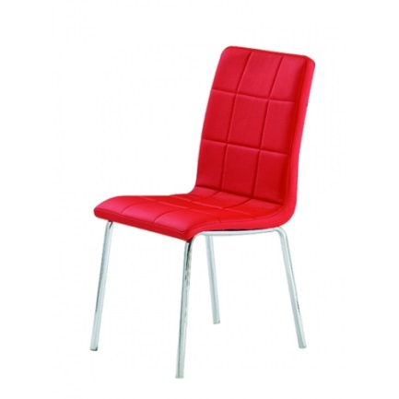
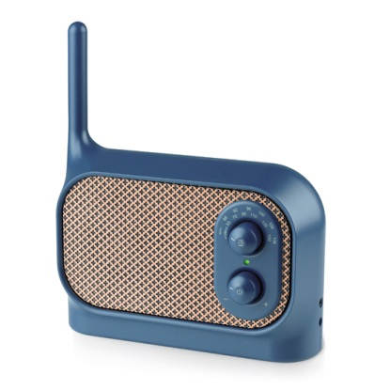
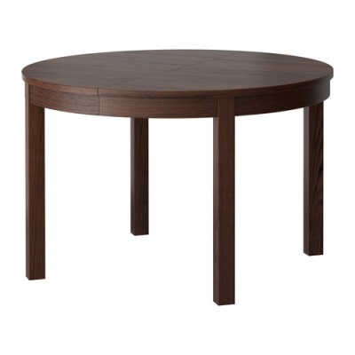
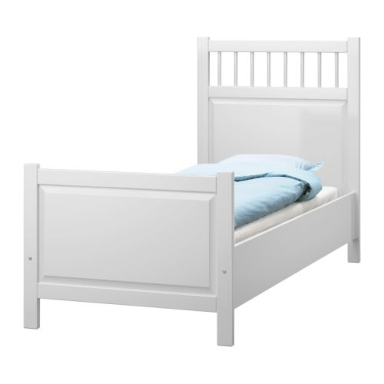
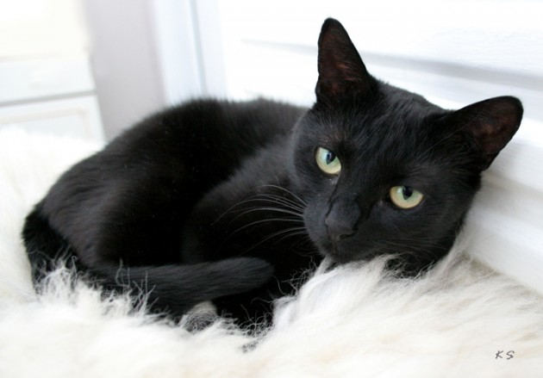
A) a white bed
B) a red chair
C) a black cat
D) a blue radio
E) a brown table
F) a yellow lamp

Slide 4
A garden

Slide 5
A living room

Slide 6
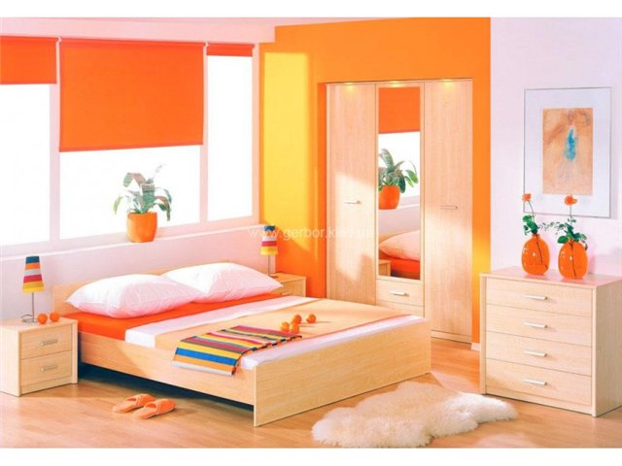
A bedroom

Slide 7
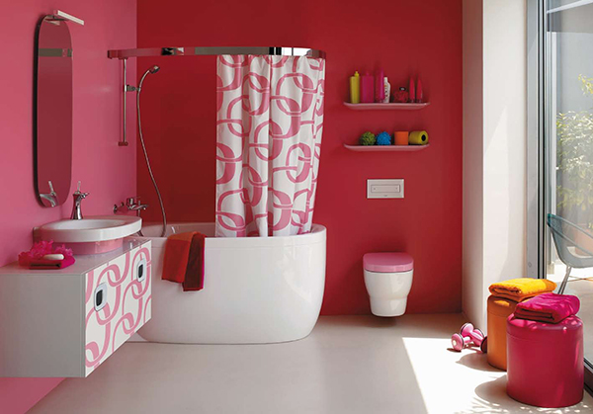
A bathroom

Slide 8
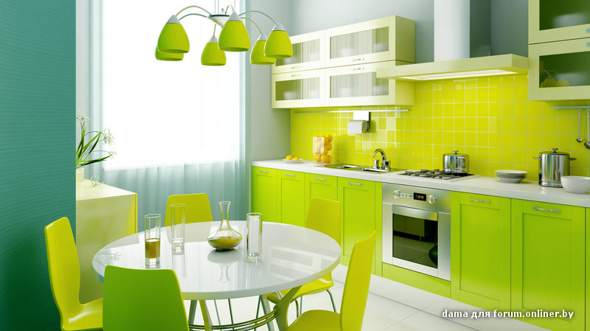
A kitchen

Slide 9
Where’s Chuckles? It’s in the kitchen.

Slide 10
She

Slide 11
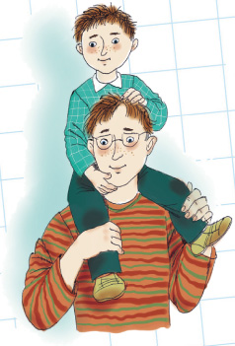
He

