Slide 1
It’s summer.
It’s sunny.
I can ride a bike.

Slide 2
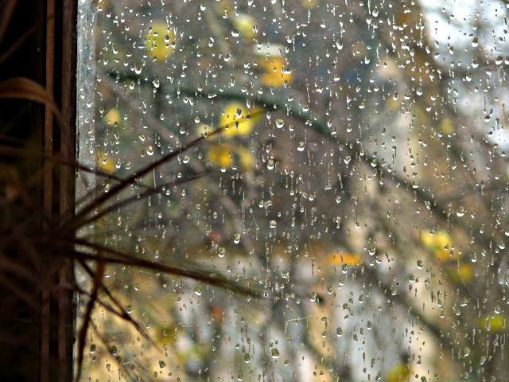
It’s autumn.
It’s rainy.
I can sit at home and read books.

Slide 3
It’s winter.
It’s snowy.
I can ski and toboggan.

Slide 4
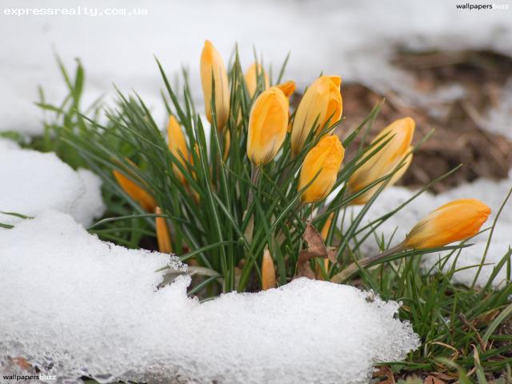
It’s spring.
It’s sunny.
I can walk in the park.

