Slide 1
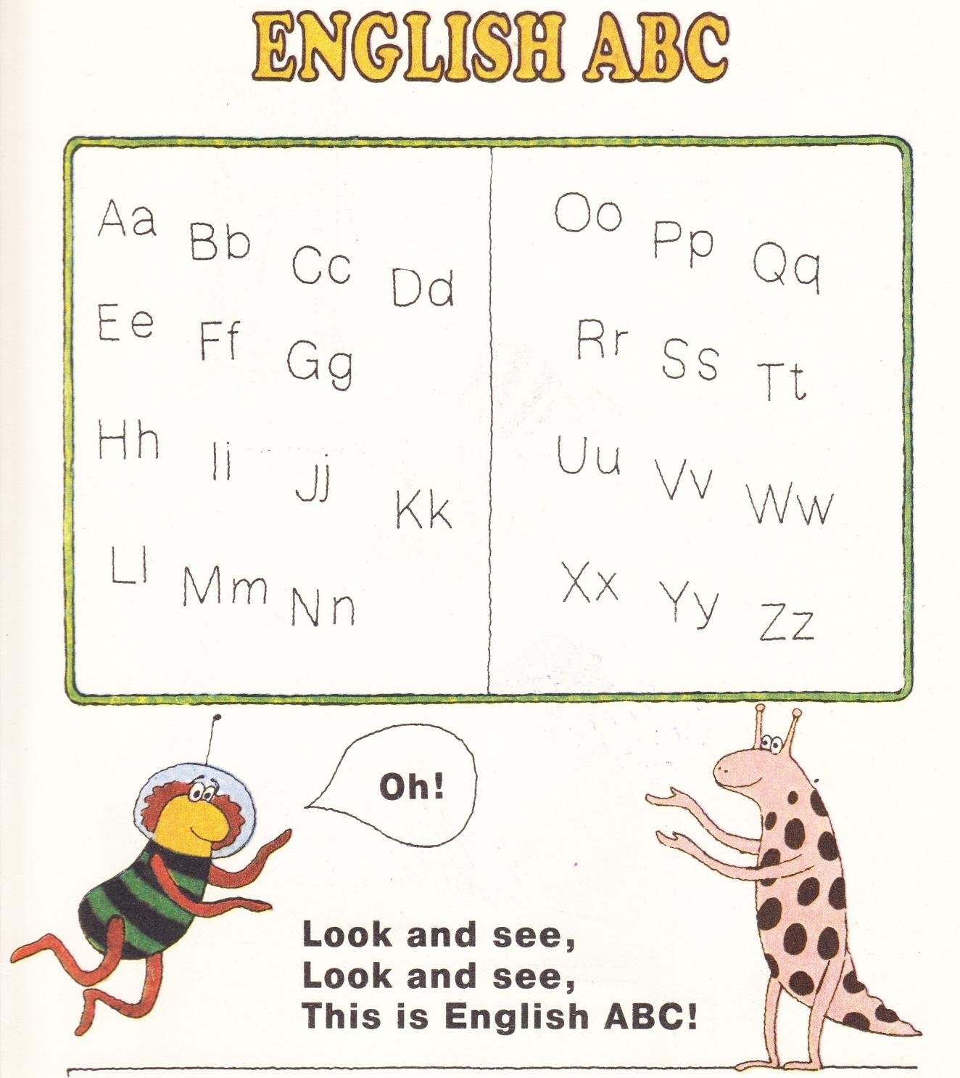
Ff
Ss
Ll
Xx
Mm
Nn

Slide 2
F f

Slide 3
four
4

Slide 4
five
5

Slide 5
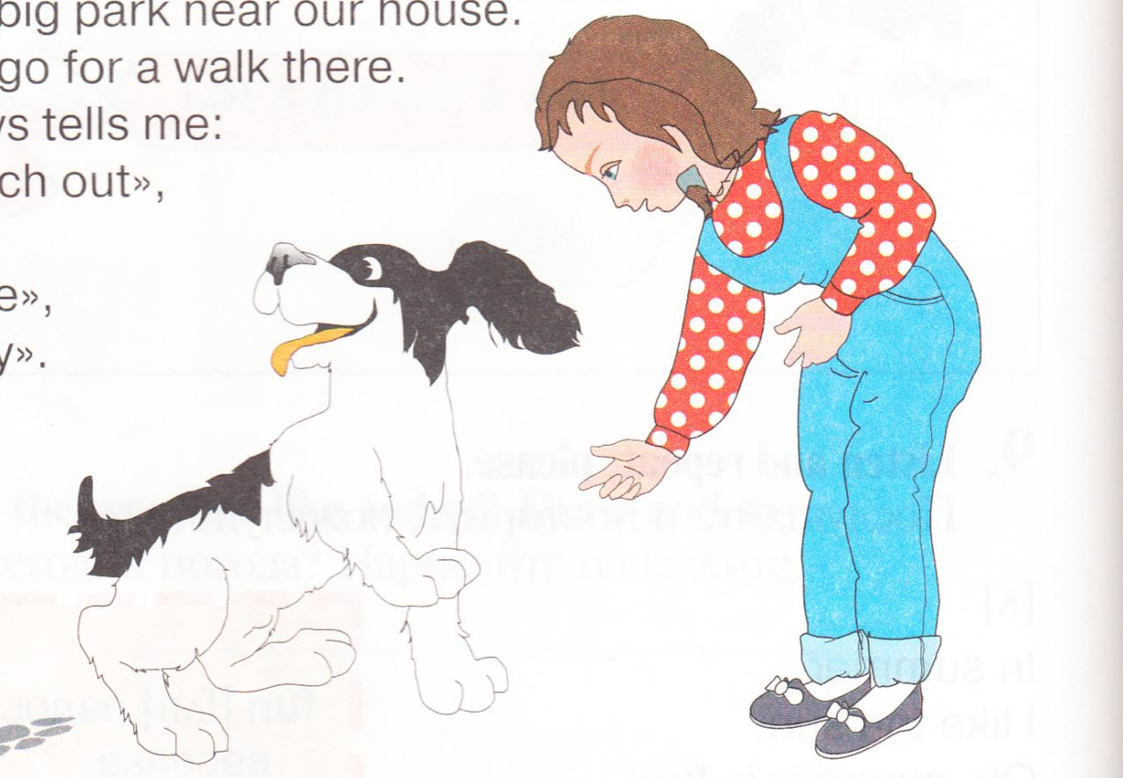
friend

Slide 6
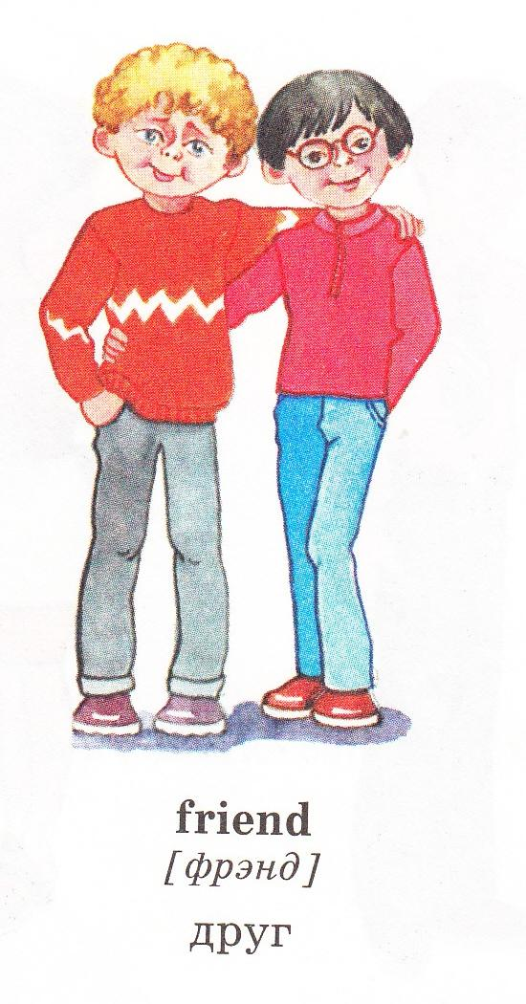
Friend

Slide 7
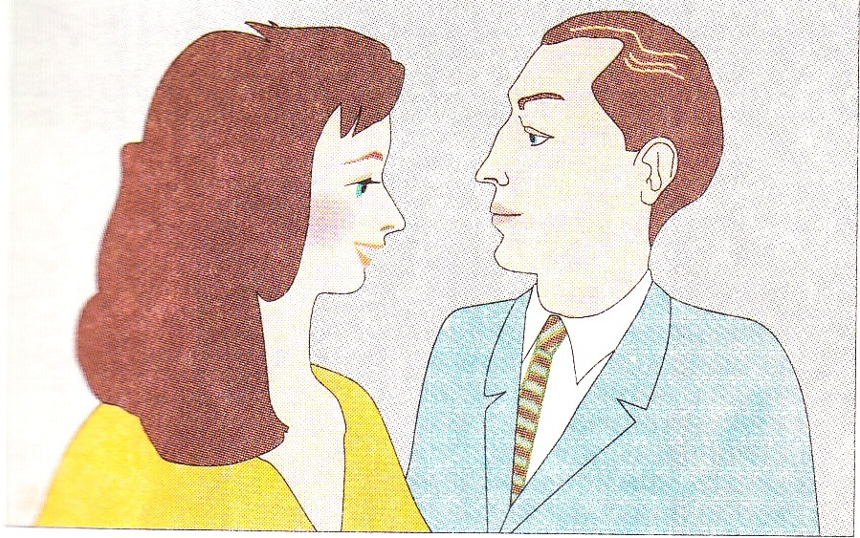
mother
father

Slide 8
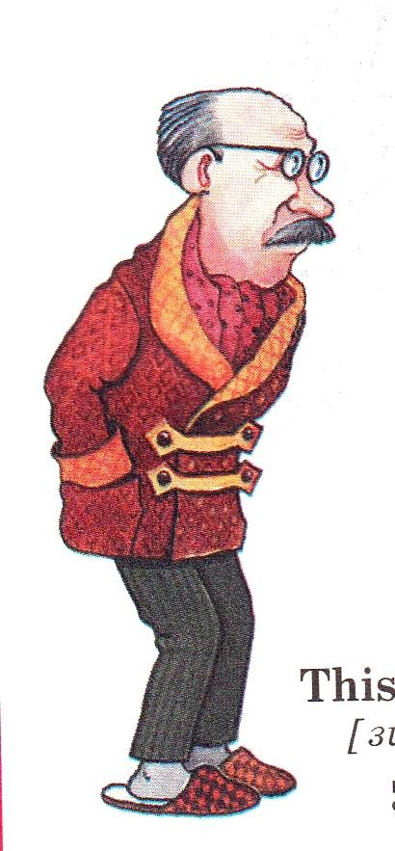
grandfather

Slide 9
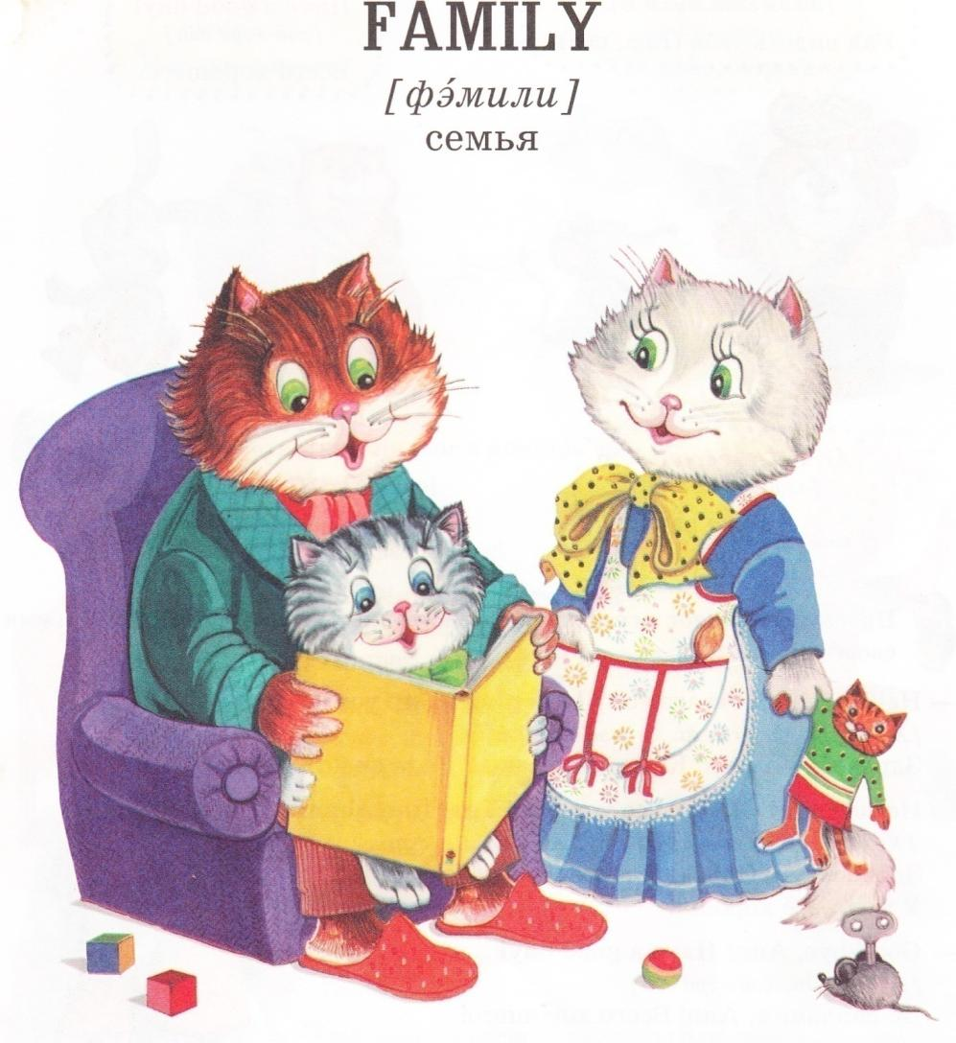

Slide 10
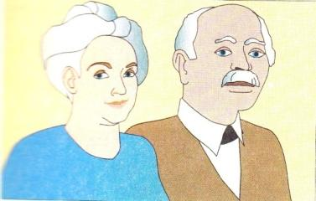
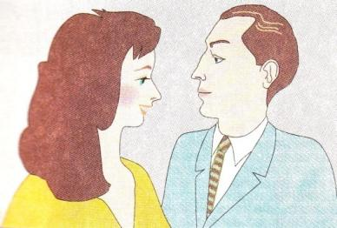
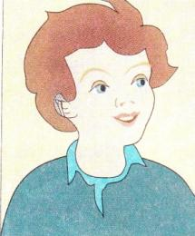
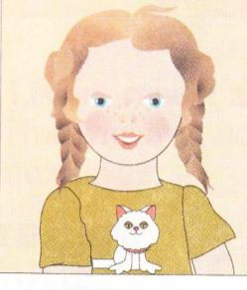
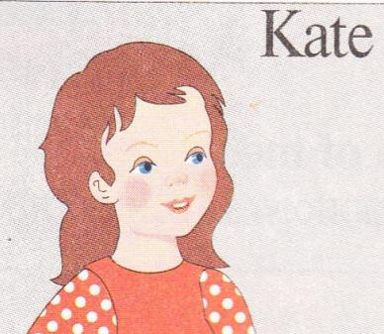
Name the members of the family
grandmother
grandfather
mother
father
brother
sister

Slide 11
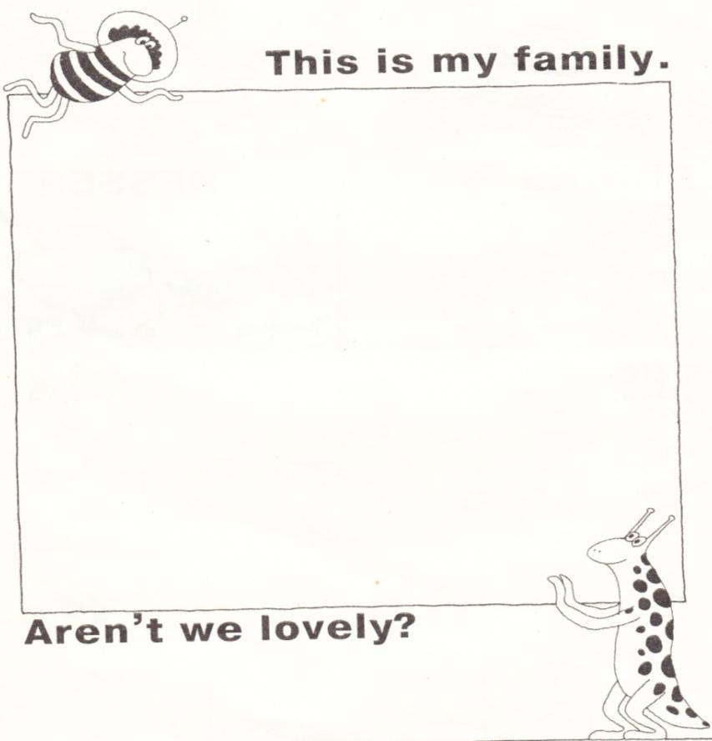
Count the members of the family
4
1
5
2
6
3
7

Slide 12
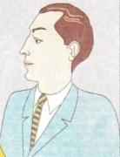
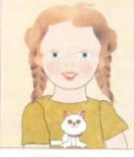
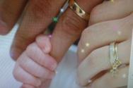
I have got a mother,
I have got a father,
I have got a sister,
I have got a brother
Mother and father,
Sister and brother
Hand in hand
With one another.

Slide 13
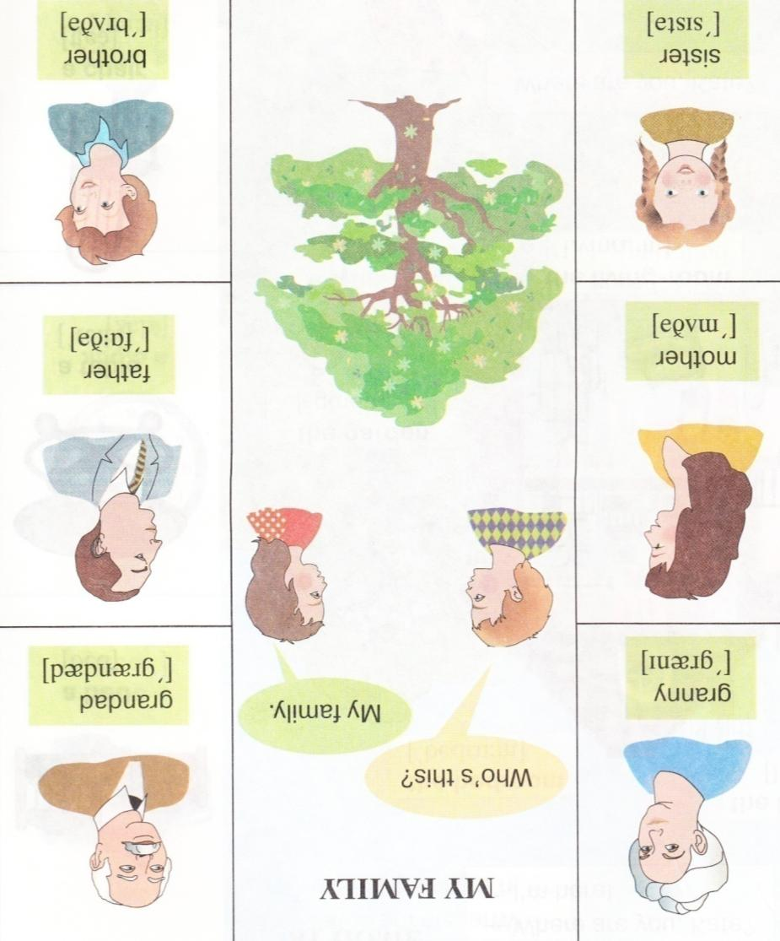
MY FAMILY

Slide 14
F f

Slide 15
F F F F F F F f f f f f f f
Family family
I have got a family
+
=
four
one
five

Slide 16
Flower,
“I’m fine”

