Slide 1
Do you have the same hobby?
Hobbies are fun things, which you can do. They sure can wile away the time for you. A treasure hunt looking for that special find, Finish of a set or take you back in time. It's exciting to add to your collection, Praise you receive for beautiful confection. Collecting stamps, crosses and poetry I write. I find hobbies can really enrich your life, Build self-esteem and add to conversation. A hobby just may bring you elation. Copyright by Jean E. Gorney

Slide 2
Twice happier the man who has a hobby.

Slide 3
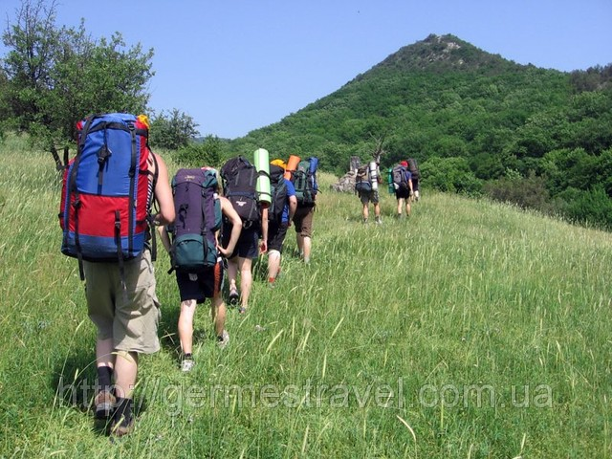

Slide 4
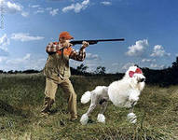

Slide 5
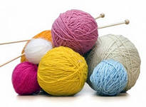

Slide 6
the rules for work in groups
1. silent
2. all pupils should work
3. listen opinions of all

Slide 7
Using the plan:
People like…
People can…
This hobby helps…
Example: They can play football or hockey, swim or run very well. People like to go to the stadium or to the swimming pool or to the sportsground. This hobby helps keep fit. What hobby is it? (IT is sport)

Slide 8
Fill in the blank:
G _ _ DENING
DAN _ ING
R _ _ DING
SP_ _ T
H _ _SERIDING
COLL_CT_NG POSTC _ _D
TH _ _TRE
CO _ _ ECTING
_ IN _ MA
SWI_ _MING
KN_TTING
HU_TING

Slide 9
HOBBY
AMUSING USEFUL
LEARN CREATE ACT
IT’S NOT A WASTE OF TIME!
ENJOYMENT

Slide 10
Your home task: talk about your hobby using plan on p. 171

Slide 11
SLIDE 2
Today we are:
1. to speak about hobbies in our life;
2. to learn about some hobbies in English – speaking countries;
3. to practice in spelling “hobby” words;
4. to develop our computer skills.

Slide 12
SLIDE 3

Slide 13
Spell all the “hobby” words correctly.
G_ _ DENING
R _ GBY
DAN _ ING
R _ _ DING
SP _ _ TS
H _ _SERIDING
CO _ LECTING
POSTC _ _ D
TH _ _ TRE
TR _VEL _ LING
_ INEMA
SWIM _ ING
PA _ NTING
JO _ GING
FI _ _ ING

Slide 14
Thank you!

