Slide 1
Let’s go shopping

Slide 2
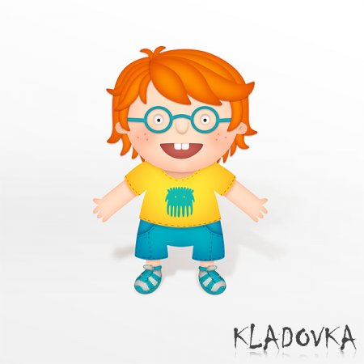
Прочитайте, что говорит мальчик и переведите подчеркнутые слова.
I have got a T-shirt, shorts and sandals on. My T-shirt is yellow. The shorts and sandals are blue.

Slide 3
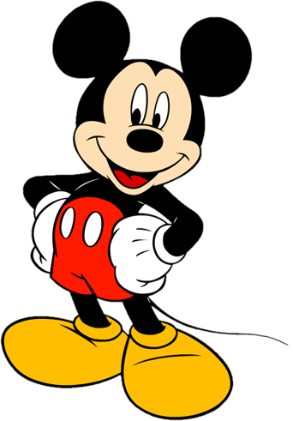
Заполните пропуски нужными словами.
You know me! I am Mickey Mouse. I wear red _______ with white _______ and yellow ________.

Slide 4
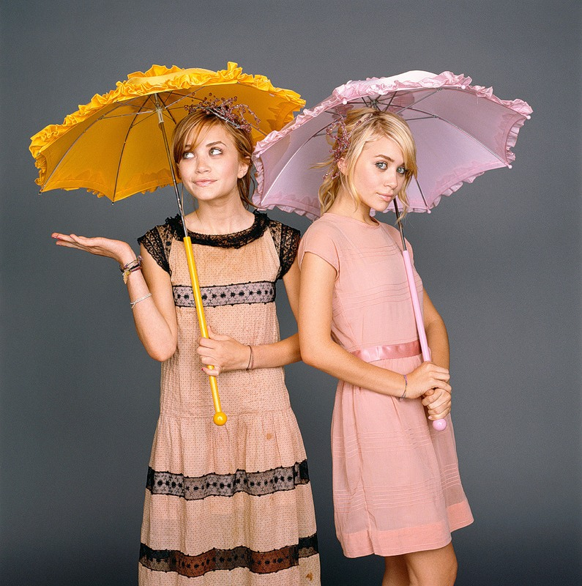
Прочитайте слова Мэри и скажите, где на фото Мэри, а где её сестра Эшли.
We are sisters. We are twins. We have got pink dresses on and umbrellas. My umbrella is pink and my Ashley’s one is orange.

Slide 5
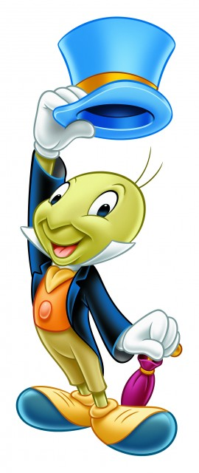
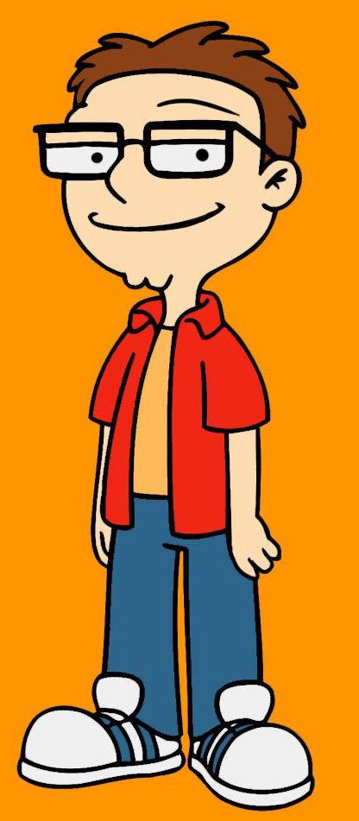
I am a cricket. I wear ….
I am a man.I wear ….
a red shirt, an orange T-shirt, blue trousers and white trainers.
a blue jacket, an orange shirt, green trousers, a blue hat and blue and yellow boots.

Slide 6
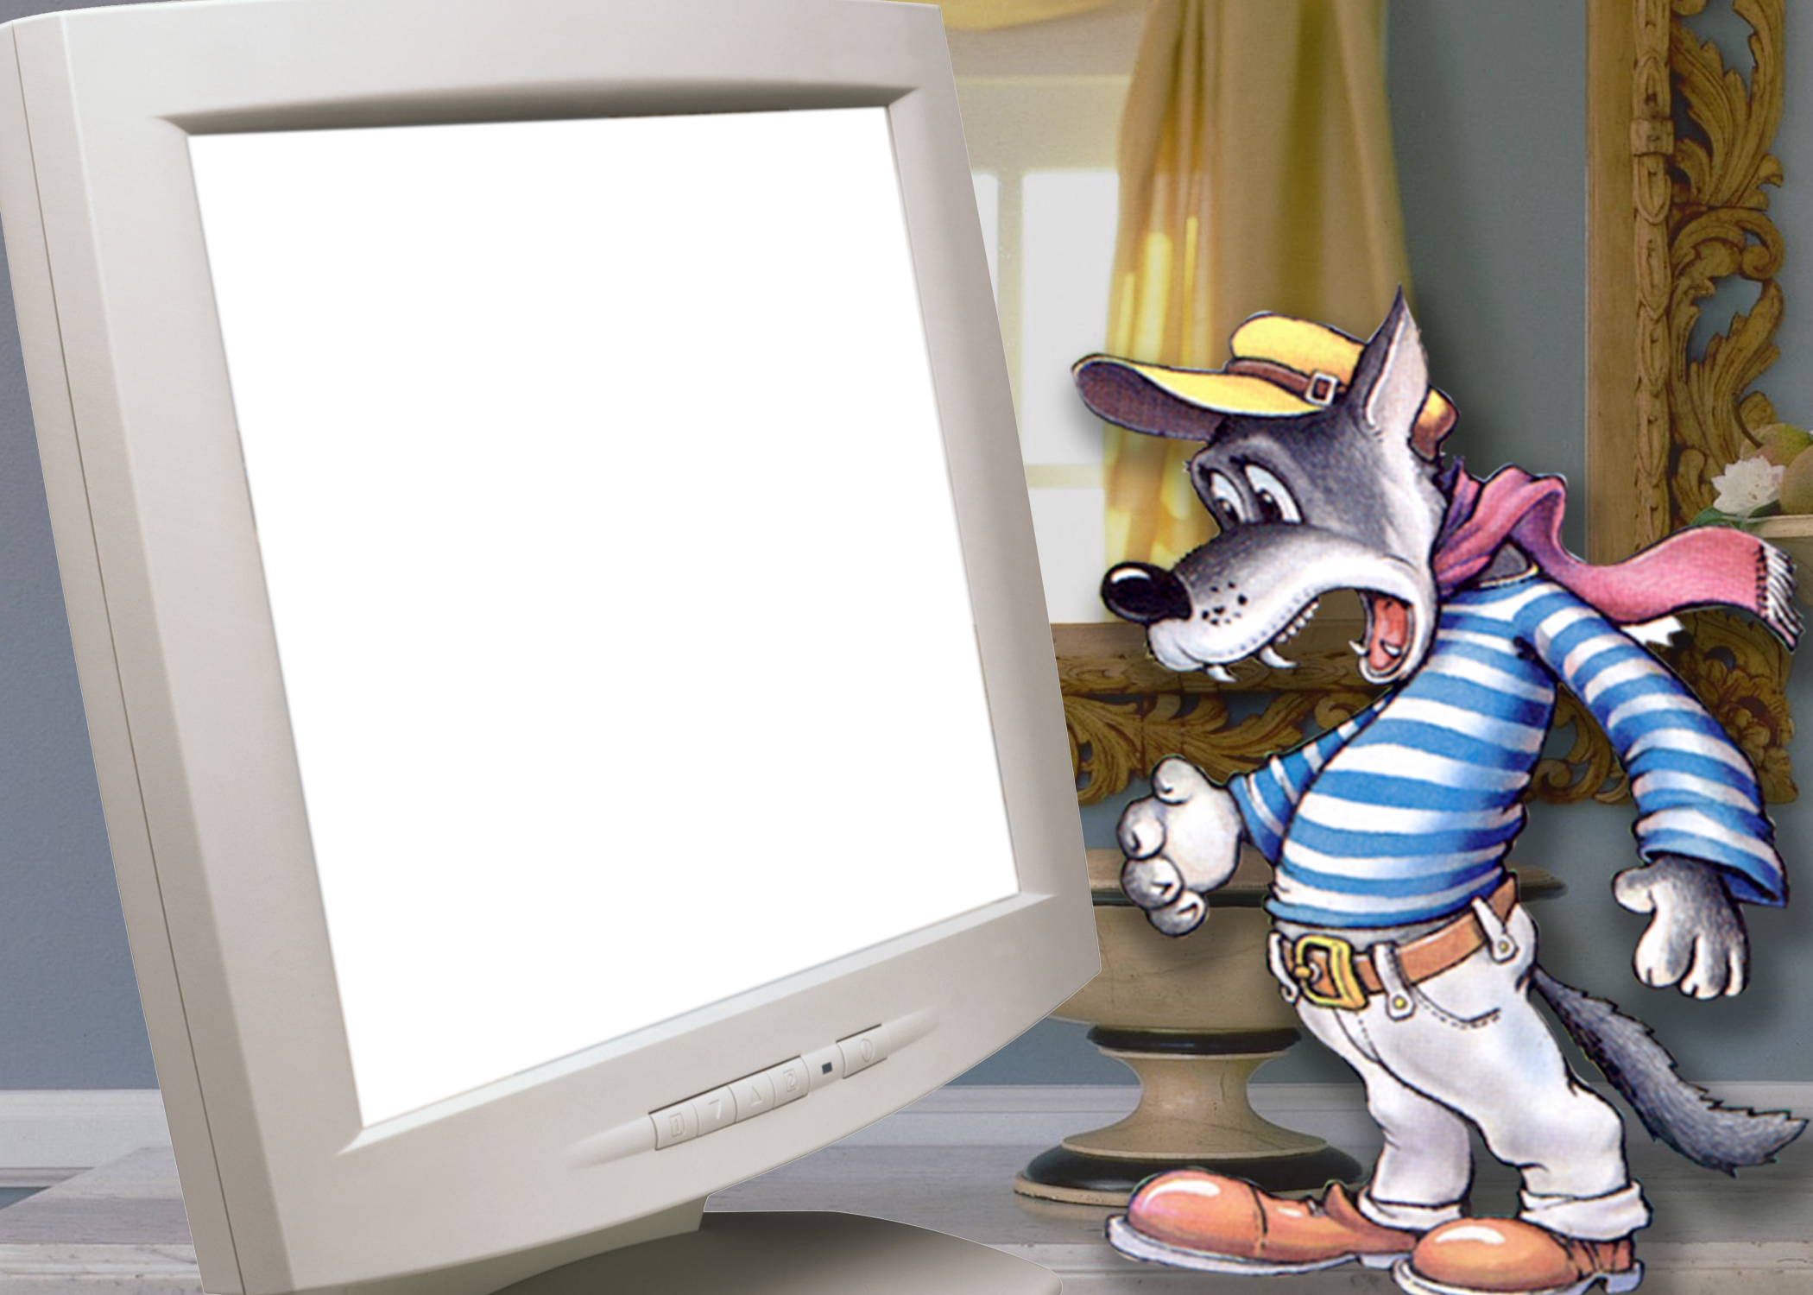
I am Wolf. I forget words. What have I got on?
You have got … on.

Slide 7
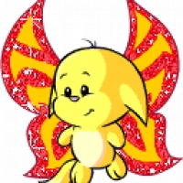
I am Crisly. It’s winter and it’s cold. Help me to buy clothes.
Buy …

Slide 8
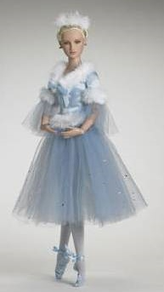
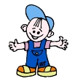
Расскажите о том, кто вам понравился.
He (she) wears …
I am Pechkin the postman.
I am Barbi.
I am Jack the boy.

