Slide 1

Алфавит в стихах
Белобородова Светлана Валентиновна
учитель английского языка
ГБОУ СОШ № 327 Невского района г. С-Петербург

Slide 2
Презентация сделана по учебнику
ENJOY ENGLISH
2 класс
М.З.Биболетовой и др.

Slide 3
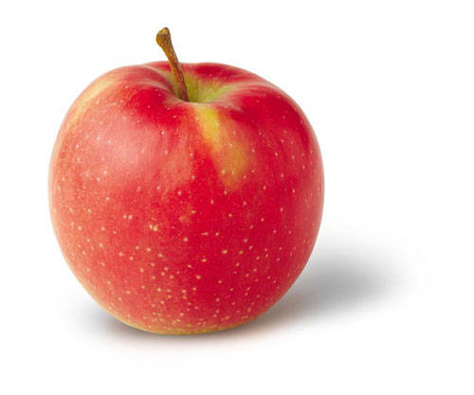
LETTER Aa
Apples here, apples there,
Apples, apples everywhere!

Slide 4

LETTER Bb
Bounce! Bounce! It is my ball!
It doesn’t want to stop at all.

Slide 5
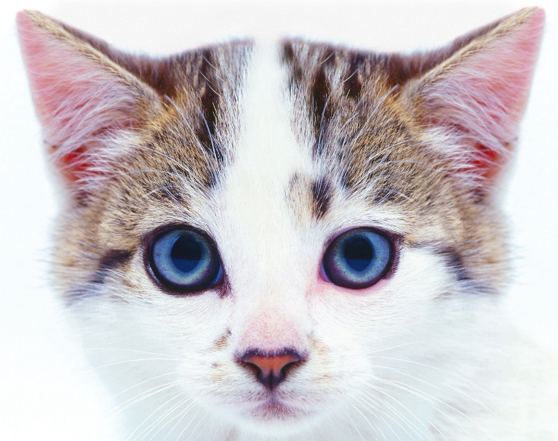
LETTER Cc
I am the cat.
My name is Hat.
I am not fat.
I like to chat!

Slide 6
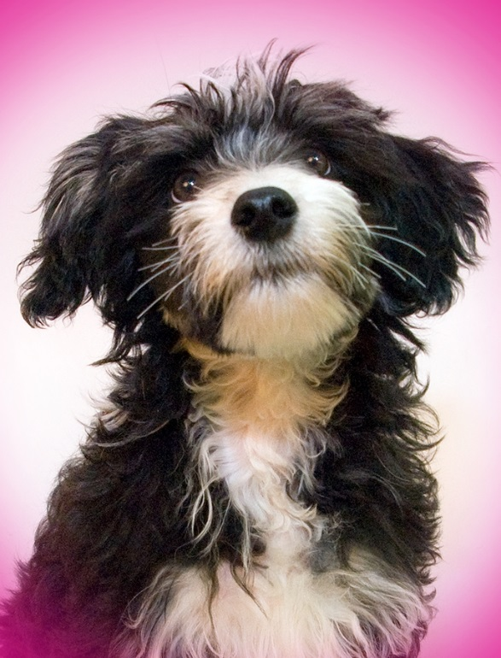
LETTER Dd
I am the dog.
My name is Jack.
My coat is white,
My nose is black.

Slide 7

LETTER Ee
Little yellow bee, bee, bee!
How many flowers can you see?

Slide 8
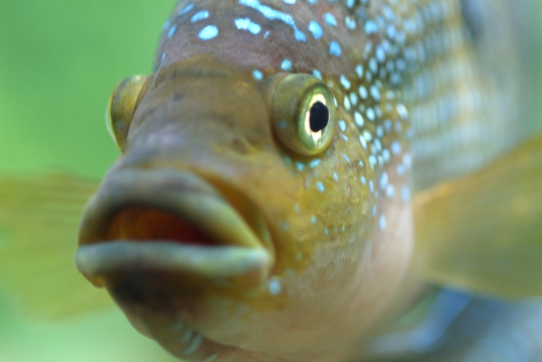
LETTER Ff
One, two, three, and four and five!
I have got a fish alive!

Slide 9
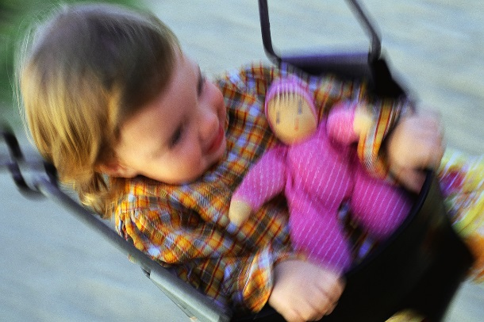
LETTER Gg
I am a girl.
I’ve got a doll.
Her name is May!
We like to play.

Slide 10
LETTER Hh
Little mouse, little mouse!
Where is your house?
I am a poor mouse,
I have no house.

Slide 11

LETTER Ii
Spring is coming!
Warm and nice!
Ice is melting!
Poor ice!

Slide 12
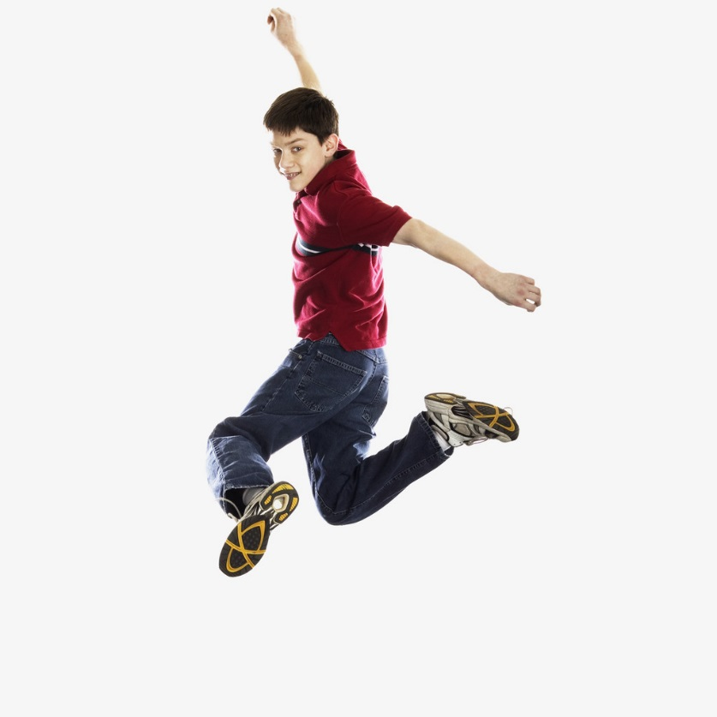
LETTER Jj
Merry Jimmy Jinn
is jumping
in his jeans.

Slide 13
LETTER Kk
The king is strong.
The king is brave.
What is his name?
He is Nick Grey.

Slide 14
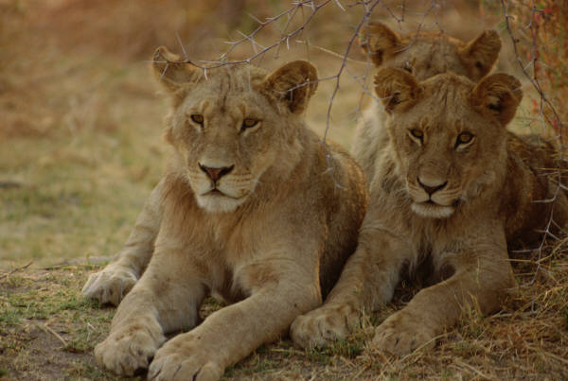
LETTER Ll
Who lives in Africa?
He, she or me?
One lion,
two lions,
three…

Slide 15
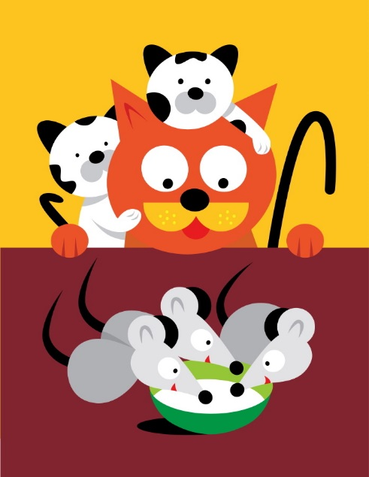
LETTER Mm
Little mice, little mice!
Would you like a piece of ice?
We would like a piece of cheese.
Yes, please!

Slide 16
LETTER Nn
How much is one plus one?
Two big nuts for little son.

Slide 17

LETTER Oo
“Tick-Tock! Tick-Tock!
Play and walk,” says the clock!

Slide 18
LETTER Pp
I’ve got a pet.
My pet is a pig.
His name is Pick.
He is not big.

Slide 19
LETTER Qq
Mary the Queen
Can dance and sing.

Slide 20
LETTER Rr
One, two, three!
One, two, three!
Nice red roses you can see!

Slide 21
LETTER Ss
Oh, Mary! Come and see!
A big snake is in the tree.

Slide 22
LETTER Tt
Where is Tricky?
Where is he?
He is under the table.
Oh, I see.

Slide 23

LETTER Uu
I’ve got a flower above my head.
Blue and yellow, green and red.
(an umbrella)

Slide 24
LETTER Vv
Can you dance?
Can you sing?
I can play the violin.

Slide 25
LETTER Ww
Tim is slim. Tim is tall.
He can sit on the wall.

Slide 26

LETTER Xx
I see two funny foxes
With two small boxes.

Slide 27
LETTER Yy
Fly! Fly! In the sky!
My nice and funny kite!

Slide 28
LETTER Zz
We go, we go, we go to the zoo!
We can see a tiger and a zebra too.

Slide 29
Картинки взяты из интернета:
Клипы Office.com

