Slide 1
Viktor Vasnetsov (1848-1926)

Slide 2
His family house in a small village near Vyatka.

Slide 3
The Academy of Arts in St.Petersburg.

Slide 4
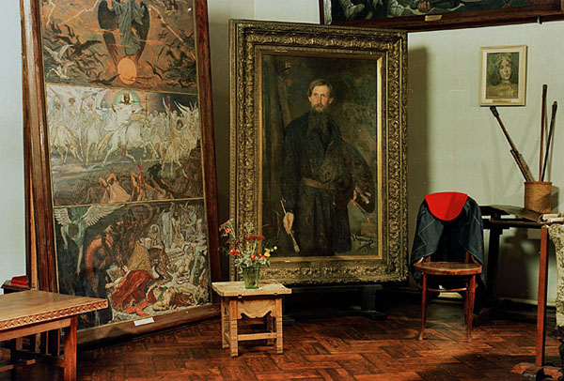
Vasnetsov’s house in Moskow.

Slide 5
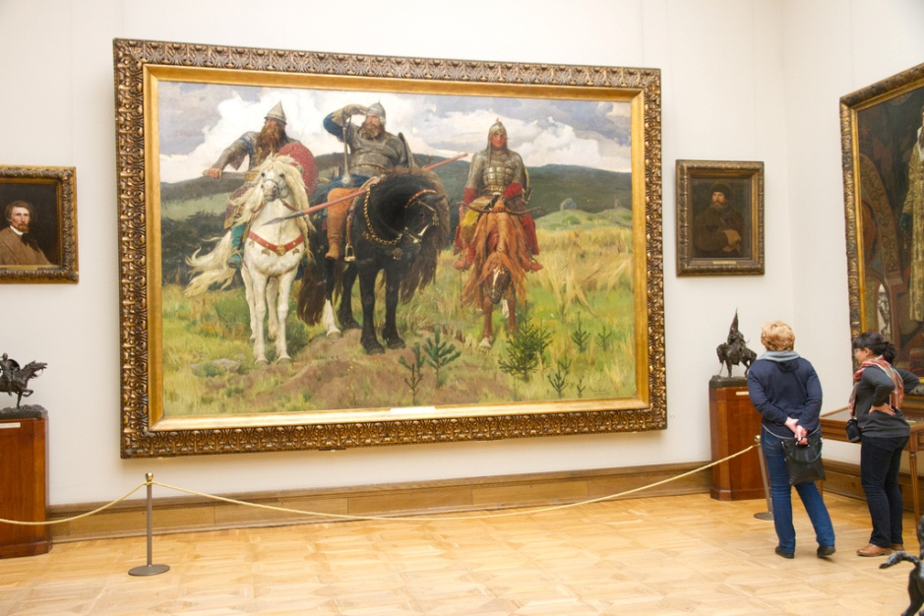
The Tretyakov Art Gallery in Moskow.

Slide 6
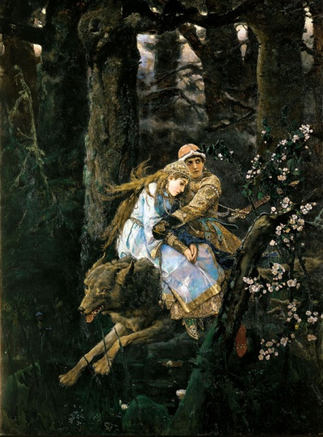
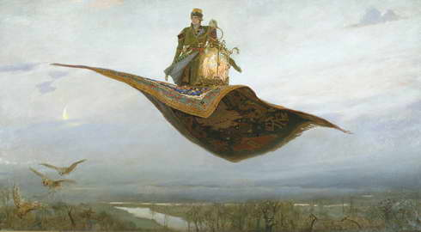
What are the names of these pictures?

Slide 7
Match the date and the event.
1848 – he visited France
1867- he was born
1877- he died
1885- he moved to St.Peterrsburg
1926 – he visited Italy

