Slide 1
CHRISTMAS JOKE
Рождественская шутка

Slide 2
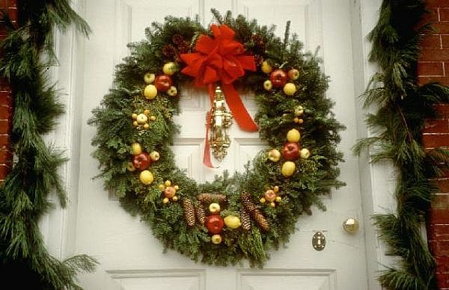
Nock-nock!

Slide 3
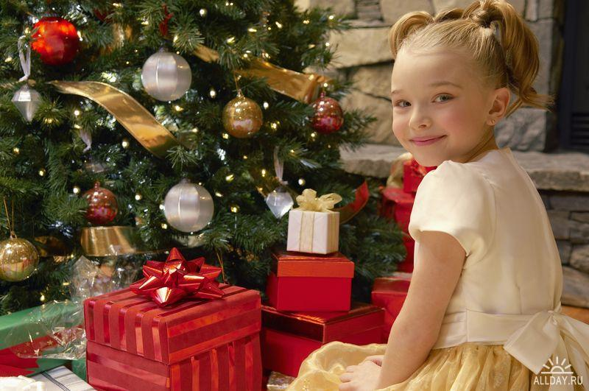
Who is there?

Slide 4
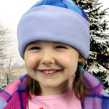
Mary.

Slide 5
What Mary?

Slide 6
Merry Christmas

