Slide 1
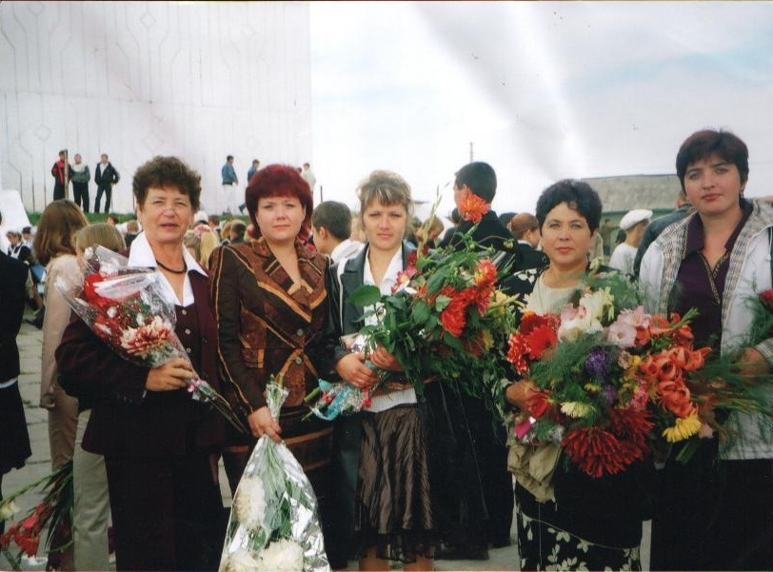
Рыжова Ольга Александровна
Учитель английского языка в МОУ ИРМО «Оёкская средняя общебразовательная школа»
I квалификационная категория

Slide 2
Использование технологии проектирования на среднем этапе обучения английскому языку
Цель:
Повышение мотивации учащихся 7-9 классов в обучении английскому языку
Задачи:
1. Изучение теоретического материала
2. Подбор материала по интересующим темам c использованием УМК Кауфман К.И. Happy English.ru
3. Создание и защита проектов по заданным темам
4. Использование проектов в учебной и внеурочной деятельностях, на конференциях, в конкурсах…

Slide 3
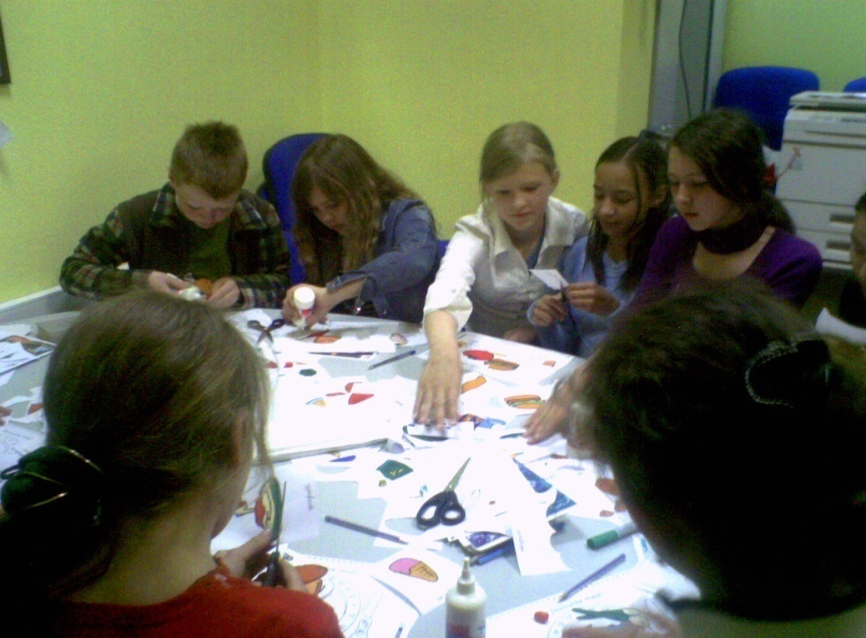
Темы проектов в 9 классе
На уроках
Внеурочные
Visiting New York
Start a film review club
Youth subcultures
Differences between BE and AE
Your fashion preferences
Your healthy lifestyle
The letter to Santa Claus

Slide 4
Типы проектов
Исследовательский проект
Информационный проект
Прикладной (практико-ориентированный) проект
Творческий проект
Ролевые, игровые, приключенческие проекты
По предметно-содержательной области
Монопредметный проект
Межпредметный проект
Надпредметный проект

Slide 5
Проекты в виде
Презентации Power Point
Брошюры, раскладушки
На листах формата А4, А3
Видеофильмы

Slide 6
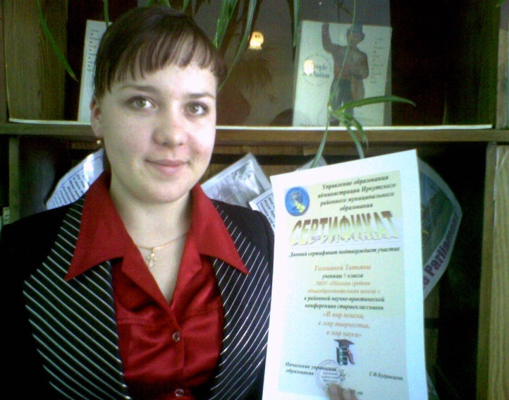
Практическая реализация
Дальнейшее использование проектов в урочной и внеурочной деятельности
Выступления на НПК
Письмо Санте – nic-snail.ru
Личные письма - Rosetta Stone LTD. 135 West Market Street, Harrisonburg VA 22801, USA
www.sharedtalk.com

Slide 7
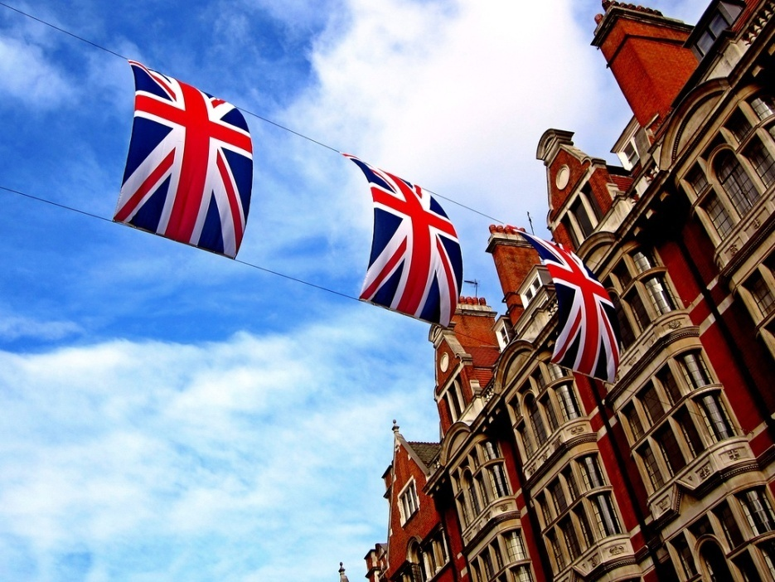
The differences between British English and American English Bortnevskaya Yuliya

Slide 8
Aim:
Find the connection and differences between American and British English, consider the characteristics of each variant of the language and to identify options for the use of languages ​​in the literature of foreign authors.

Slide 9
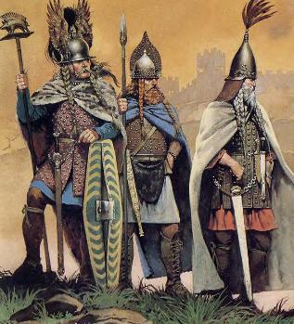
The history of British language

Slide 10
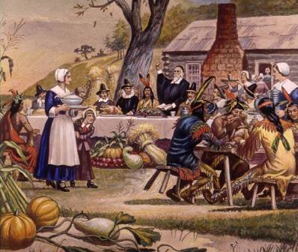
The history of American language
In XVII-XVIII centuries in America (New World), the crowd surged immigrants represented the French, Spanish, German, Dutch, Norwegian and even Russian. But most of them were from England (the British Isles as a whole, this is Scotland, and Wales), where it was said in English

Slide 11
Differences in spelling
SAE | SBE
color | colour
center | centre
сheck (noun) | cheque (noun)
defense / license / practise | defence / licence / practice
all right | alright
maneuver | manoeuvre
tire | tyre
aging | ageing
whiskey (U.S. & Ireland) | whisky (Scottish)

Slide 12
Differences in vocabulary
Британский | Американский
flat lawyer luggage milliard cab company city/town centre chemist's lift autumn petrol motorway cross-roads living room coach post cinema trousers sleeper railway shop-assistant | apartment attorney baggage billion taxi corporation downtown drugstore elevator fall gas highway intersection drawing room long-distance bus mail movies pants Pullman railroad saleman, clerk

Slide 13
Differences in punctuation
SAE | SBE
Date writing, number/word order. (Never use only numbers!)
month/day/year 12/03/03 December 3, 2003 | day/month/year 12/03/03 March 12, 2003
Use of commas and periods inside/outside quotation marks.
He said, "I love you." | He said, 'I love you'.
Business letter salutations, colons vs commas.
Dear Mr. Jones: | Dear Mr Jones,
'Honorifics': Mr. or Mrs. or Dr. Smith (U.S.) vs Mr or Mrs or Dr Smith (GB), etc.
Mr. Smith Mrs. Brown Dr. Wolf | Mr Smith Mrs Brown Dr Wolf

Slide 14
Differences in grammar
SAE | SBE
The Government is acting like itself again. | The Government are acting like themselves again.
We lived on Main Street. | We lived in the High Street. (cf. 'street people' ...)
I didn't tell him about my new job yet. | I haven't told him about my new job yet.
He's in the hospital with a broken leg. | He's in hospital with a broken leg.
I'm hungry. I gonna have lunch. | I'm hungry. I am going to have lunch.

Slide 15
Differences in phonetics
Word | SAE Pronunciation | SBE Pronunciation
advertisement | 'æd vз:r ta z mənt | əd'vз: t smənt
controversy | 'ka:n trə vз:r si | 'k n trə vз: si kən'tr v əsi
laboratory | 'læb rə t r i | lə'b r ə tri
secretary | 'sek rə ter i | 'sek rə tri
leisure | 'le ər | 'le ə
schedule | 'sked ju:l | ' ed ju:l
dynasty | 'da nə sti | 'd n ə sti
dance | dænts | da:nts
oregano | 'reg ə no | r 'ga: nə
clerk | klз:rk | kla:rk
ate | e t | et
ballet | bæ'lei | 'bæ lei

Slide 17
The use of these languages ​​in the literature as an example of an American author
J. London “White Fang” ” There is only six now”, he said. “You an` me a-sittin by the fire” “Takes more`n a handful of them pesky critters to do for yours”

Slide 19
The use of these languages ​​in the literature as an example of the British author
William Shakespeare “Hamlet” There`s, That`s, It`s, I`ll, We`ll, I`d, You`re ‘Ay , sir, to be honest, as this world goes, is to be one man picked out of ten thousand’ ‘My Lord, what do you read?’

Slide 20
Conclusion
In this study we examined the differences of British English and American English languages ​​and the application of these languages ​​in the literature. As a result, we found that more and more popular in our time is American English, as it is considered easier to remember. As for fiction writers of the United States, American English is fully preserved only in direct speech.
But this does not mean that the British version has ceased to apply. British English is the "language of kings." Beautiful, correct and concise.

Slide 21
Не забывайте про здоровьесберегающие технологии на уроках
Смена видов деятельности
Эмоциональные разрядки
Физминутки

Slide 22
Список литературы
Кауфман К.И. Английский язык. Happy English.ru: учебник для 9 класса общеобразовательных учреждений/ К.И. Кауфман, М.Ю. Кауфман. – Обнинск: Титул, 2008. – 272с.
Мюллер В.К. Новый англо-русский словарь 160 000 слов. 8-е издание/ К.В. Мюллер, В.Л. Дашевская. – М: Русский язык, 2001. – 880 с.
Полат Е.С. Новые педагогические и информационные технологии / Е.С.Полат - М: Просвещение, 2002. – 56с.

Slide 29
СПАСИБО ЗА ВНИМАНИЕ!

