Slide 1
Презентация по теме «Describing people»
Учитель английского языка
Атоян Л.М.

Slide 2
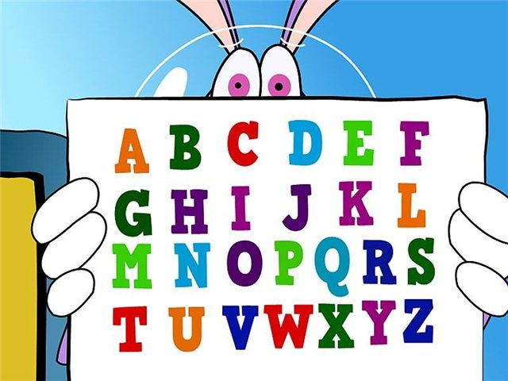

Slide 3
Фонетическая разминка
[ ]- cat, fat, hat, black, bat, has
[h] – has, hair, hen, have, hand
[e ] – pen, ten, desk, men, red, bed

Slide 4
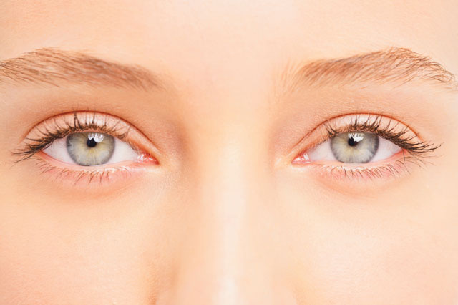
Eyes

Slide 5
Big eyes

Slide 6
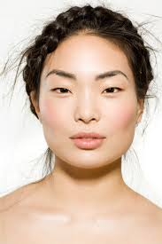
Small eyes

Slide 7
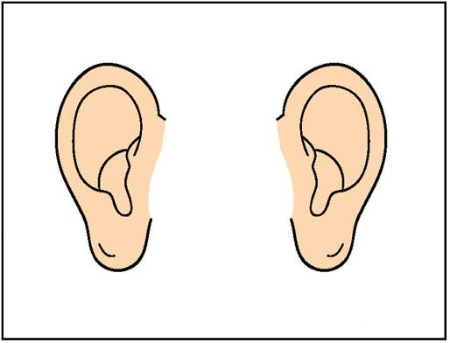
Ears

Slide 8
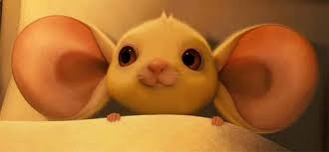
Big ears

Slide 9
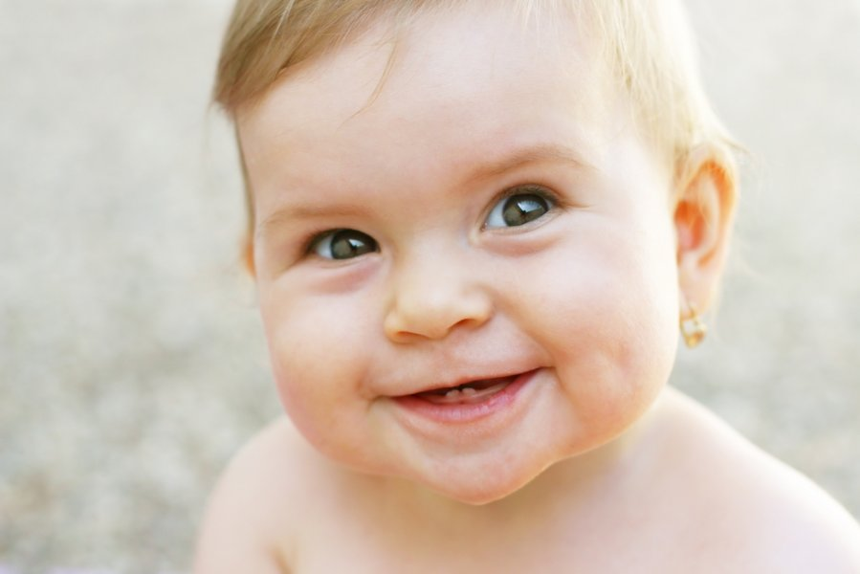
Small ears

Slide 10
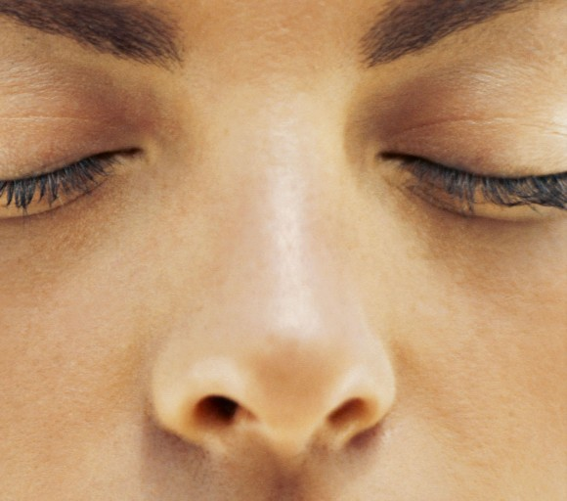
Nose

Slide 11
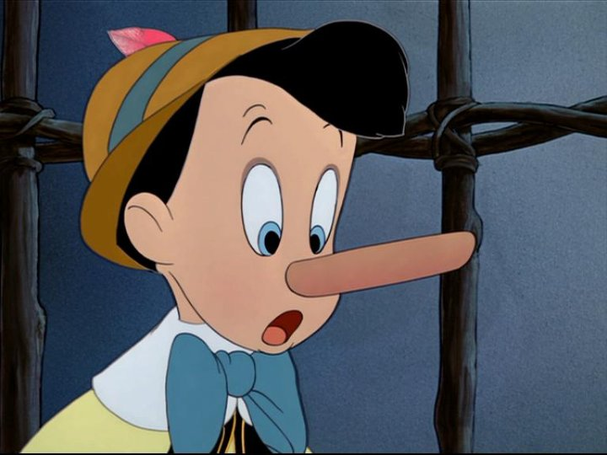
A big nose

Slide 12
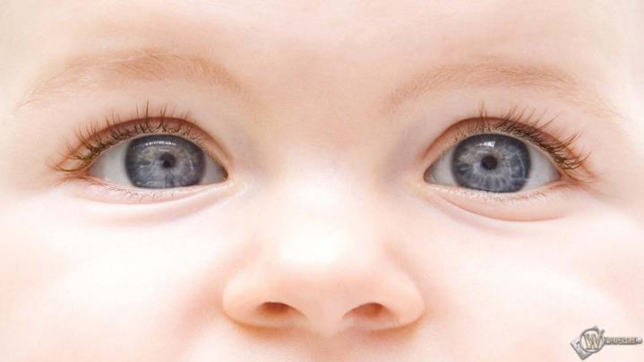
A small nose

Slide 13
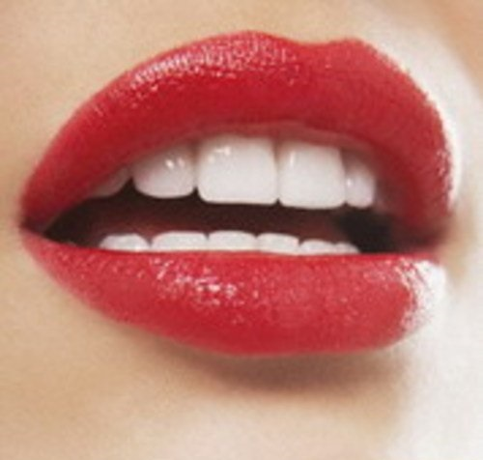
mouth

Slide 14
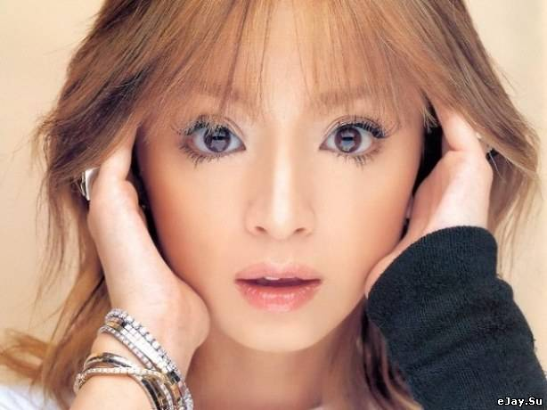
A small mouth

Slide 15
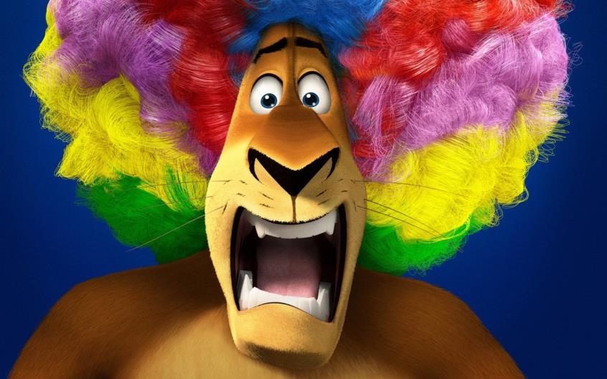
A big mouth

Slide 16
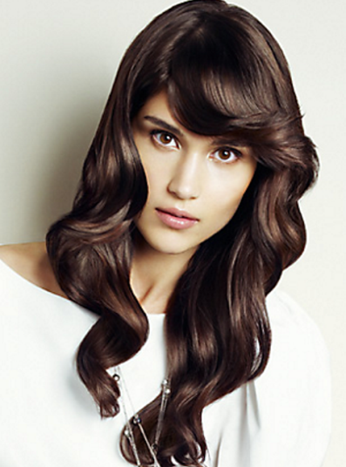
Dark Hair

Slide 17
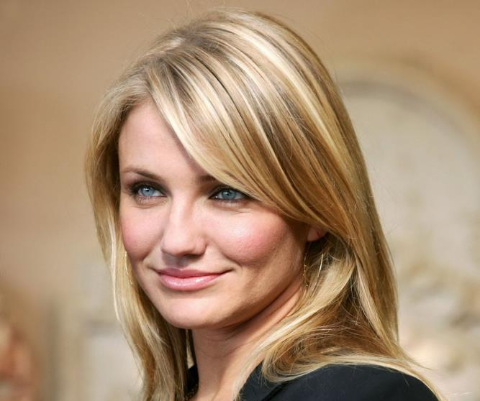
Fair hair

Slide 18
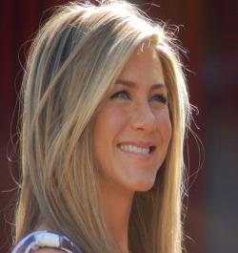
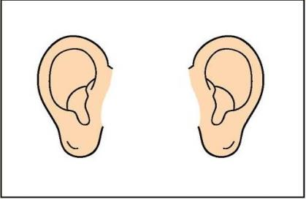
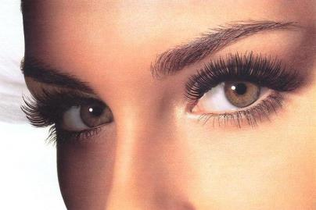
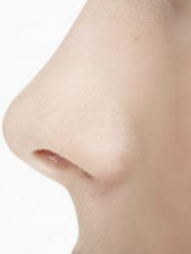
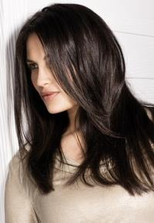
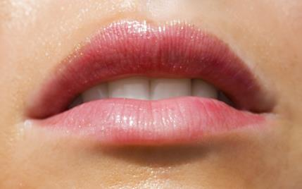
What is this?

Slide 19
Write down the missing letter
N_s_
E_rs
_ye_
M__th
D_ _ k h_ _r
F_ _ _ai_

Slide 20
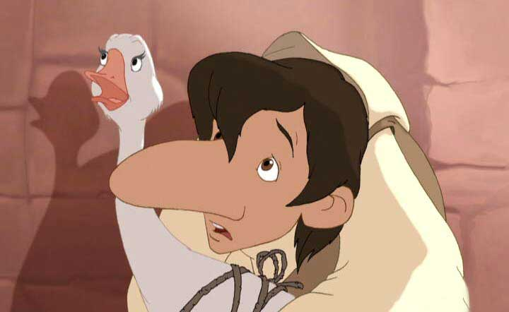

Slide 21
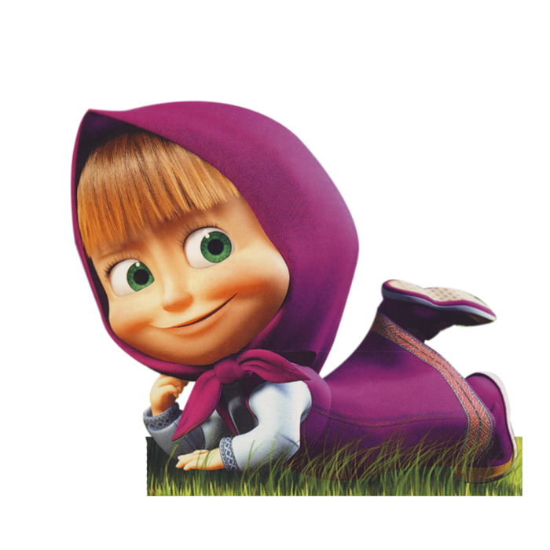
She has got

Slide 22
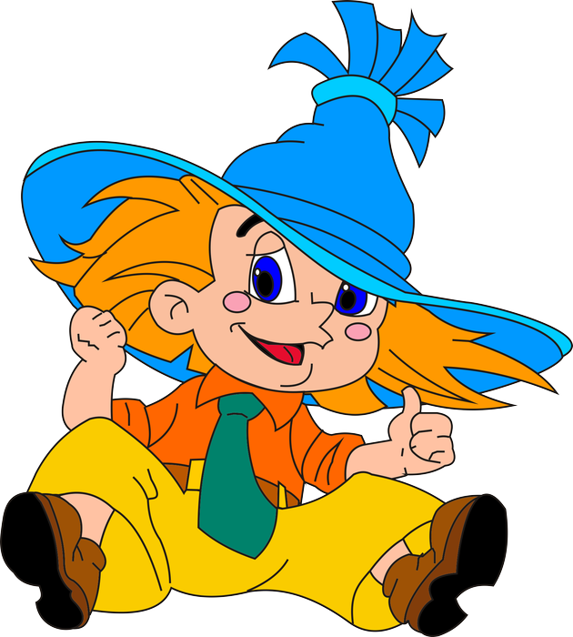
He has got

Slide 23
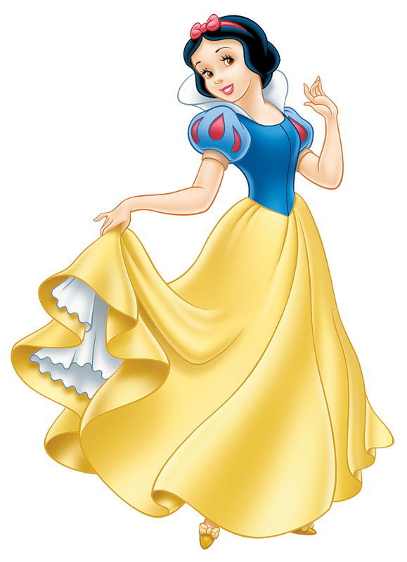
She has got

Slide 24
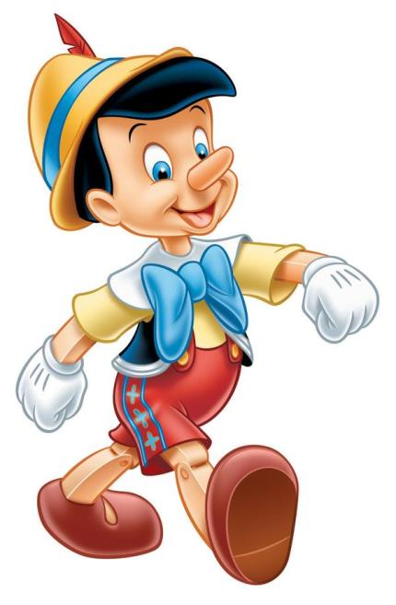
He has got

Slide 25
She has got

Slide 26
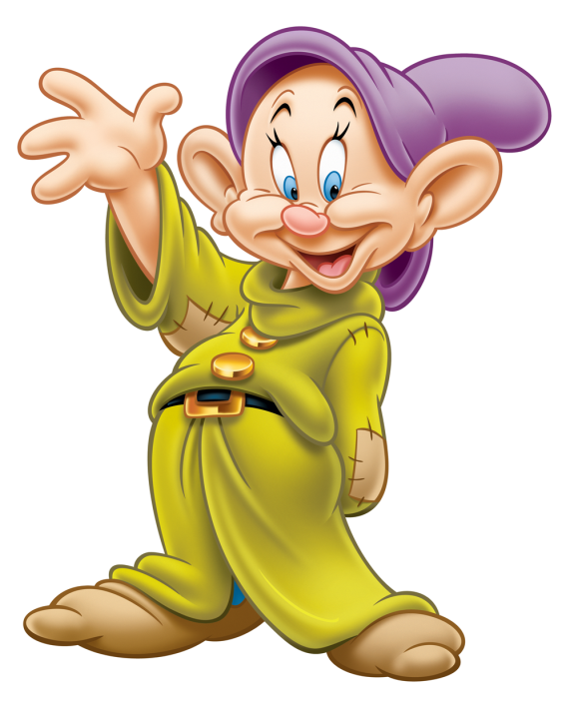
He has got

Slide 27
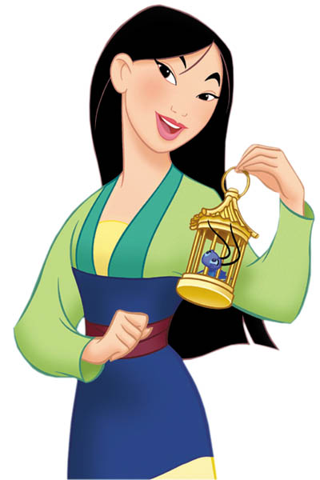
She has got

