Slide 1
Фонетическая зарядка на английском языке
МБОУ СОШ №2
Г.Городец Нижегородская область
Иванченко Елена Александровна

Slide 2
A Happy Day
We have a date to celebrate Which comes but once a year. And so today we'd like to say From all of us to you, "Happy birthday! Happy birthday! "Happy birthday to you!«
we have a date to celebrate —у нас есть дата, которую надо отметить

Slide 3
I have two eyes, And I can see A book and a pen In front of me. I see a window And a door. I see the ceiling And the floor.

Slide 4
[au]
"Little grey mouse, Where is your house?" "I live under the floor, My flat has no door".

Slide 5
[ ı ]
Dick’s stick is thick,
Nick’s stick is not so thick,
Pick’s stick is not so thick
As Nick’s stick and Dick’s stick.

Slide 6
[w]
Whether the weather be fine,
Or whether the weather be not,
Whether the weather be cold,
Or whether the weather be hot,
We'll weather the weather
Whatever the weather,
Whether we like it or not.

Slide 7
Звук [ j ], [ Ѳ ]
New things to learn,
New friends to meet,
New songs to sing,
New books to read,
New things to see,
New things to hear,
New things to do
In this happy New Year!

Slide 8
What Can You Do?
I can swim like a fish, I can run like a dog, I can jump like a frog, I can fly like a bird.
Why Can't I?
Can you tell me why I can run I can jump, But I cannot fly?

Slide 9
1. Why do you cry, Willy? Why do you cry? Why, Willy? Why, Willy? Why, Willy, why?
2. "Willy, Willy! Tell me true! Willy, Willy! Who are you?" "I am a little boy".

Slide 10
Звук [h]
We are happy brother pigs,
We are happy piggy-wigs,
We have time to jump and play,
We are happy all the day!

Slide 11
Звук [еı ]
Rain, rain, go away,
Come again another day,
Little Johnny wants to play,
Rain, rain, go away.

Slide 12
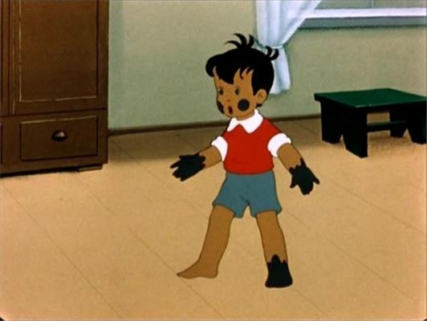
What are little boys made of, made of?
What are little boys made of, made of?
Frogs and snails, and puppy-dog’s tails,
That’s what little boys are made of.

Slide 13
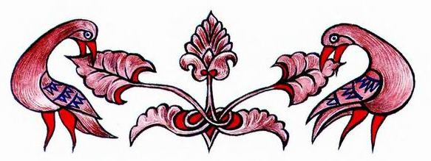
Without your tongue you can’t talk,
Without your feet you can’t walk,
Without your eyes you can’t see.
Without your heart you can’t be.

Slide 14
Звук [ υ ]
Pussy-cat, pussy-cat, where have you been?
I have been to London to look at the Queen.

Slide 15
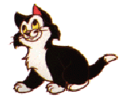
Звук [αυ]
Little mouse, little mouse,
Will you come out of your house?
Thank you, Pussy! Says the mouse.
I won’t leave my little house.

Slide 16
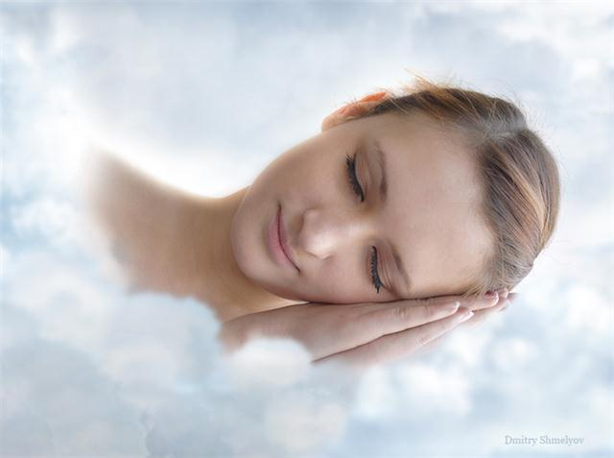
Звук [3:]
Early to bed,
Early to rise
Makes a man
Healthy, wealthy and wise.

Slide 17
Звук [ æ ]
The fat black cat ran after the black rat,
But the fat black rat ran away from the fat black cat.

Slide 18
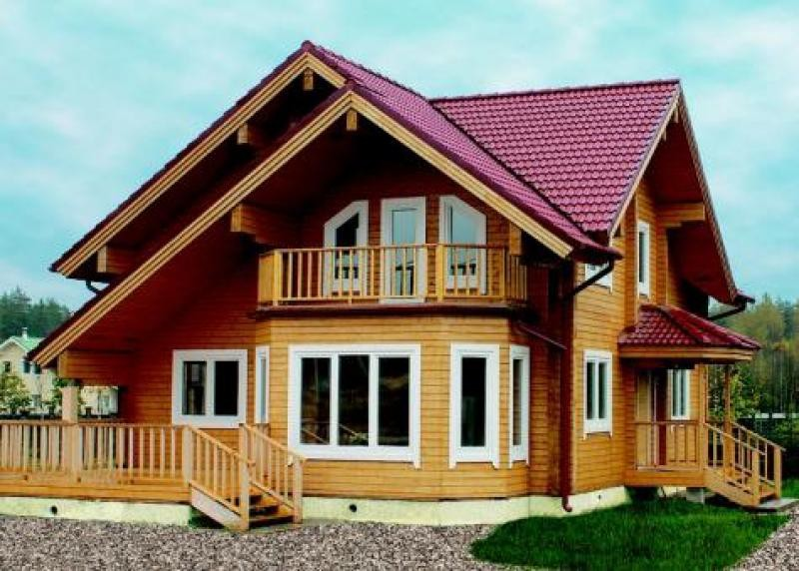
Звук [ ð ]
This is a ceiling,
This is a floor,
This is a window,
This is a door.

