Slide 1
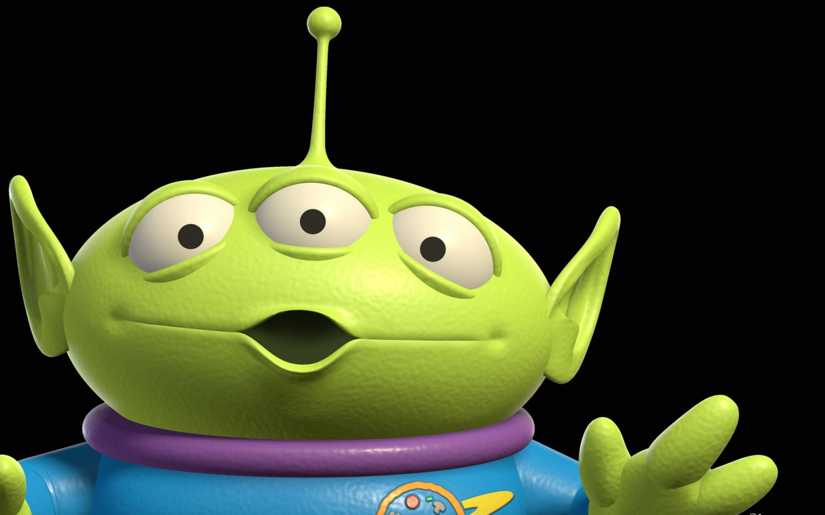
Hallo, I am Ufo!

Slide 2
His name is…
His birthday is on…
He is…
He has…

Slide 3
1) is, What, name, your?
2) are, How, old, you?
3) a, you, Are, student?
4) do, What, like, you, do, to?
5) you, Can, fly?

