Slide 1
Step41
Презентация подготовлена учителем МБОУ СОШ п. Солидарность Елецкого района Липецкой области Зуботаревой Еленой Николаевной
2015 г.

Slide 2
Good morning, good morning, good morning to you good morning, good morning, I am glad to see you.

Slide 3
Прочитайте и переведите
doll, tree, sun, frog, milk, granny, pig, hill, see, kid, wind, she, jug, bee, desk, pen, elf, bed, tеnt, dad, ten, meet, bell, mug, net, belt, he, I can, sweet, queen, quilt, car, star, door, park, farm, port, floor, horse, good, bad, sad, happy, funny, grandad, chimp, shop, it, match, cherry, chick, bench, ship, fish, dish, mum, shelf, sheep, how are you, where are you from, bye, tulip, they, student, hug, feed, be good, sit, sleep, stand up, kiss, name, plate, lake, plane, cake, game, rose, stone, bone, phone, boat, coat, cold, old, pupil, cute

Slide 4
Oo Uu [ɒ] [ǝᴜ] [ʌ] [ϳu] box rose mum tulip doll stone jump cute dog phone bus pupil 2) an old boat, a blue phone, a good student, a cute cat, a black tulip, a sad pupil

Slide 5
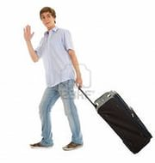
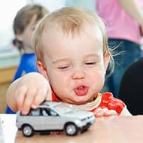
Прочитайте текст и ответьте на вопросы
Pedro and Mario are not from London. Pedro is from Madrid. Mario is from Rome. Pedro is big. He is a student. He is a good student. Mario is little. He is not a pupil. Little Mario is cute.
Is Pedro from Madrid?
Is Mario from London?
Are they pupils?
Are they from Paris ?
Is little Mario cute?
Is Pedro big?

Slide 6
Прочитай предложения и замени подчеркнутые слова местоимениями
Tim and Nicola are from Paris.
Jane and I are not happy.
Mark is a good student.
Bess is a queen.
Ann and I are not from Boston.
Ken and Don are not from Leeds.
Fred is not a pupil.
Kate is cute and funny.
I can see a tree.

Slide 7
Поработайте в парах ,узнайте ,откуда эти люди.
Образец: -Where is Nicola from?
- She is from Paris.
Jane – Leeds
Mario and Ann –Rome
Pedro – Madrid
Bill and Sam – Boston
Clara – Bonn
Mark and Jack – London
Polly – Moscow
Pete and Rose - Saratov

Slide 8
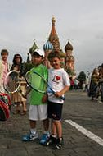
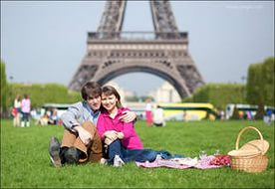
Вставь нужную форму глагола am/is/are
1)They ___ from Moscow, they__ from Paris.
2) Meggy Finn ___ a student. ___ she a good student?
3) I__ not a student, I __ a pupil.
4) We ___ from Moscow. Moscow__ big and green.
5) ___ you a cook?- No, I __ not.

Slide 9
Оцените себя
Выберите смайлик и назовите цвет по –английски.
Если вам все было понятно на уроке
Если вам почти все было понятно на уроке
Если вам было понятно совсем немного

Slide 10
Домашнее задание: Step 41, повторить слова (зачет)

