Slide 1
CLOTHES
[kləuðz]

Slide 2
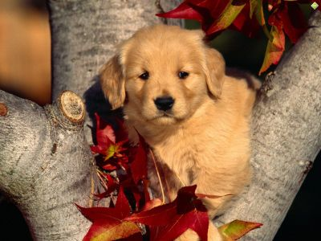
Seasons of the year

Slide 3
Days of the week
Sunday
Wednesday
Monday
Tuesday
Thursday
Friday
Saturday

Slide 4
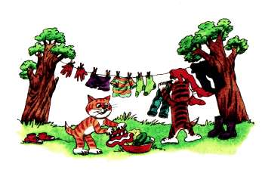

Slide 5
shorts [∫:ts]
dress [dres]
shirt [∫:t]
T-shirt ['ti:∫:t]
jeans [di:nz]
jacket ['dækıt]
coat [kət]
raincoat ['reınkət]
shoes [∫u:z]
boot [bu:t]
mitten ['mıtn]
scarf [ska:f]

Slide 6
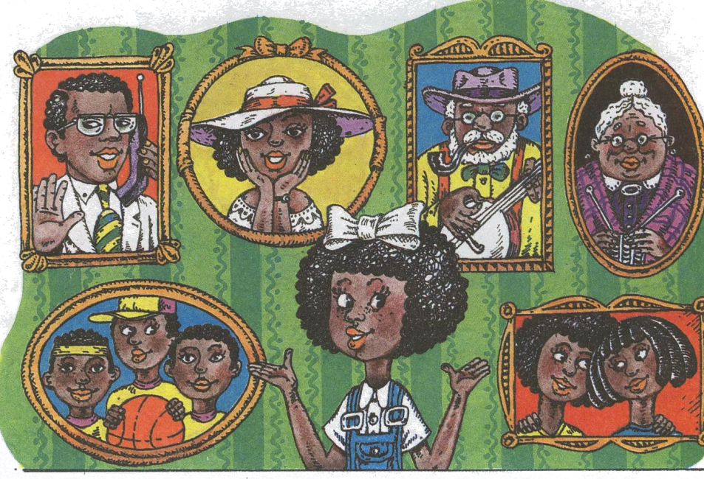
My family
Mother,
Father,
Sister,
Brother,
Grandfather,
Grandmother,
Daughter,
Son,
Aunt,
Uncle.

Slide 7
Физ. минутка
Hands up, hands down
Hands on hips
Sit down.
Hands to the sides
Bend left, bend right
Sit down.

Slide 8
Ex.1, p.72
Ex.2, p.72
Ex.3, p.73
Ex.4, p.73

Slide 9
Can I help you?
Here you are.
Anything else?
How much is it (are they)?
I`d like to…
No, that`s all.

Slide 10
Ex.6, p.74
E: Excuse me, can you show me the scarf?
A: Yes, please.
E: How much is it?
A: 5 pounds.
E: Here you are.
A: Thank you.

Slide 11
A: Can I help you?
E: Show me these mittens, please.
A: Here you are.
E: Oh, they aren`t warm!
A: Anything else?
E: No, that`s all.

Slide 13
Home task:
New words;
Ex. 1, p.81 (wr)

