Slide 1
Презентация к учебнику М.А. Гацкевич
The Kazan Cathedral
Учитель английского языка
ГОУ СОШ №180 г. Санкт-Петербург
Белоброва Е.Д.

Slide 2
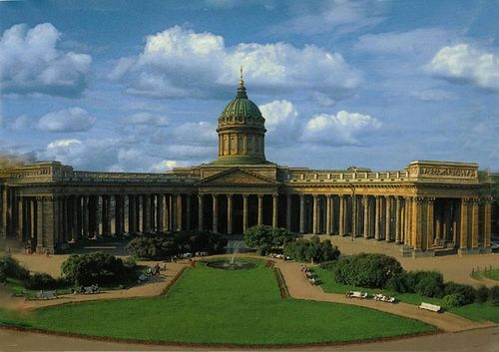
Was erected between 1801 and 1811 by the Russian architect Andrei Voronikhin.

Slide 3
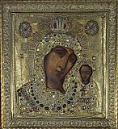
In honour of the icon
of the Kazan Virgin.
The Kazan Virgin was the Patroness of the defenders of the Motherland against enemies.

Slide 4
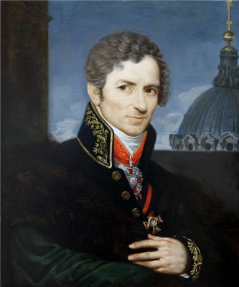
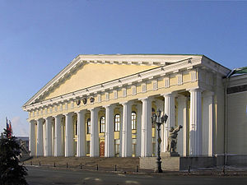
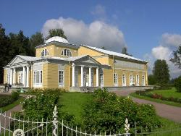
Mining cadet corps
The rose pavilion in Pavlovsk
Andrei Voronikhin

Slide 5
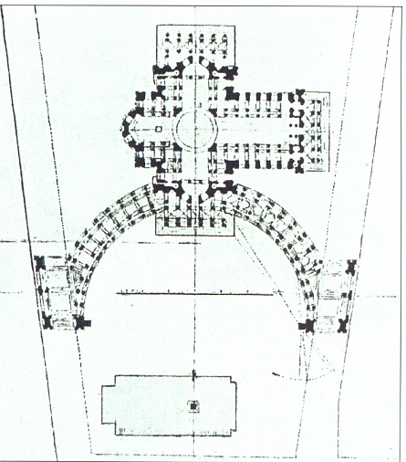
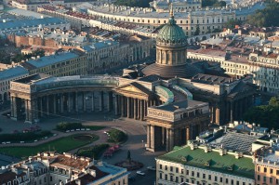
The cathedral overlooks
Nevsky Prospect
with its northern facade.
There are 96 thirteen-metre-high columns in the faсade of the cathedral.

Slide 6
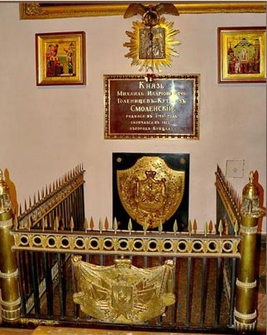
The Kazan Cathedral was
a monument to Russia’s victory
over Napoleon
in the Patriotic war of 1812.
The tomb of the great general Mikhail Kutuzov

Slide 7
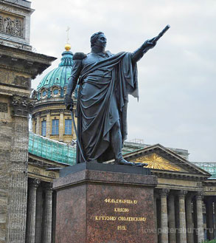
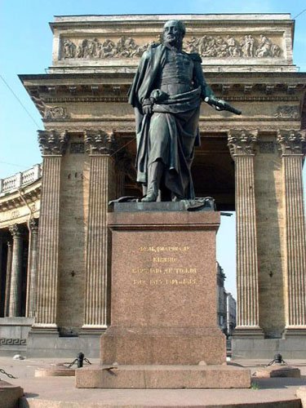
M.Kutuzov
M.Barklay-de-Tolli
Were the work of the sculptor Boris Orlovsky and the architect Vasily Stasov

Slide 8
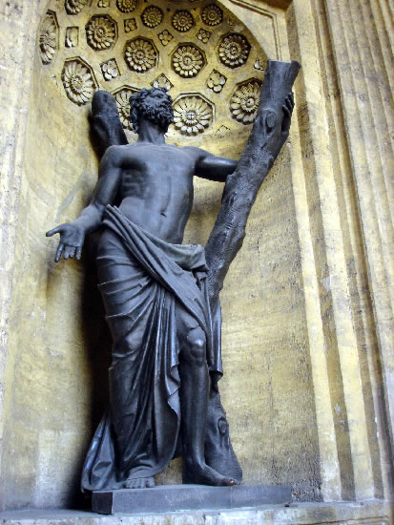
The sculpture of St.Andrew
Was created by the sculptor Vasily Demut-Malinovsky

Slide 9
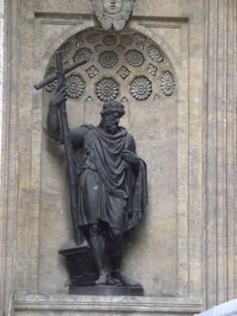
The sculpture of Prince Vladimir
Christianity was adopted in Russia
in the period of Prince Vladimir’s rule
in Kiev in approximately 988.
Was created by the sculptor Stepan Pimenov.

Slide 10
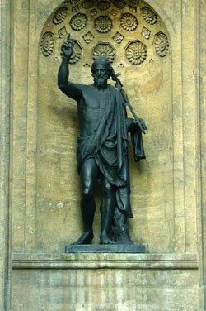
The sculpture of John the Baptist
Was created by the sculptor Ivan Martos.

Slide 11
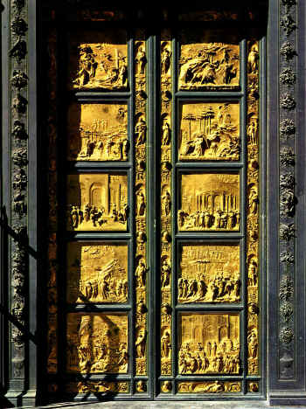
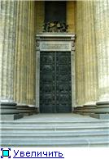
“The Paradise Doors”
The central entrance door
Were created in the middle
of the 15-th century
by the Italian sculptor Lorenzo Giberti.
Is an exact copy of the “Paradise Doors”

Slide 12
Использованные интернет-ресурсы.
http://www.pravoslavie.ru/sas/image/100415/41503.p.jpg
http://s39.radikal.ru/i086/1102/81/eab4c91e4bdb.jpg
http://turizm.lib.ru/img/n/nowak_anatolij_wladimirowich/sanct-petersburg/097-proektkazanskogosoborachertezh1838god.jpg
http://img-fotki.yandex.ru/get/4527/44617652.a8/0_67709_aa0b8cee_-1-L.jpg
http://spasskievorota.ru/thumb_pamatnik_kutuzovu_01.jpg
http://i017.radikal.ru/1003/10/55e80dc4cf8b.jpg
http://storage.futubra.com/source/82342.jpg
http://img135.imageshack.us/img135/9309/dscf9010.jpg
http://s56.radikal.ru/i151/1003/6b/fcc959a01360.jpg
http://upload.wikimedia.org/wikipedia/commons/thumb/3/32/Gorny.jpg/300px-Gorny.jpg
http://onlinereservations.ru/wp-content/uploads/2011/05/Kazan-Cathedral-300x199.jpg
http://www.piter-arch.ru/gallery/detales/557.jpg
http://www.gymnasium-meschede.de/projekte/projekt12-05/images/Baptisteriumtuer.jpg
http://i038.radikal.ru/0801/47/ec27dc48fffft.jpg

