Slide 1
St.Valentine’s Day

Slide 2
Adam John Lennon Napoleon Rose Onegin Natasha Romeo Lady Di
Juliet
Prince Charles
Yoko Ono Josephine Jack
Tatyana Pyer
Eva

Slide 3
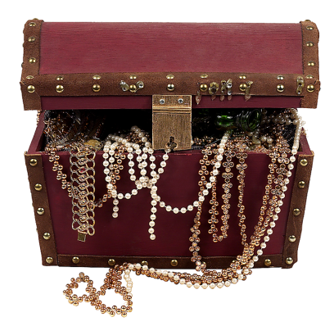
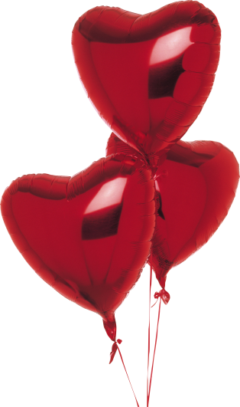
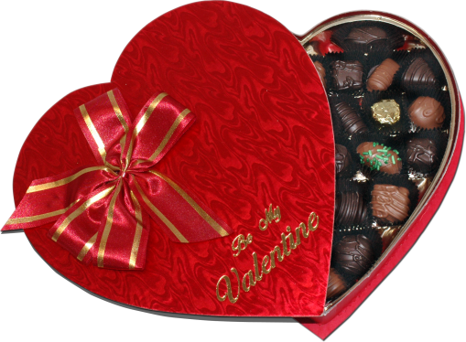
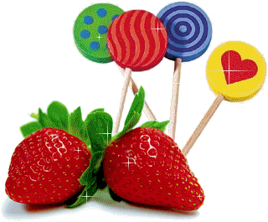
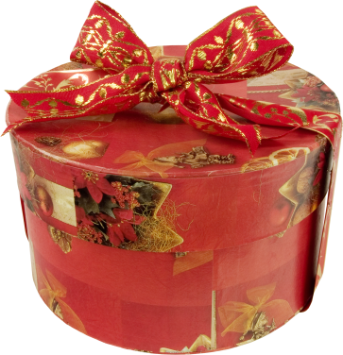
St.Valentine Symbols
Red roses & hearts
Chocolates & candy
Valentine Cards
Gifts
Toys
Jewelry

Slide 4
It is love that makes the word go round.
Love cannot be forced.
Love is blind as well as hatred.
Love will creep where it may not go.
Для любви нет преград.
Любовь побеждает все.
Любовь зла – полюбишь и козла.
Насильно мил не будешь.

Slide 5
I have a little valentine That someone sent to me It’s pink & white And red & blue, And pretty as can be. Forget – me – nots are on the edge, And tiny roses, too, and Such a lovely piece of lace, The very palest blue. And in the centre there is a heart. As red as red can be! And on it’s written All in gold, “To you, With Love, From Me.”

