Slide 1
It’s a traditional North American holiday.
Which is a form of harvest festival.

Slide 2
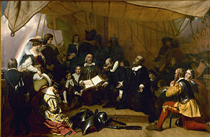
“Mayflower” 1620

Slide 3
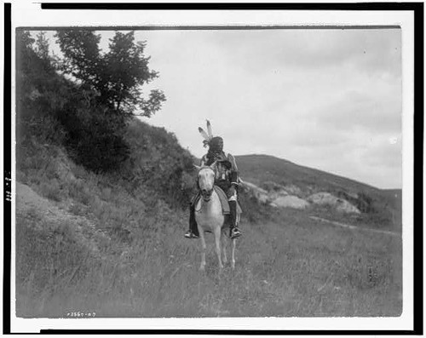

Slide 4
“Plymouth”

Slide 5
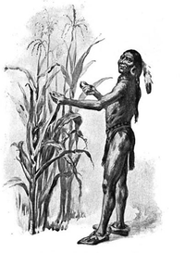
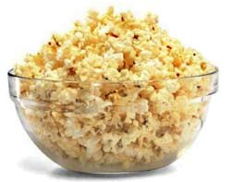

Slide 6
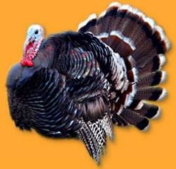
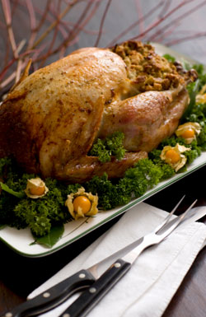
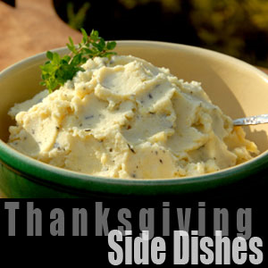
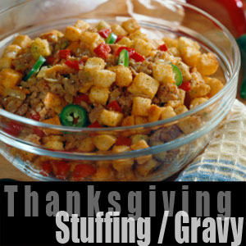
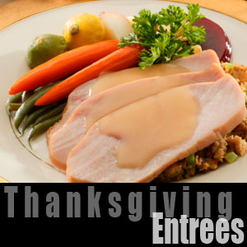
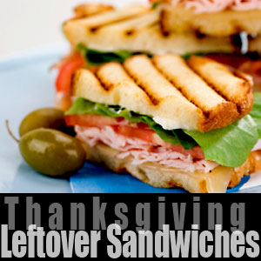
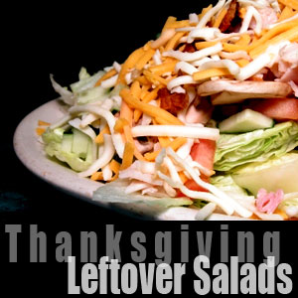
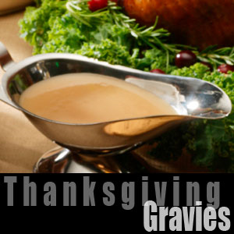
Thanksgiving
The first Thanksgiving took place in December 1621, when the Pilgrims held a three-day feast in Plymouth Rock, Massachusetts to celebrate their bountiful harvest.
Since then it is celebrated on the fourth Thursday of each November as the holiday.
Of all the Thanksgiving symbols the Turkey has become the most well known.

Slide 7
MENU
Roast turkey
Cranberry jelly
White mashed
Potatoes
Pumpkin pies
Hot dog
Ham
Creamed corn
Chicken
Lobster

Slide 8
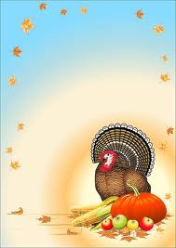
1. IAGKHTNSAIVN
2. EUTKYR
3. IPE LPAEP
4. MYAFLI
5. ESDFINR
6. GSIPMRLI
7. EPI KNUPMIP
8. ISNDANI

Slide 9
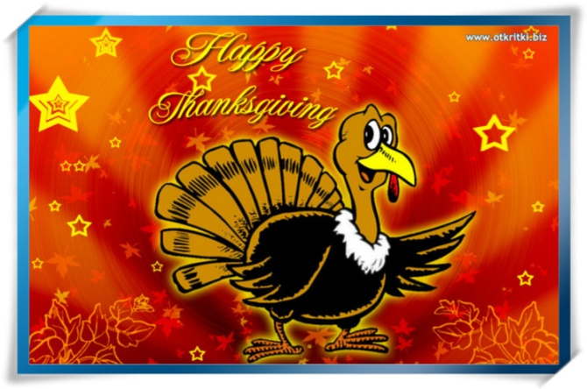
Thanksgiving is celebrated
A) on the 4th Thursday of November
B) on the 4th Tuesday of November
C) on November 26

Slide 10
Friendly Indians taught Pilgrims to plant
A) popcorn
B) pumpkins
C) bread

Slide 11
Shops, classrooms and homes are decorated with
A) flags
B) turkeys
C) stars

Slide 12
Thanksgiving is celebrated
A) monthly
B) weekly
C) annually

Slide 13
The Pilgrims ate at the 1st Thanksgiving
A) meat and seafood
B) vegetables and fruit
C) all of the above

Slide 14
The wild turkey is one of the fastest birds
A) true
B) false

Slide 15
The 1st Thanksgiving celebration took place in
A) 1620
B) 1621
C) 1622

Slide 16
There are Thanksgiving Days with
A) demonstrations
B) parades
C) meetings

