Slide 1
Food preparation

Slide 2
roast scramble bake

Slide 3
grill fry boil

Slide 4
scramble mash poach

Slide 5
steam boil pickle

Slide 6
roast fry pickle

Slide 7
fry poach boil

Slide 8
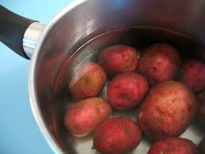
steam poach boil

Slide 9
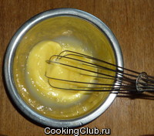
scramble fry poach

Slide 10
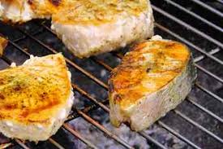
bake roast grill

Slide 11
steam boil scramble

