Slide 1
Do You Read Newspapers on Sundays?

Slide 2
Newspapers
National
Quality
Tabloids
Local
Daily
Sunday

Slide 3
National newspapers
Quality papers
Large size
Have many detailed articles about national and international events
Tabloids
Smaller in size
Have more pictures and shorter articles about less important events or about lives of well-known people

Slide 4
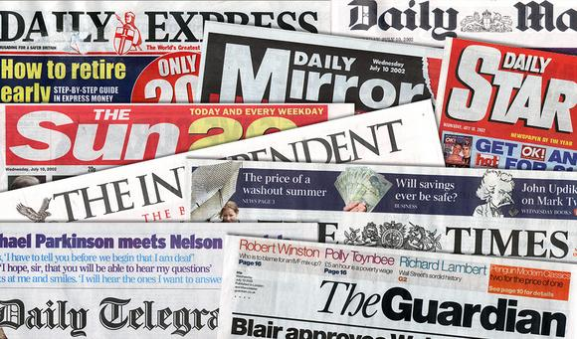
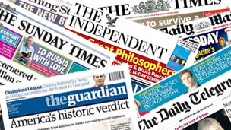
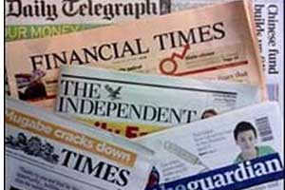
What are the names of British newspapers?

Slide 5
National serious newspapers
Published on everyday of the week except Sunday
Give information about events happening in London
Express political opinions

Slide 6
Sunday newspapers
All Sunday newspapers are
national
They are larger than daily ones and have 2 or 3 sections

Slide 7
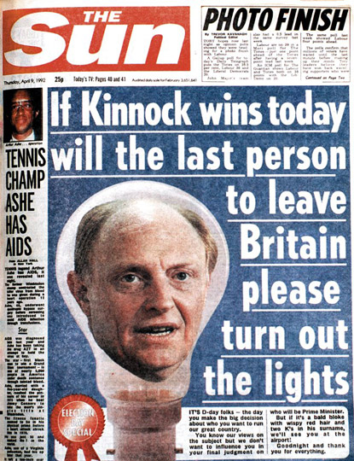
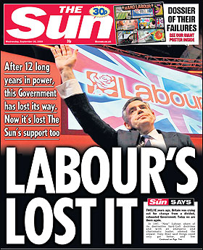
Tabloids
Though some people disapprove of tabloids, they are quite popular
The Sun is the biggest-selling newspaper in Britain

Slide 8
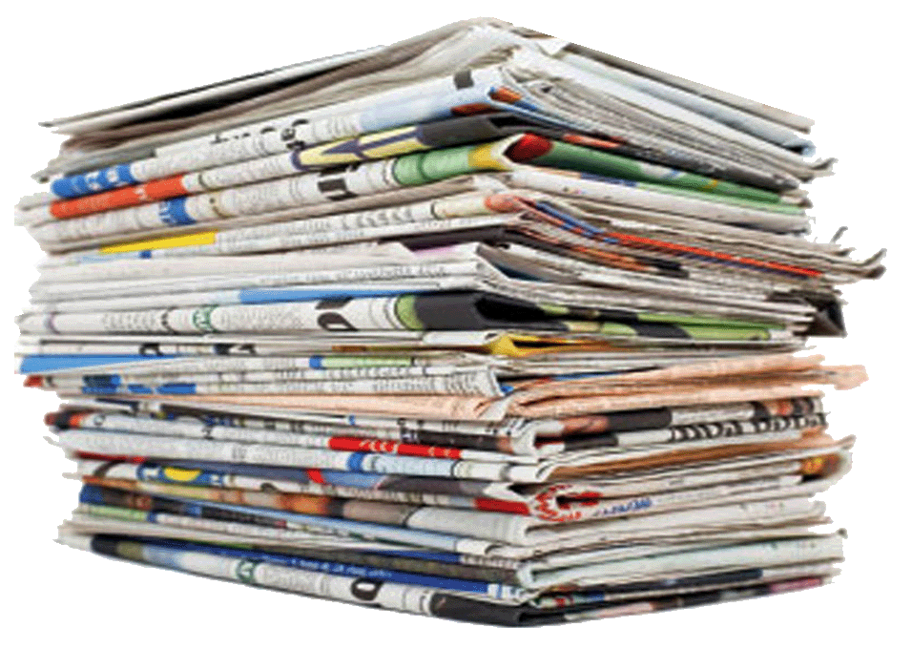
Local newspapers
Give information
about films, concerts and other things happening in the local area
Free local papers contain a lot of advertisements and some news

Slide 9
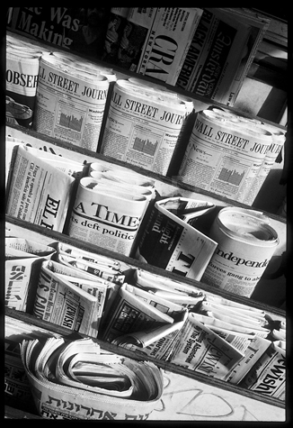
Remember and answer:
Why do some people disapprove of tabloids?
Why are there free newspapers? Do you have them in Russia?
What is the difference of daily and Sunday papers?

