Slide 1
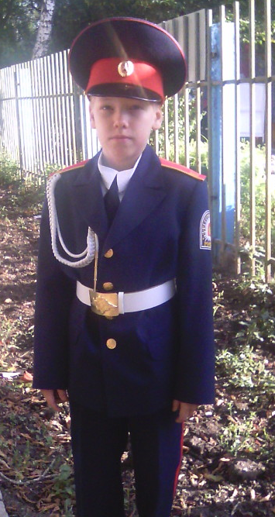
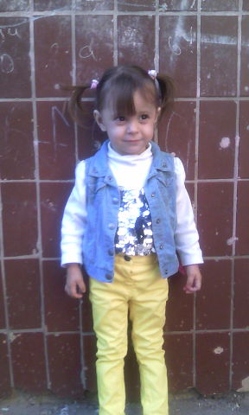
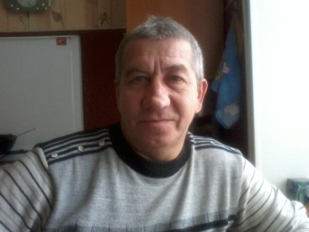
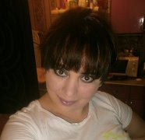
My family is cadet 3K "2" class Goryunov Yaroslav
Municipal budget educational institution secondary school № 170 named of Hero of the Soviet Union Z.A. Kosmodemyanskaya Samara city

Slide 2
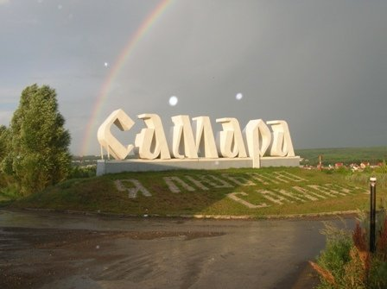
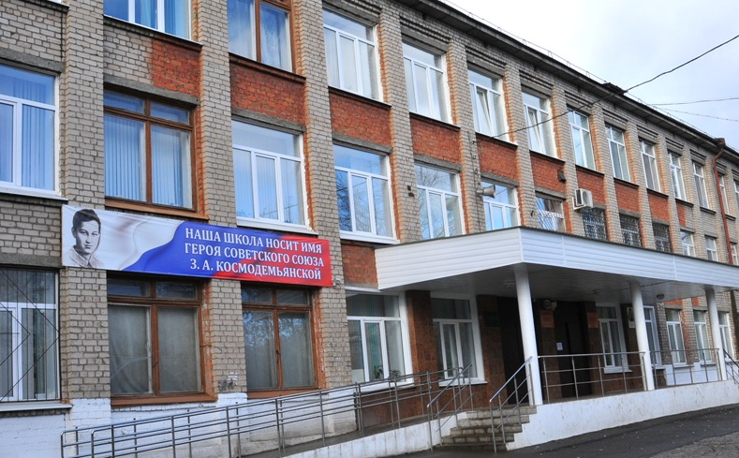
My name is Jaroslav. I have got a family. My family is not very large. They are my mother, my sister and our cat. We are an ordinary family, we live in Samara. I study at school № 170, in the cadet corps.

Slide 3
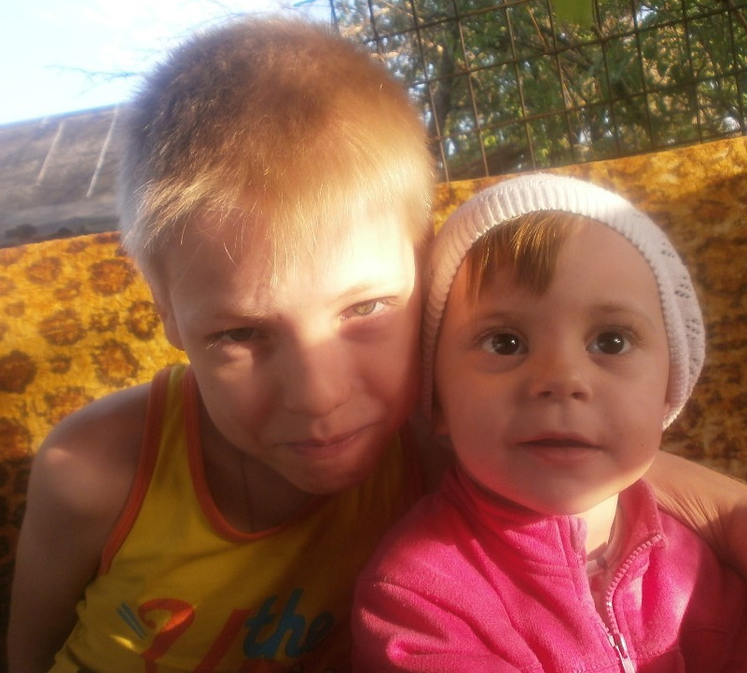
My mother’s name is Gulya. She is 35. My mom is a housewife. My sister's name is Malika. She is 2 years old.
I love my family very much.

Slide 4
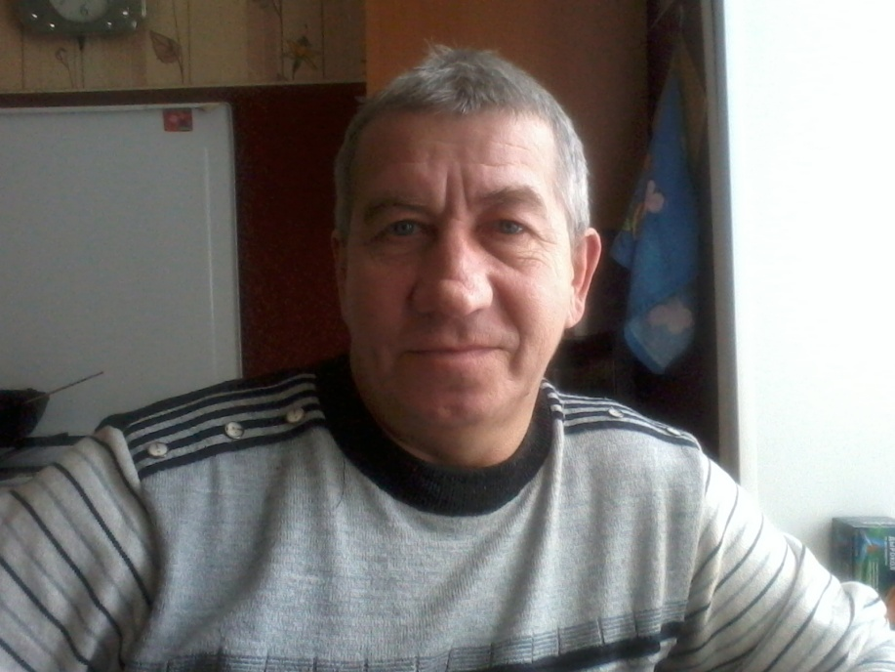
I have got grandparents, they like gardening. Our family is very friendly. We love to spend time together.

Slide 5
We often go to the village where my brother lives. His name is Artem. He is my best friend.

Slide 6
I love my family, we always help each other in different situations.

Slide 7
Thank you for
your attention.

