Slide 1
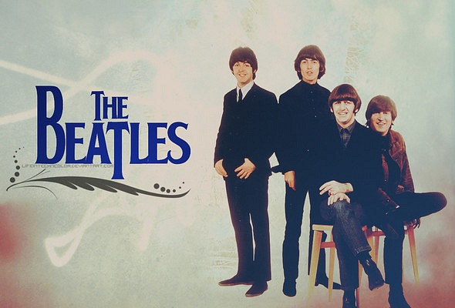

Slide 2
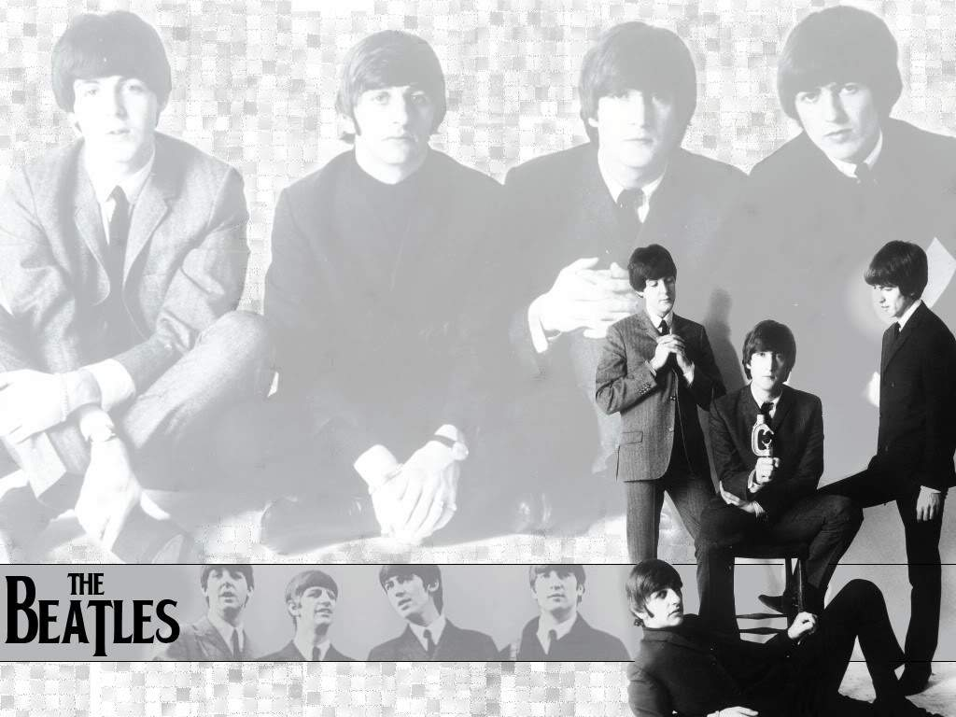
The Beatles
Who are they?

Slide 3
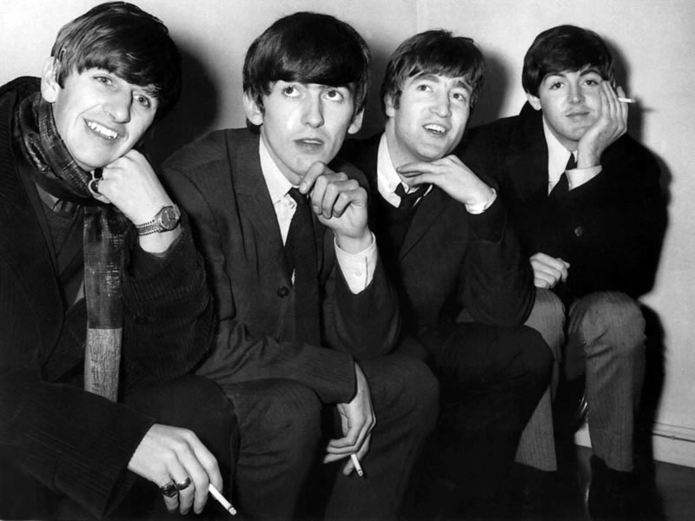
The Beatles were an English rock band formed in Liverpool in 1960 who became the most commercially successful and critically acclaimed act in the history of popular music. Their best-known lineup consisted of John Lennon, Paul McCartney, George Harrison, and Ringo Starr.

Slide 4
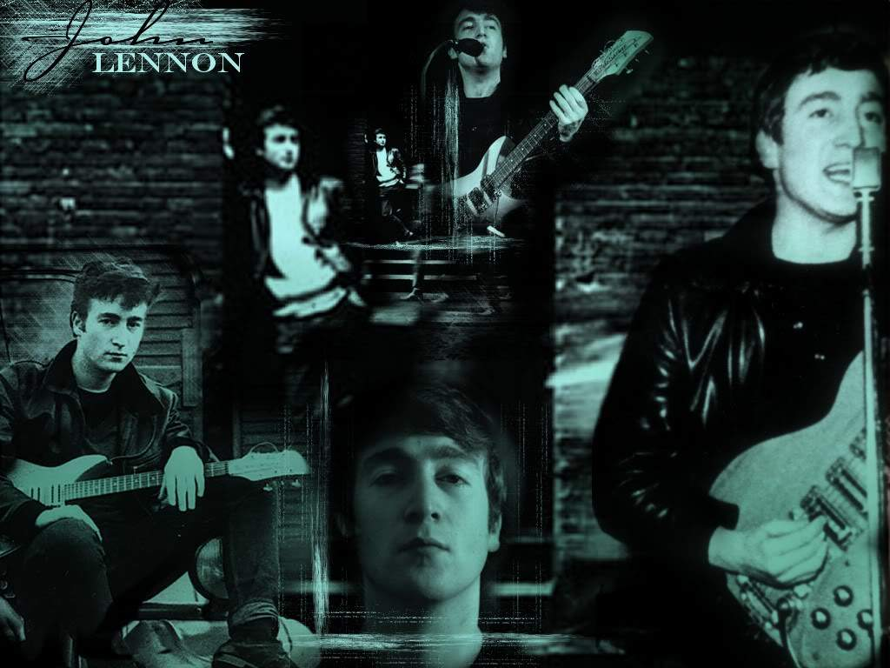
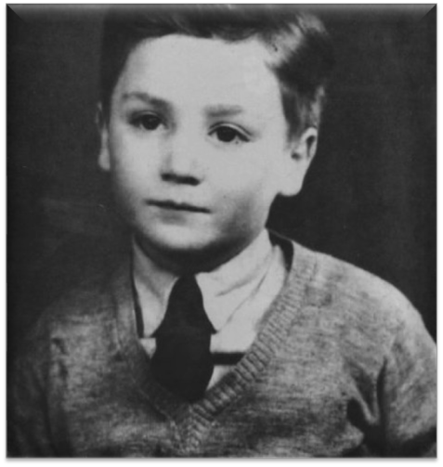

Slide 5
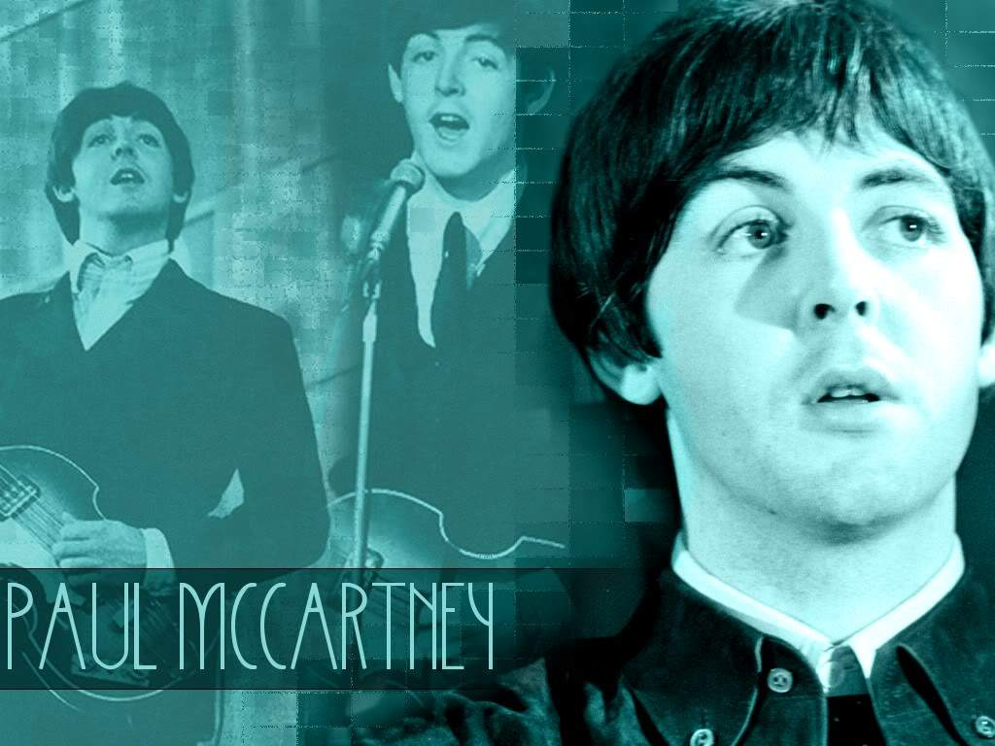
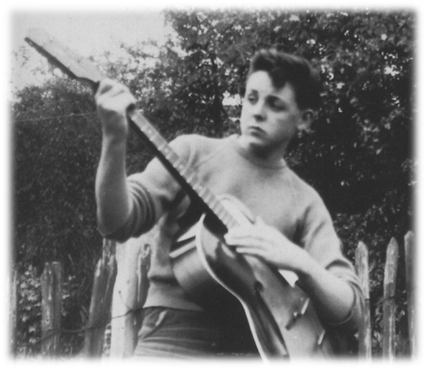

Slide 6
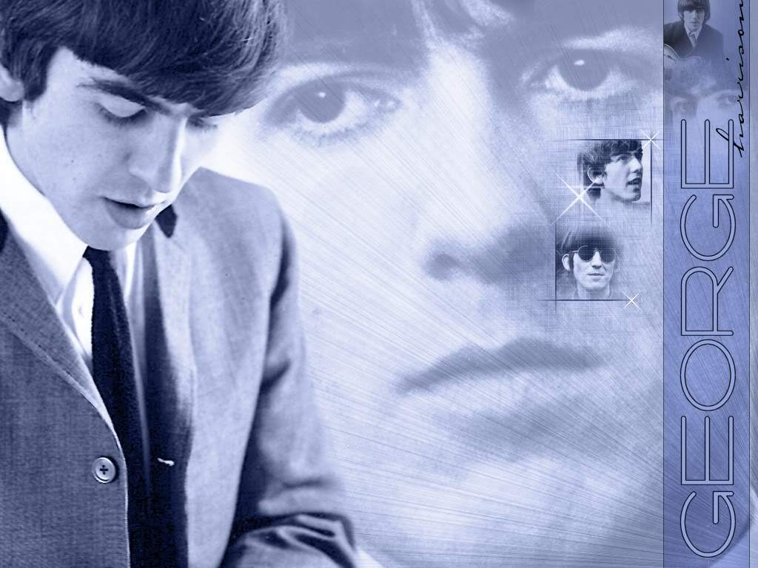
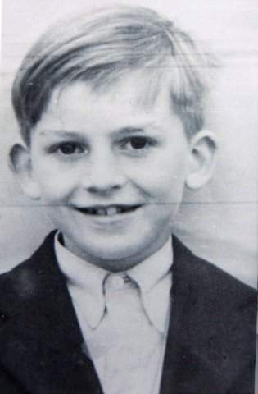

Slide 7
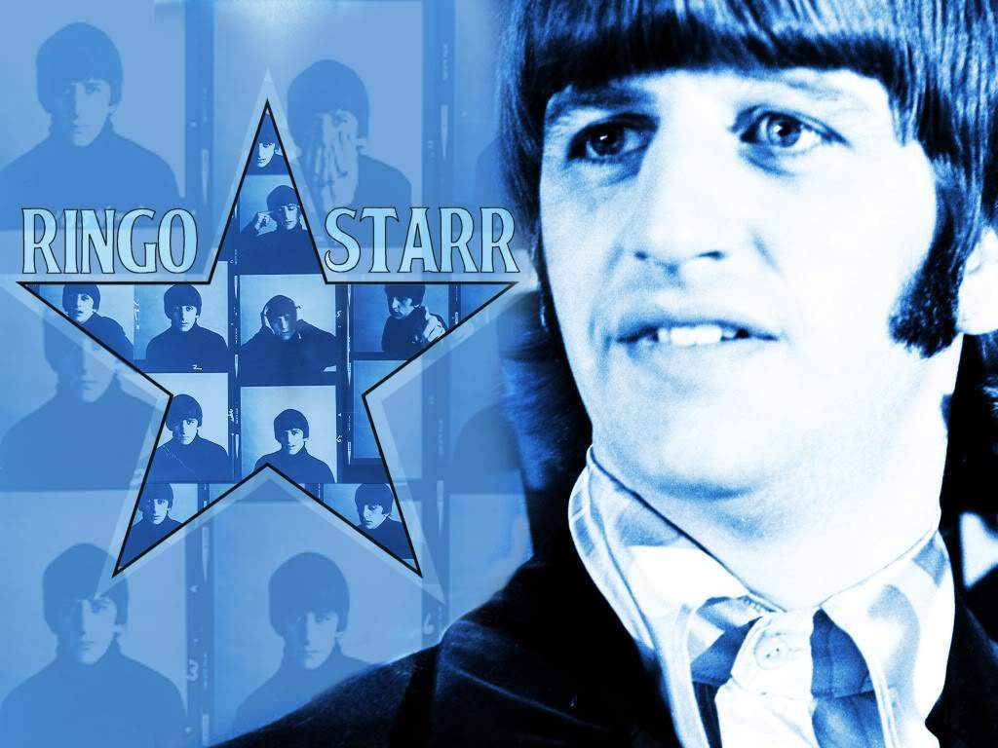
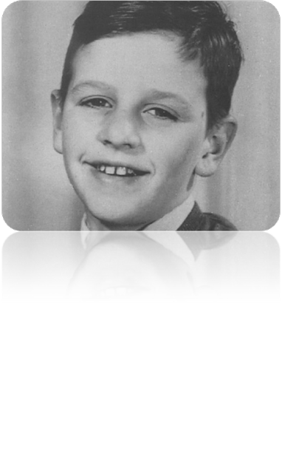

Slide 8
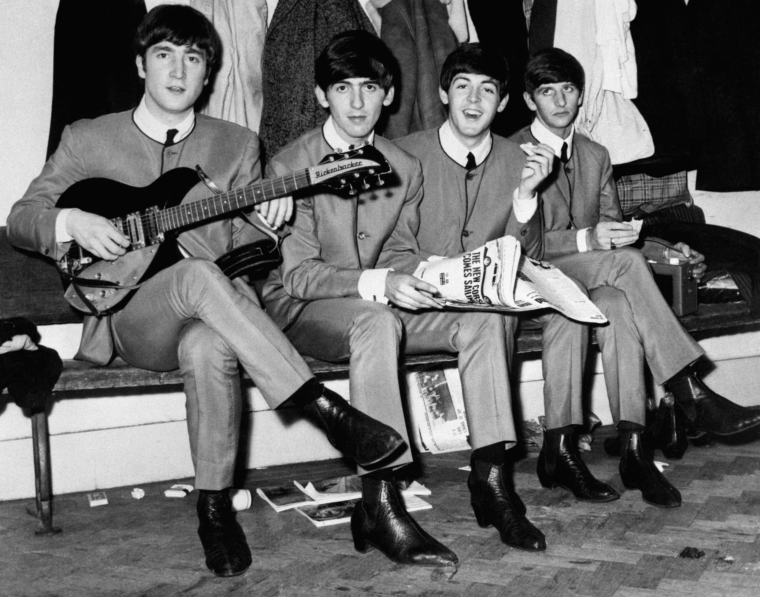
Rooted in skiffle and 1950s rock and roll, they later utilised several genres, ranging from pop ballads to psychedelic rock, often incorporating classical and other elements in innovative ways. In the early 1960s, their enormous popularity first emerged as "Beatlemania", but as their songwriting grew in sophistication, they came to be perceived by many fans and cultural observers as an embodiment of the ideals shared by the era's sociocultural revolutions.

Slide 9

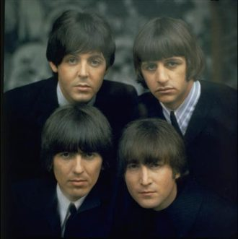
The Beatles built their reputation playing clubs in Liverpool and Hamburg over a three-year period from 1960. Manager Brian Epstein moulded them into a professional act and producer George Martin enhanced their musical potential. They gained popularity in the United Kingdom after their first single, "Love Me Do", became a modest hit in late 1962. They acquired the nickname the "Fab Four" as Beatlemania grew in Britain over the following year, and by early 1964 they had become international stars, leading the "British Invasion" into the United States pop market

Slide 10
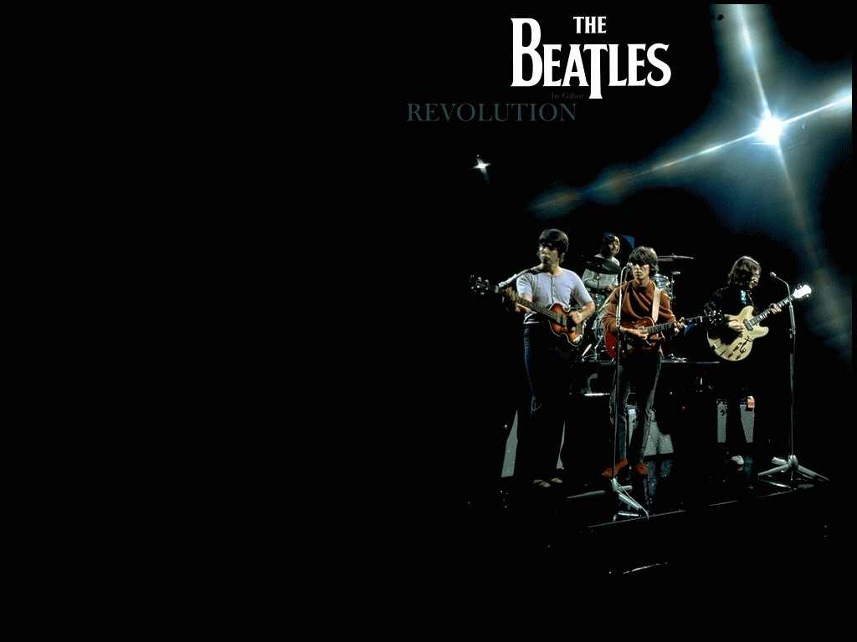
The Beatles' influence on popular culture was—and remains—immense. Former Rolling Stone associate editor Robert Greenfield compares the band to Picasso as "artists who broke through the constraints of their time period to come up with something that was unique and original.... In the form of popular music, no one will ever be more revolutionary, more creative and more distinctive". From the 1920s, the United States had dominated popular entertainment culture throughout much of the world, via Hollywood movies, jazz, the music of Broadway and Tin Pan Alley and, later, the rock and roll that first emerged in Memphis, Tennessee. The Beatles not only sparked the British Invasion of the US, they became a globally influential phenomenon as well.

Slide 11
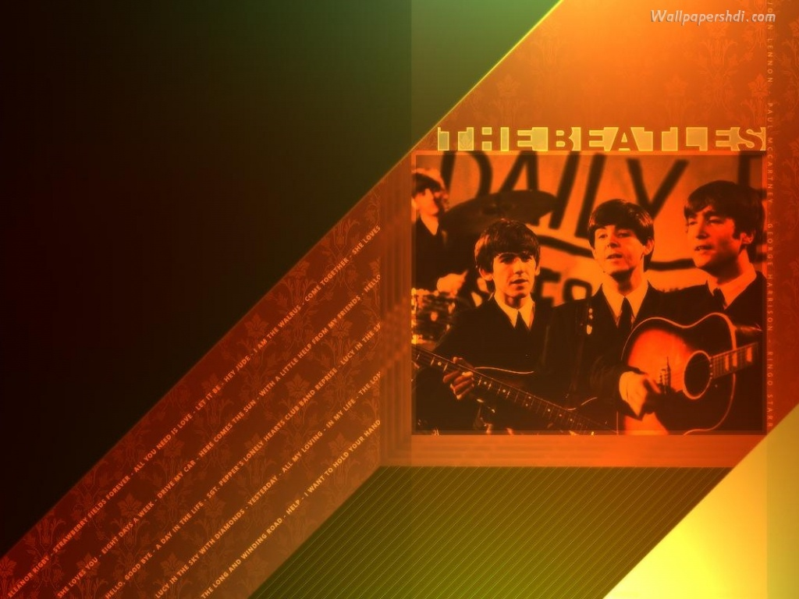
Their musical innovations and commercial success inspired musicians worldwide. Many artists have acknowledged their influence and enjoyed chart success with covers of their songs. On radio, their arrival marked the beginning of a new era; programme director Rick Sklar of New York's WABC went so far as to forbid his DJs from playing any "pre-Beatles" music. The Beatles helped to redefine the LP as something more than just a few hits padded out with "filler", and they were primary innovators of the modern music video. The Shea Stadium show with which they opened their 1965 North American tour attracted an estimated 55,600 people, then the largest audience in concert history; Spitz describes the event as a "major breakthrough...a giant step toward reshaping the concert business." Emulation of their clothing and especially their hairstyles, which became a mark of rebellion, had a global impact on fashion.

Slide 12
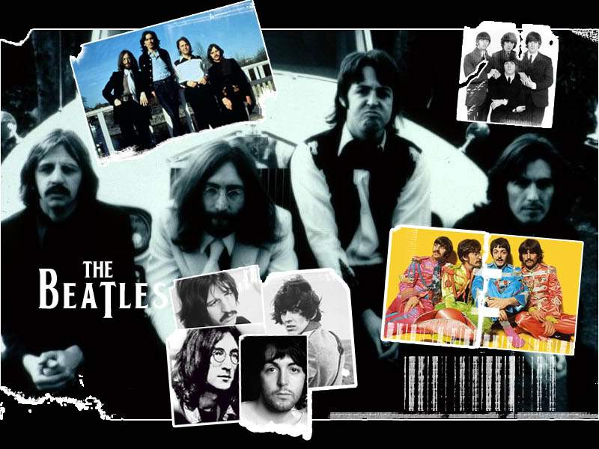

Slide 13
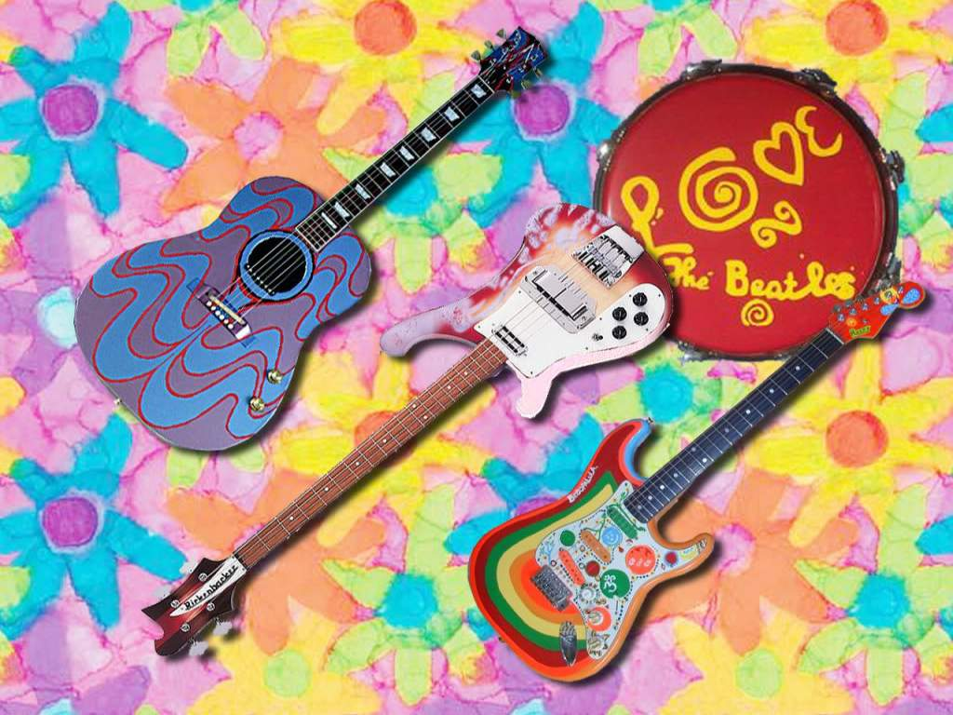

This band, their great music means a lot for me. And not only for me. Many people all over the world love Beatles. So I can say with sure that they are still existing because their music will never die!

