Slide 1
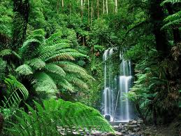
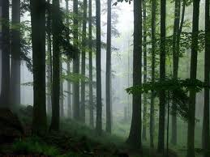
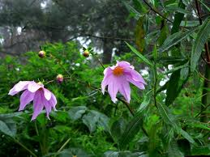
Life in the rain forest
Бобченко О.В. учитель английского языка МБОУ «СОШ №12» г. Астрахань; 4 класс

Slide 2
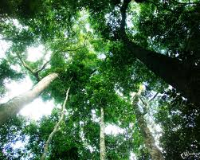
The weather in the tropics is very hot and wet. The trees in the rain forest grow very tall. There are lots of different kinds of trees. Some trees are seventy meters tall. The floor of the rain forest is quite dark. There are a lot of dead leaves there, but not many green plants. The leaves at the top of the trees are very thick. They make a canopy. Smaller plants, like orchids, live on the tree trunks in the canopy. Smaller plants and new trees grow by the side of the rivers. When a tree falls down, new plants can grow in the space. Once there were a lot of rain forests. Now there aren‘t many. They are disappearing quickly.
dead – сухие
floor – нижний ярус леса, земля
at the top – на верхушках
canopy – полог, верхний ярус леса
by the side of the rivers – по берегам рек

Slide 3
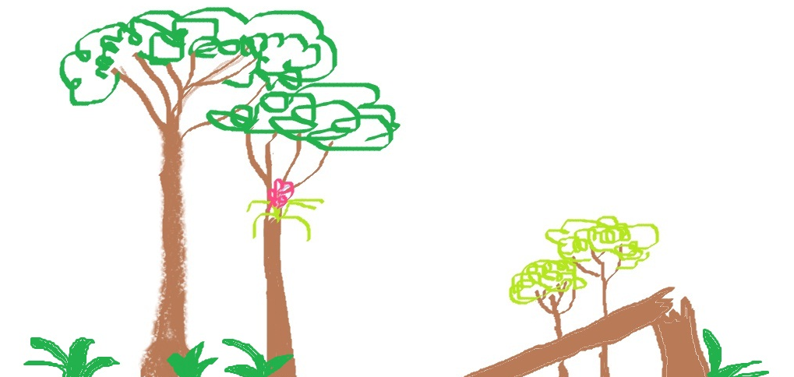
What do you know about rain forests?
canopy
orchids
fallen tree
floor

Slide 4
Answer the questions, please!
Are there any rain forests in Russia?
What‘s the weather like in the rain forest?
How tall are some trees in the rain forest?
Are the leaves at the top of the trees thick?
Do orchids grow on the floor of the rain forest?
ANSWERS
No, there are not.
The weather in the tropics is very hot and wet.
Some trees are seventy meters tall.
The leaves at the top of the trees are very thick.
Orchids grow on the tree trunks in the canopy.

Slide 5
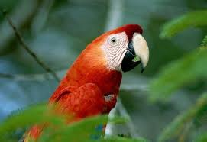
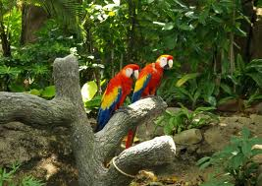
There are lots of beautiful birds in the rain forest.
They are in danger because people sometimes
catch them and sell them for pets.

Slide 6
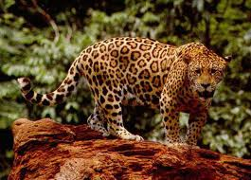
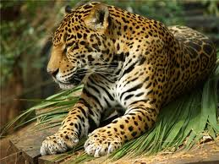
Leopards are very beautiful.
They are in danger because some people kill them for their fur.
fur – мех
kill - убивать

Slide 7
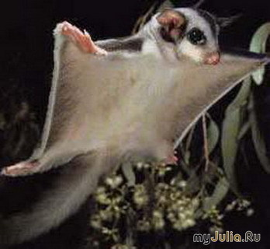
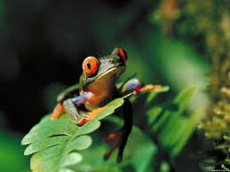
This flying squirrel lives in the canopy
of the rain forest. It «flies» from tree to tree.
This frog lives in trees.
It uses suckers on its feet
to hold on to the leaves.

Slide 8
Why? Because…
Read the questions and find the answers.
Why do some people kill leopards?
Why do hunters catch birds in the rain forest?
Why do some frogs have special feet?
Why do some squirrels «fly» ?
Because they need to hold on to the leaves.
Because they want their fur.
Because they need to move from tree to tree.
Because they want to sell them.

Slide 9
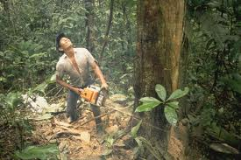
Write down your homework
Ex.4 p. 69. A project.
Why are forests disappearing quickly? Write about it.
What animals are in danger in Russia? Write about them. Draw pictures and collect photos for your project.
Goodbye!

