Slide 1
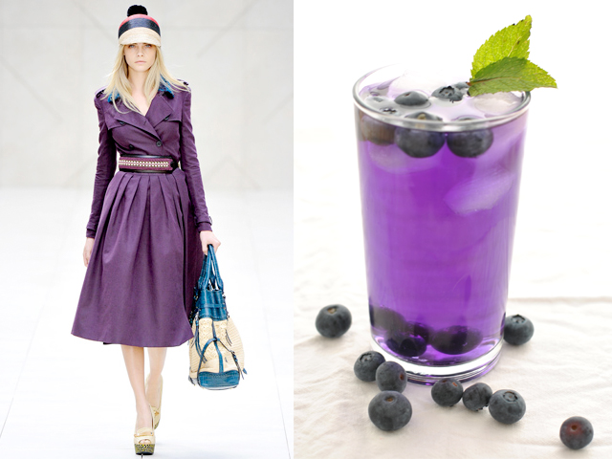
Clothing & Food

Slide 2
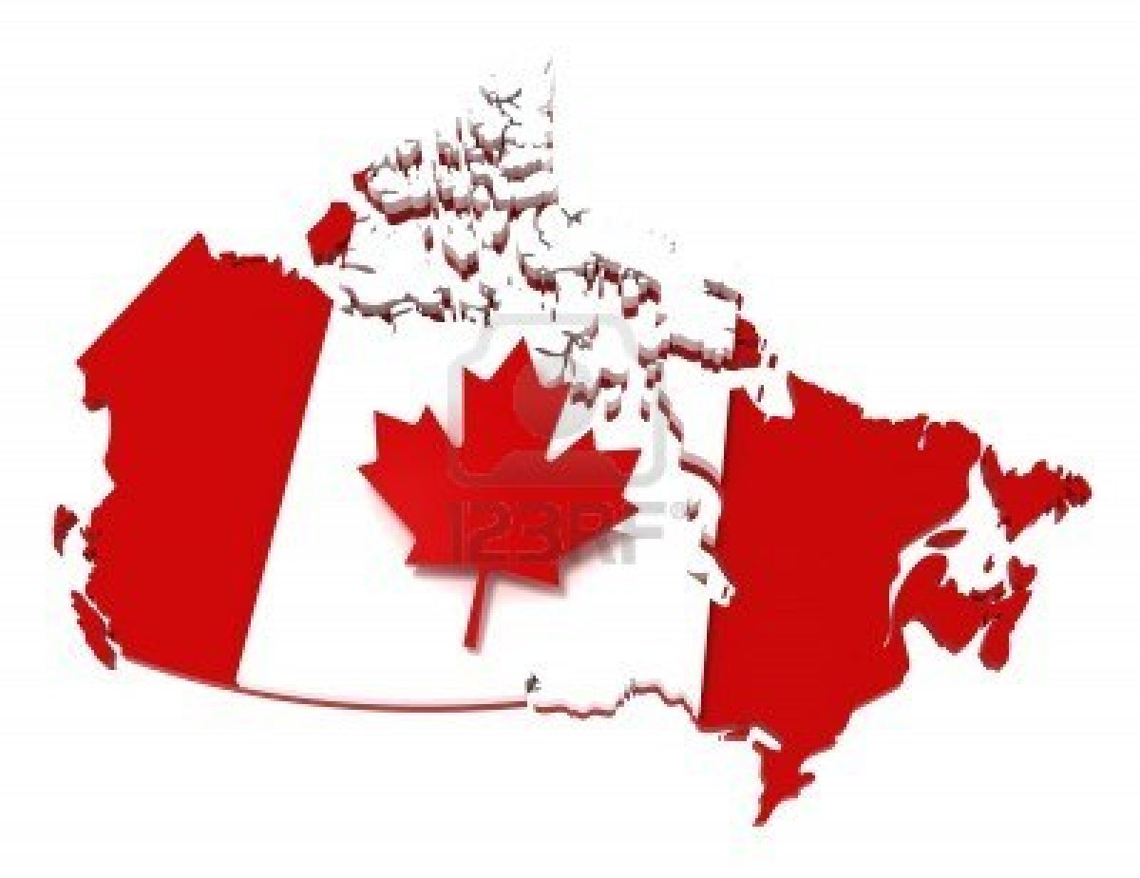
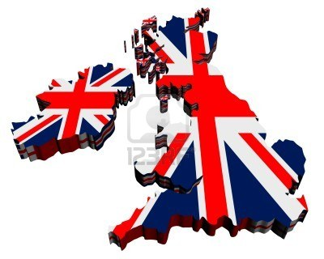
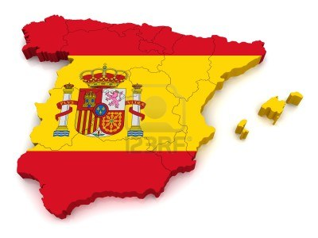
Canada t -25
Great Britain
t +7
Spain
t +30

Slide 3
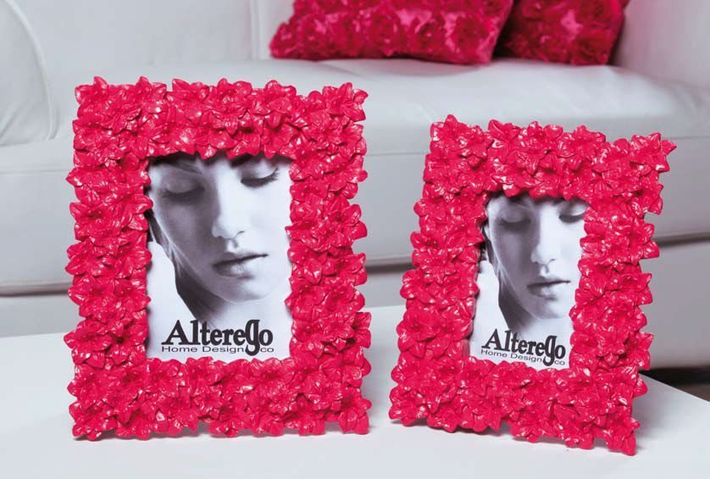
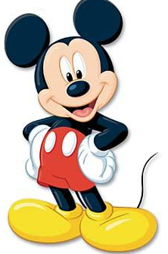
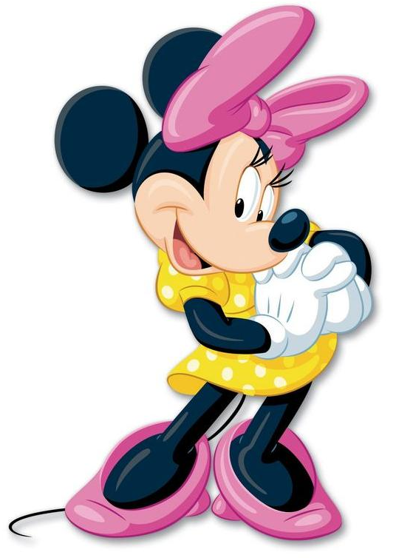

Slide 4
Hello, my friends!
My name is Minnie Mouse. I live in America, in a very happy country. I have a lot to do every day. So when I have a day off I like to go to the mountains and ski with my friends. I usually wear a pink sweater, blue jeans, brown boots and red ear-muffs. If it is very cold I wear a yellow scarf and yellow mittens. And how do you usually spend your weekends?
Best wishes,
Minnie Mouse
Hello, kids!
I’m an American boy. Do you know me? Do you know that I have a dog and his name is Pluto? Every morning I and Pluto run in the park. I usually wear green shorts, a blue T-shirt, yellow boots and a blue cap. But sometimes we have cold weather. Then I put a brown jacket and brown gloves on. And do you like sport as we do?
Best wishes,
Mickey Mouse

Slide 5
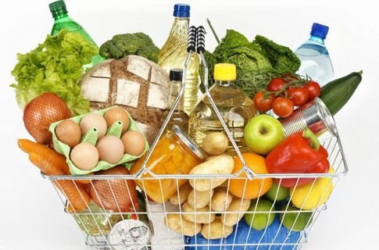

Slide 6
Can I help you?
Would you like some…
Here you are.
Anything else?
What would you like?
I’m hungry
Can I have…
I would like…
How much are they?

