Slide 1

SEASONS
Времена года

Slide 2
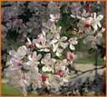

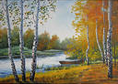

Spring is green.
Summer is bright.
Autumn is yellow.
Winter is white.

Slide 3




Slide 4
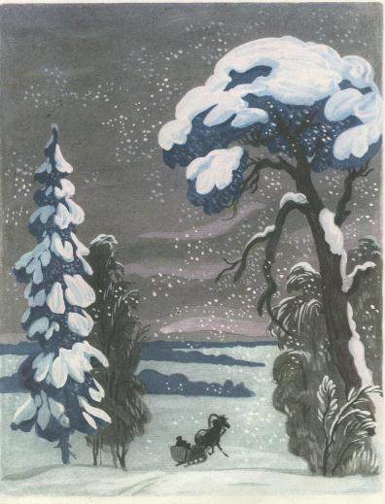
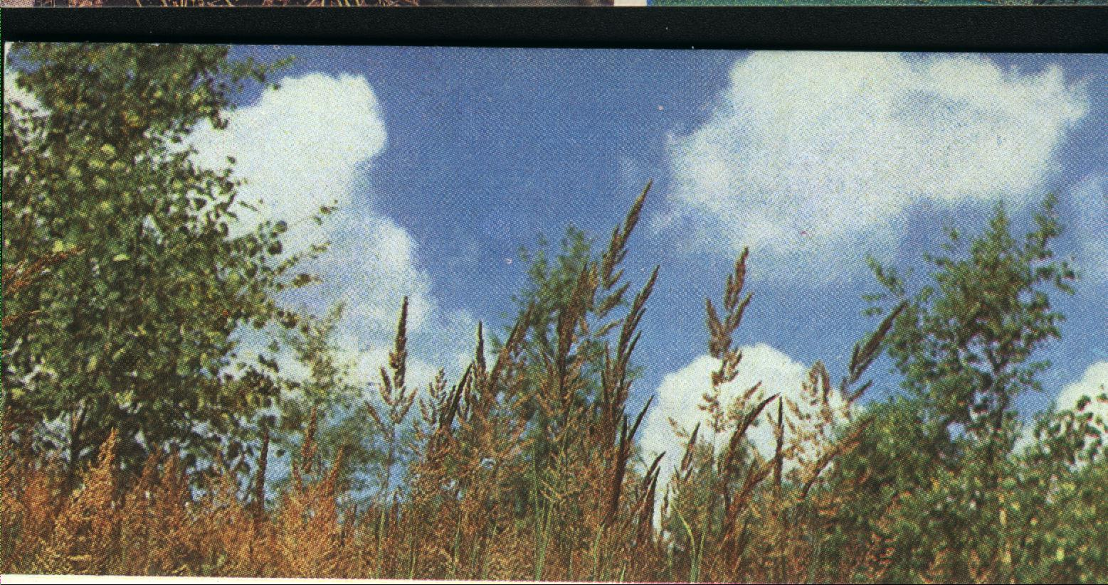
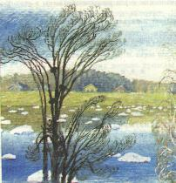
Summer
Winter
Autumn
Spring

Slide 5
What can we do in different seasons?
PLAY FOOTBALL
READ BOOKS
GO TO SCHOOL
RIDE A BIKE
SKATE
SKI
WATCH TV
PLAY CHESS
DRAW PICTURES
PLAY COMPUTER GAMES
IN WINTER
IN SPRING
IN SUMMER
IN AUTUMN

Slide 6
Do you like autumn?
?
Why do you like autumn?
?
?
Do you like to read books in autumn?
?
to

Slide 7
Let’s have a rest!

Slide 8
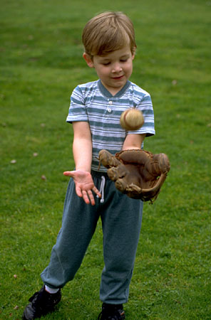
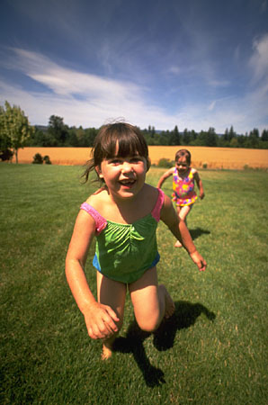


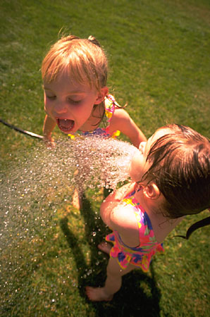
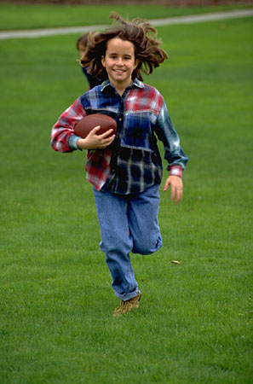
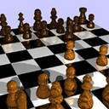
Bill
Mary
Pam
Jill
Jessica

Slide 9
The Town Mouse and
the Country Mouse.
The Town Mouse lives in a town.
She is … . The … Mouse
likes to play … games.
She can … well.
(white, Town, dance, computer)

Slide 10
AUTUMN
SUMMER
WINTER
SPRING

Slide 11
Homework
W.B. Ex. 4, p. 41
W.B. Ex. 1, p. 42

Slide 12


Thank you very much!

