Slide 1
Big
Little
Young
Old
Nice
Wise
Kind
Angry
Hungry
Dangerous
Friendly
Funny

Slide 2
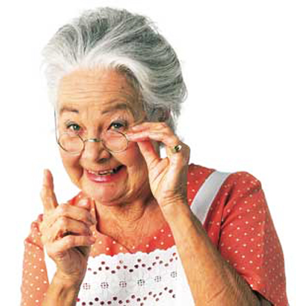
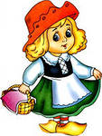
OLD, YOUNG, NICE, WISE
Granny is … and …
(old, wise)
Little Red Riding Hoot is … and …
(young,nice)

Slide 3
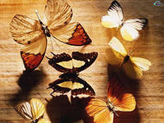
ANGRY, KIND, HUNGRY,FUNNY
The wolf is … and …
(angry, hungry)
The butterflies are … and …
(kind, funny)

Slide 4
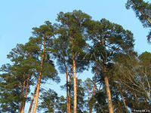
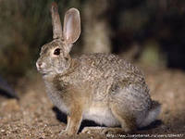
BIG LITTLE
The trees in the wood are …
(big)
The hare is …
(little)

Slide 5
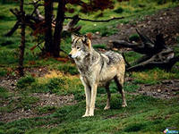
DANGEROUS
Don’t go alone to the wood!
It is dangerous!

Slide 6
May there always be sunshine!

