Slide 1
My Birthday
Made by teacher
Vera Alexandrovna Kartashova
2014/15
Based on Spotlight 2
&
Pupil’s Book 1 ‘You and me’
Cathy Lawday

Slide 2
Home task ‘The town Mouse & Country Mouse’ p. 40 41 . (Students’ book)
Country Mouse:
Hello, Town Mouse.
Welcome to my house!
It’s very small, but it’s very nice.
A lovely house
For two small mice!
Town Mouse:
Oh no! It’s very bare!
Where’s the table?
Where’s the chair?
No bedroom, no bathroom,
No kitchen – oh, dear!
I want to go home,
I don’t like it here!

Slide 3
How well do you know the numbers?
Listen and say
Listen and sing
one
two
three
four
five
six
seven
eight
nine
ten
One, two, three.
You and me.
Four, five, six.
Watch my tricks.
Seven, eight, nine and ten.
Now sing the song again.

Slide 4
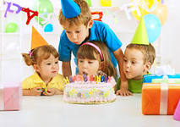
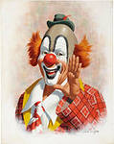
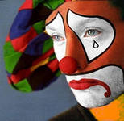
Listen and repeat. St. Book. P. 44 Ex.1
Candles
Party
Happy
Sad
1
2
3
4
5
6
7
8
9
10
1
2
3
4

Slide 5
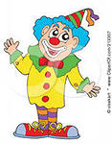
Ex 2., 44 Chit-chat
How old are you? I’m 5
9
6
4
8
3
5
7
1
2
10

Slide 6
Listen and read Ex. 3., P 45
How old is Lulu?

Slide 7
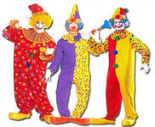
In the garden
Happy birthday to you.
Happy birthday to you.
Happy birthday, dear Lulu.
Happy birthday to you!

Slide 8
Song “Are you happy today?”
A you sad today? No, we aren’t.
Are you sad today? No. we aren’t.
Are you happy today? Yes, we are.
We’ll clap our hands to show it.
Are you happy today? Yes, we are.
And we want everyone to know it!

Slide 9
Well done!!!

Slide 10
Giving presents to each other. Speaking skills
Here’s a present.
Thank you! Oh, it’s a …

Slide 11
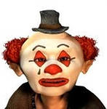
Ex 1., P. 44. Finish the sentences and read them.
He’s… He’…
They are… It’s a…
sad
happy
candles
party

Slide 12
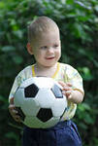
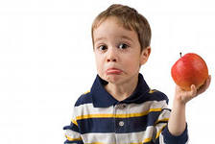
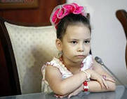
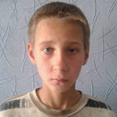
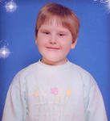
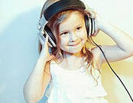
EX. 2., P.46. What do the children say? Speaking skills.
55
333
3
6
4444
1
10
8
7

Slide 13
Ex. 2., P. 46 Read and choose the right answer!
5
I’m ten/one!
10
I’m five/three!
I’m six/nine!
6
I’m two/eight!
8
7
I’m nine/four!
9
I’m six/seven!

Slide 14
EX. 3., P. 47. Listen and sing the song
I’m happy today,
It’s my birthday!
I’m happy, I’m happy today!
How old are you?
I’m five today!
I’m happy, I’m happy today!

Slide 15
Home task
SB - Ex. 3 (read and retell) p.45.
WB - Ex. 1-2

Slide 16
Thank you!!!
Well done!!!

