Slide 1
Module 8 ‘Day by Day’ Unit 16 ‘On Sundays’
Made by teacher:
Kartashova Vera Alexandrovna
Based on ‘Spotlight - 3’
School 1315
2014

Slide 2
Home task
Sing the song about the days & dance.
Monday, Monday,
It’s a fun day.
Tuesday, Wednesdays, too!
Thursday, Friday,
They are fine days,
But Saturdays and Sundays
Are for me and you!

Slide 4
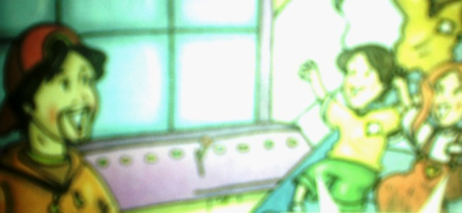
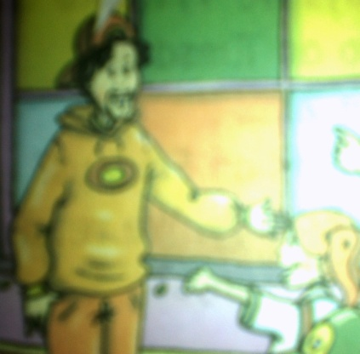
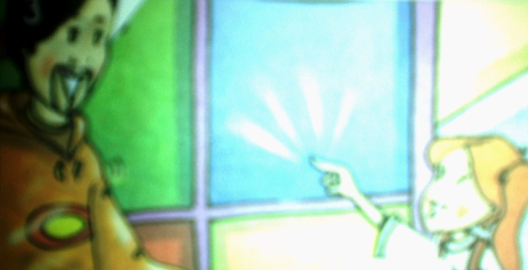
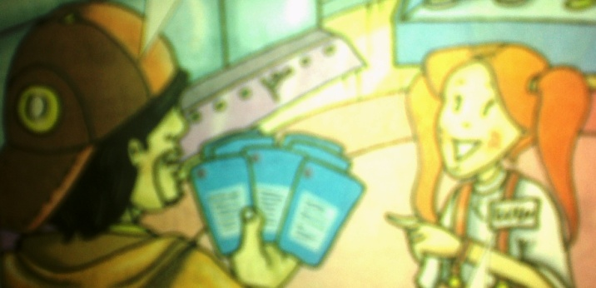
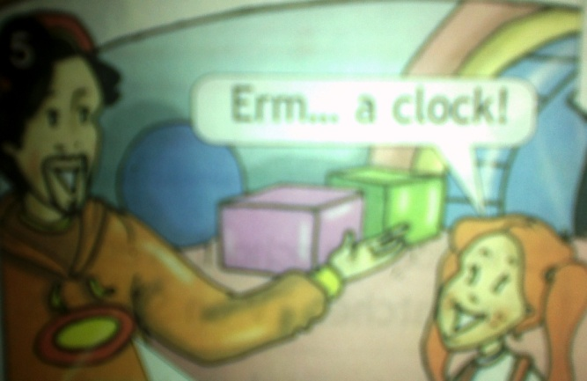
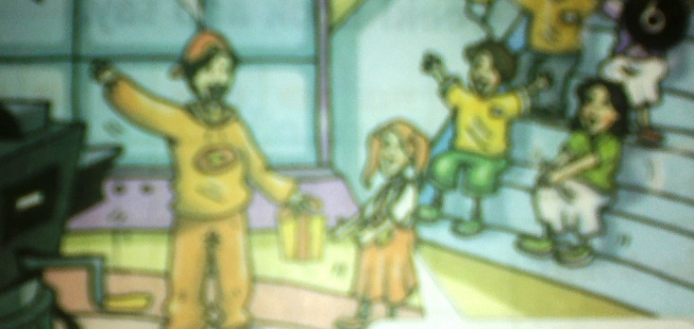
Listen and act
What day is it today, children?
What do we do on Mondays?
It’s Monday!
We play games!
Lulu, what color do you want?
Now, pick a card.
Blue!
That one!
Erm… a clock!
Well don, Lulu! This is for you!
What’s got two hands, a face and numbers?
Oh, thank you!

Slide 5
Module 8 ‘Day by Day’ Unit 16 ‘On Sundays’

Slide 6
We say
In the morning
At night
At seven o’clock

Slide 7
16a ‘On Sundays’
Ex. 1 . Listen and repeat.
In the morning
Have a Shower
Have breakfast
In the afternoon
Have lunch
Listen to music
In the evening
Visit my friend
Have supper
At night
Watch a video
Go to bed

Slide 8
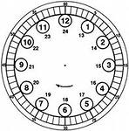

Slide 9
Ex. 5 Read and say yes or no
Hooray! It’s Sunday!
Lulu’s favorite day is Sunday. She gets up at 10 o’clock. In the Morning she has breakfast, then she visits her grandma and grandpa. Then, at one o’clock she comes home and has lunch with her family.
In the afternoon, Lulu watches a video or listens to music.
Then, at six o’clock, it’s time for supper.
In the evening, she plays games with Chuckles. They have a lot of fun!
Then, at nine o’clock, Lulu goes to bed. Sundays are happy days for Lulu!

Slide 10
Say yes or no
yes
Lulu loves Sundays.
Lulu gets up early on Sundays.
In the morning she goes to school.
She goes to bed at ten o’clock.
no
no
no

Slide 11
Answer the questions
What is Lulu’s favourite day?
When does she get up on Sundays?
What does she do in the morning?
Who does she visit in the morning?
When does she have lunch?
What does Lulu do in the afternoon?
When does she have supper?
What does Lulu do in the evening?
What time does she go to bed?
Lulu’s favourite day is Sunday.
She gets up at ten o’clock.
She has breakfast in the morning.
She visits her grandma and grandpa.
She has lunch at one o’clock.
She watches a video or listens to music.
She has supper at six o’clock.
She plays games with Chuckles.
She goes to bed at nine o’clock.

Slide 12
Listen and read the days. There is one extra day.
Monday Tuesday Wednesday
Thursday
Friday Saturday Sunday
games
quiz
making toys
songs
painting
watching cartoons

Slide 13
Sing along !
Holiday Rock
One o’clock, two o’clock,
Three o’clock’s fine,
Any time; it’s holiday time!
Morning, evening, noon or night!
It’s holiday – the time is right!
Monday, Tuesday, Wednesday’s fine,
Any time; it’s holiday time!

Slide 14
Well done!!!
Thank you for your work!

Slide 15
All the minutes gradually fly away – And you shouldn’t wait for them again! And, of course, we’re sorry ‘bout the past, but yet All the best is certainly ahead!
Spreading like tablecloth, Distant way goes on And it can reach right heaven’s horizon. Everyone, everyone Should believe in the best The blue coach is rolling, rolling on…
Blue coach\Mira+Maximova+-+The+Blue+Coach+(Goluboy+vagon)_(mp3top100.net).mp3

Slide 16
Maybe we offended someone just in vain? The calendar will turn over that page. We are rushing forward to adventures, Friends! Hey, come on, speed up, engineer!
Spreading like tablecloth, Distant way goes on And it can reach right heaven’s horizon. Everyone, everyone should believe in the best The blue coach is rolling, rolling on…

Slide 17
The blue coach is running and swinging on. The rapid train is speeding up it’s pace. And how come this day is coming to the end? Why can’t we prolong all happy days?
Spreading like tablecloth, Distant way goes on And it can reach right heaven’s horizon. Everyone, everyone should believe in the best The blue coach is rolling, rolling on…

Slide 18
Thank you!!!

