Slide 1
My last Christmas
Saint-Peterburg
school: 349
Teacher: Borisova M.A.

Slide 2
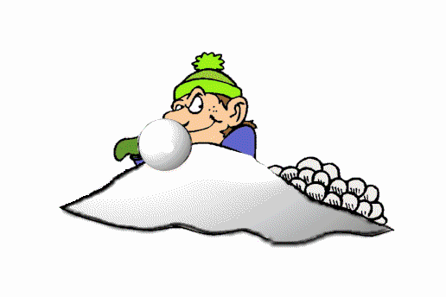
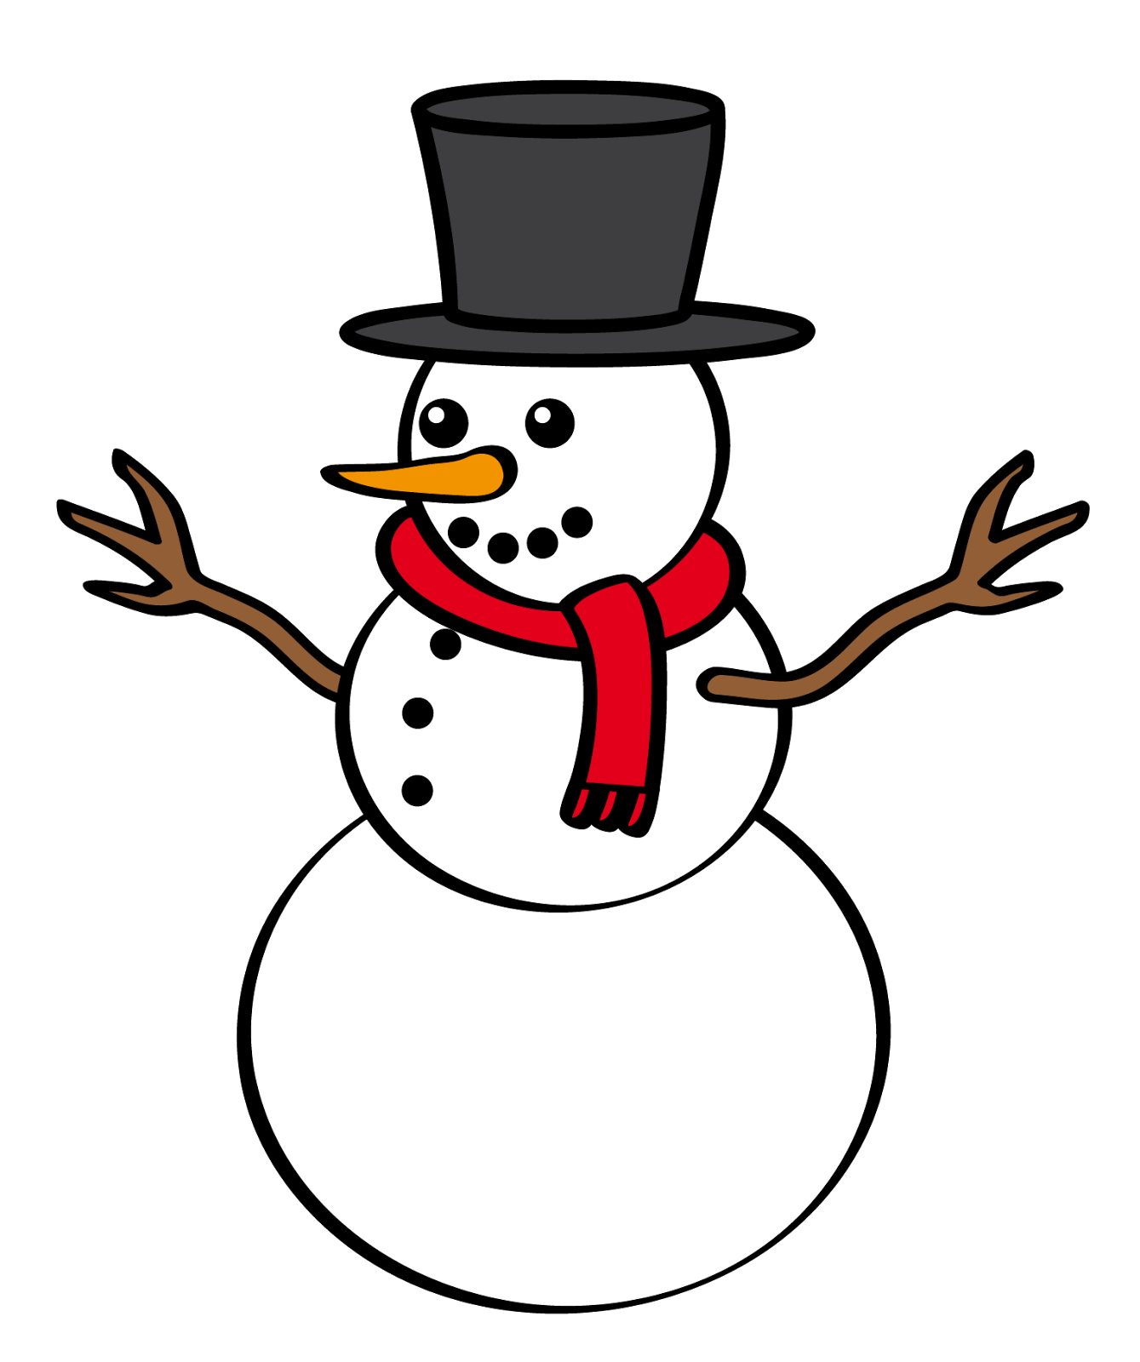
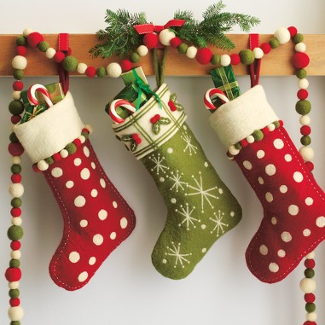
Let`s remember and learn
snowballs
snowman
christmas sock
garland

Slide 3
Answer the questions
What did you do last Christmas?
Did you play snowballs?
Did you ride your sledge?
Did you spend last Christmas in the town or in the country?

Slide 4
Put the words in brackets in the correct form
Last Christmas I (spend) in my country house. It (to be) very snowy winter. I (to be) there with my friends and relatives. We (play) snowballs, (eat) turkey and (make) the snowmen. In Christmas night we (sing) Christmas songs all together. It (to be) very beautiful there: candels, snow, garlands and socks on the wall. And there (to be) sweets in the socks! I want this Christmas (to be) as funny as last!

Slide 5
Test yourself
Last Christmas I spent in my country house. It was very snowy winter. I was there with my friends and relatives. We played snowballs, ate turkey and made the snowmen. In Christmas night we sang Christmas songs all together. It was very beautiful there: candels, snow, garlands and socks on the wall. And there were sweets in the socks! I want this Christmas to be as funny as last!

Slide 6
Answer the special questions
Where did she spend last Christmas?
What was the weather like then?
With whom she was there?
What did they do?
Where was the Christmas socks?

Slide 7
Make the special questions
Last winter Bob spent Christmas night in his friend`s house.
Use: where, when, what, with whom, who, did, why

Slide 8
Thanks for lesson!
See you next time!

